Slide 1


Slide 2
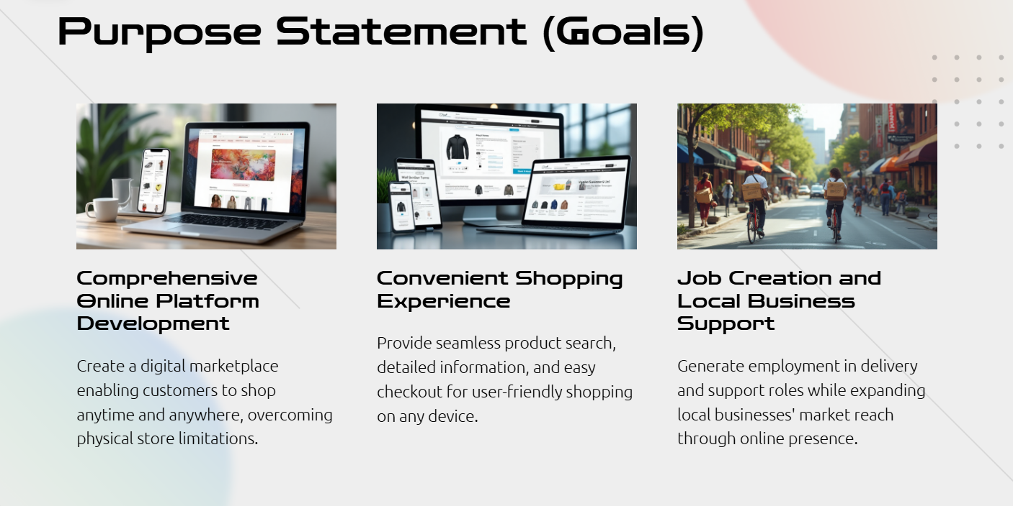

Slide 3
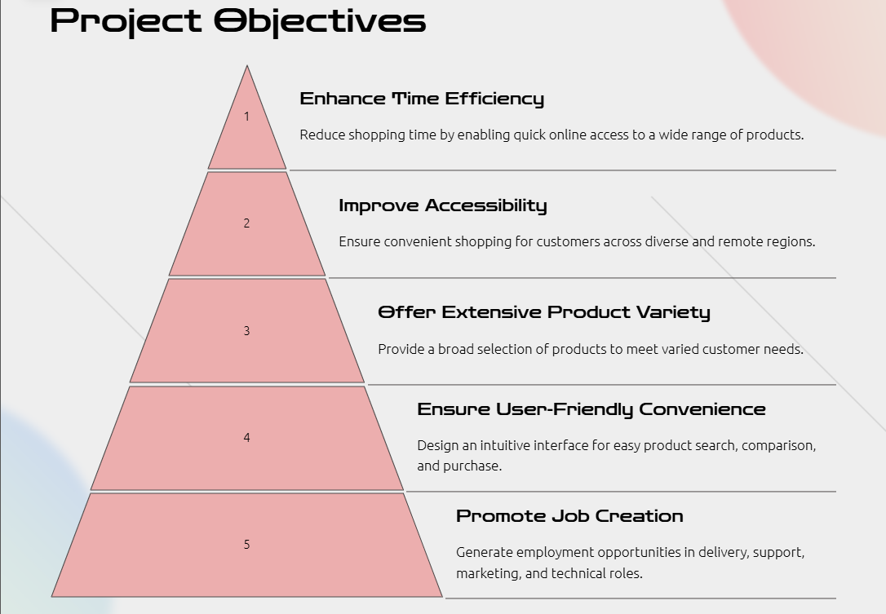

Slide 4
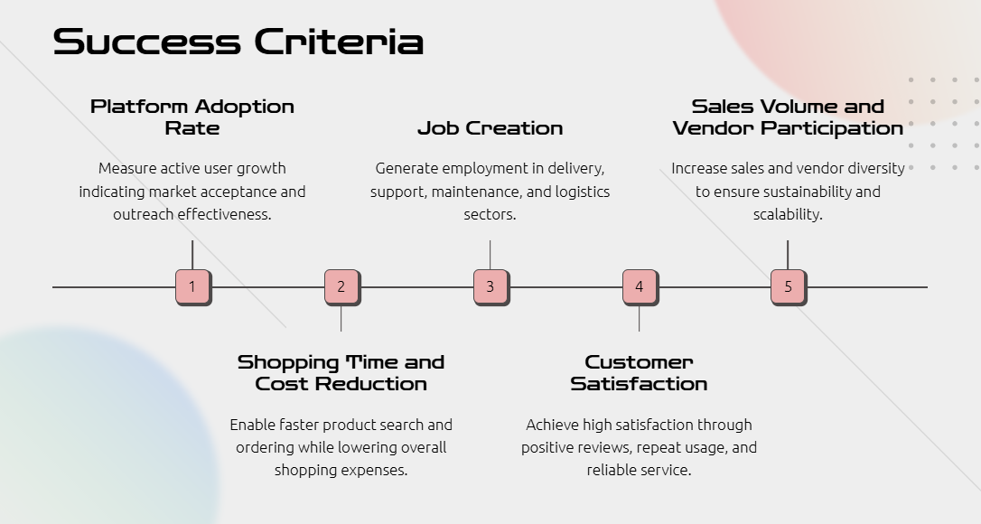

Slide 5
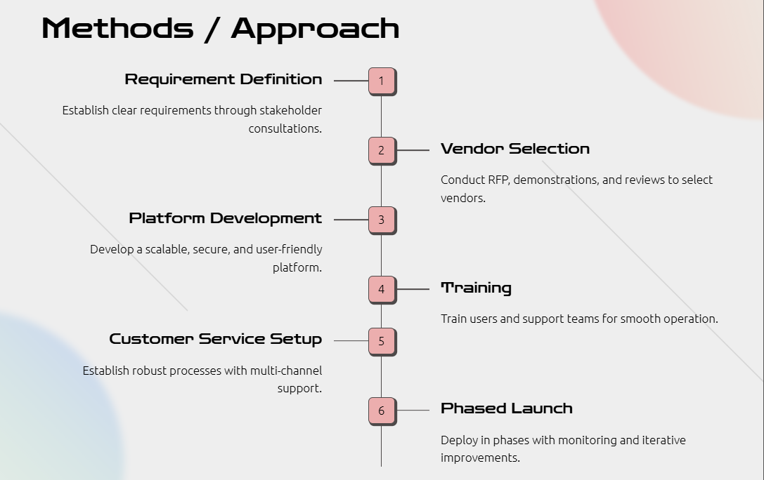

Slide 6
Category | Estimated cost
Development team (Dev, QA, UI, BA) | 700000
Infrastructure (cloud, DB, SSL, backup) | 100000
Softwere licences (PDF Generetor) Streeming API | 25000
Training and change managemnet | 25000
contingency reserve | 200000
Total estimated budget | 1100000

Slide 7
Role | Count | Responicibilities
Business analyst | 1 | Requirement gathering, documentation, UAT, STM
Front-end developer | 2 | UI development, integretion with backend, responsive design
Back-end developer | 2 | Logic implimentation, API development, Database interaction.
UI/UX Desingner | 1 | Wireframe mockups,UI logouts, user flows
QA tester | 2 | Intergretion, system testing, bug logging, UAT support.
DevOps Engineer | 1 | Deployement, testing setup, performance tuning
Project Manager | 1 | Timeline, scope, and budget monitoring, client cordination.
Trainer support staff | 1 | Conduct user tracing, respond to support, queries post lounch

Slide 8
SISTUATIONS AND BACKGROUND
online shopping currently provide the good products and things
in online like flipkart and amozon
and its provid 24/7 service to the customers it’s a very inefficient and limits
and limits scability, and its time saving method to shopping
it’s a manual testing application using devlopers and designers
and all kind of resourcess workes for this applications
this application back ground situation Empact on application success

Slide 9
OPPORTUNITIES
* Peoples gets jobs and its time saving metod, convinate shopping provise
* customers getting discounts and reasonble price for products.
* costomers make wider product selection with good product information
* provide 24/7 service to customers and get fast deliveries
* generate the employment for IT non-IT people
* peoples get marketing jobs and live shopping support

Slide 10
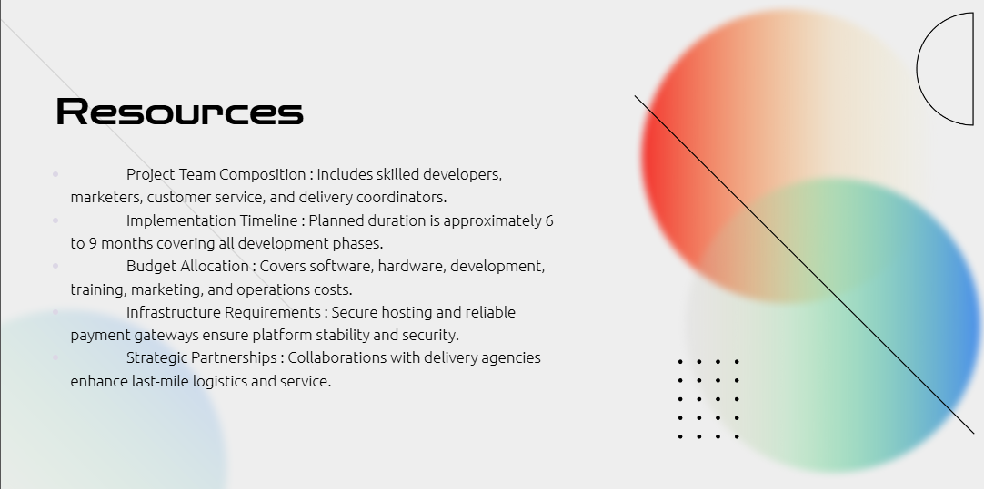

Slide 11
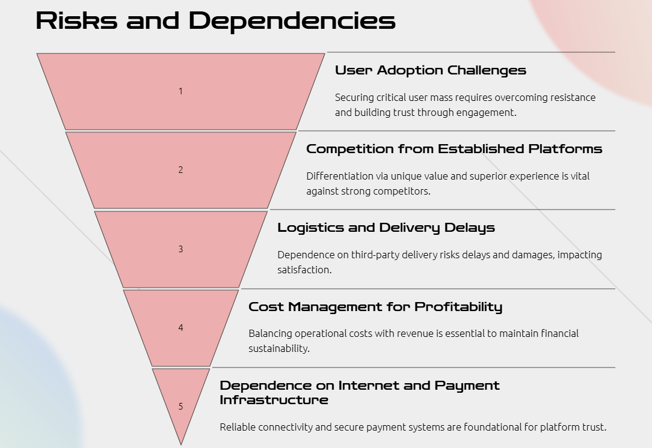

Slide 12
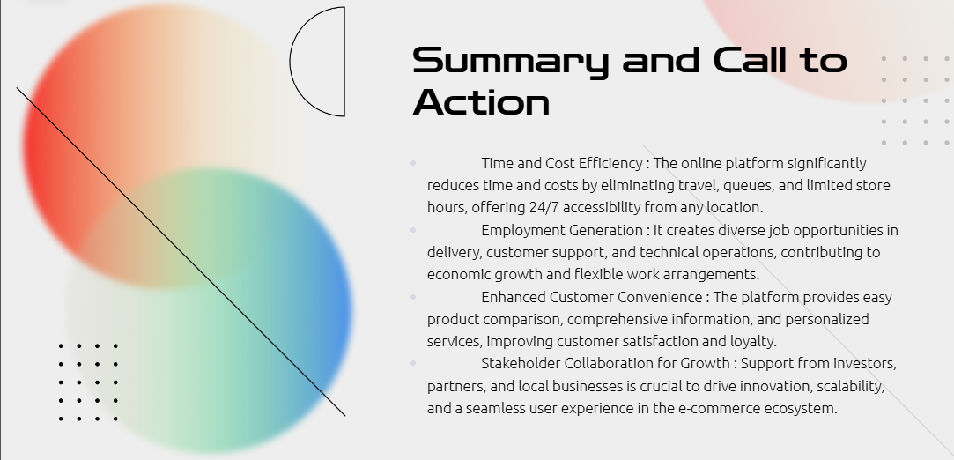

Slide 13

sutharisrikanth124@gmail.com

