Slide 1
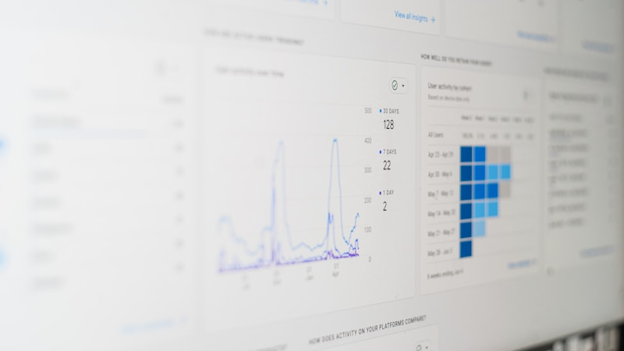
Finance Flow Optimization
Integrating and Streamlining All Financial Operations

Slide 2

Situation / Problem / Opportunity
Current Scenario:
Customers currently perform tasks manually using different tools.
Fragmented operations across general ledger, tax, audit, forecasting, legal compliance, data management, and return filing.
Opportunity:
Develop a unified software solution to consolidate functions.
Improve efficiency and reduce errors with integrated processes.

Slide 3
Project Overview & Vision
Project Vision:
Create an integrated system that enhances financial management.
Scope Includes:
General Ledger Management
Tax Management
Audit
Forecasting & Budgeting
Legal Compliance Management
Data Management
Return Filing Management
Business Impact:
Streamlined workflows and improved decision-making.

Slide 4

Functional Modules
Module Breakdown
General Ledger Management
Tax Management
Audit
Forecasting & Budgeting
Legal Compliance Management
Data Management
Return Filing Management

Slide 5
Project Objectives
Solution Selection
Prototype & Testing
Enhanced Efficiency
User Adoption
Scalability

Slide 6
Success Criteria
Operational Excellence:
Improve records’ availability and accessibility of information, forms, and collateral.
Reduce system downtime, waiting periods, and improve overall system response times.
User & Business KPIs:
Increase user productivity and satisfaction.
Demonstrate quick turnaround times and measurable improvements in financial reports.

Slide 7
Methods & Approach
Step 1: Initiation
Establish a selection committee.
Define clear and detailed requirements.
Step 2: Vendor Selection Process
Issue RFP.
Host vendor demonstrations and conduct comparative reviews.
Step 3: Implementation
Select the optimal solution.
Conduct thorough prototyping and testing.
Train end users and technical staff.

Slide 8

Resource Allocation
People
Time
Implementation timeline
Budget:
Hardware, software, training, and services
Other Resources
Third-party software evaluations, site visits, and Dataquest reports

Slide 9

Risk Factors & Dependencies:
User Familiarity: Existing solution has been in place for several years and is intuitive to current users.
Cost Justification Challenges: Difficulty in quantifying improvements in ease of use, quality, speed, and support.
Integration Concerns: Potential obstacles merging legacy systems with new software.
Vendor Dependence: Reliance on timely and quality deliverables from chosen vendors.

Slide 10
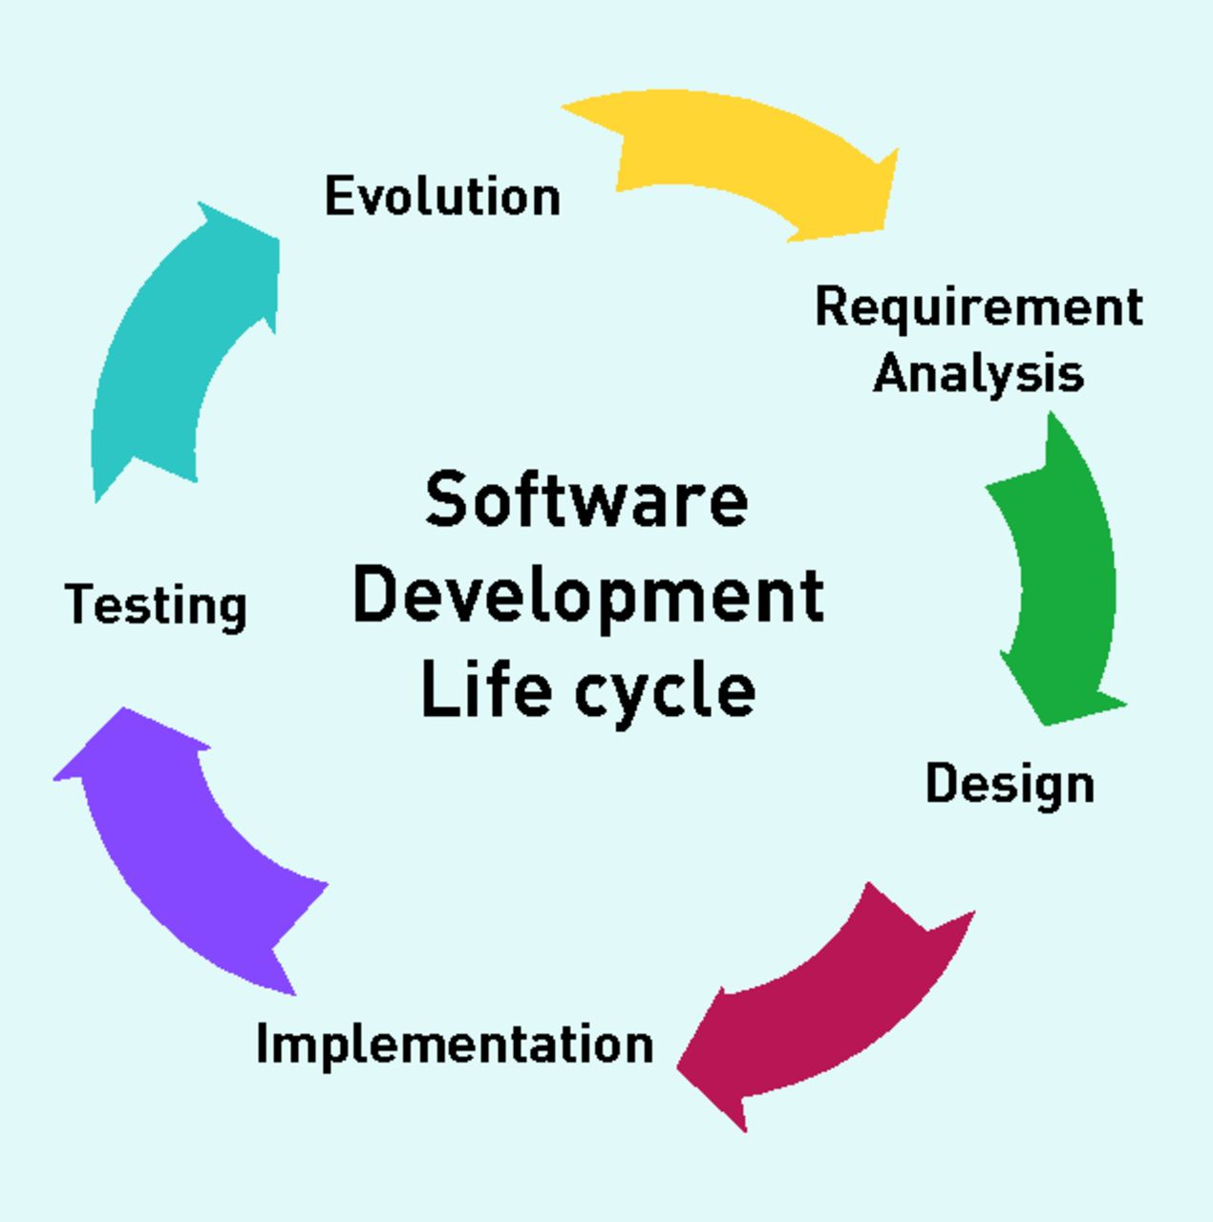
Timeline & Milestones
  Waterfall Project Phases:
Requirement Gathering & Analysis
Design & Prototype
Testing & Validation
Pilot Roll-out & User Training
Full Go Live & Post-Implementation Review
Development

Slide 11
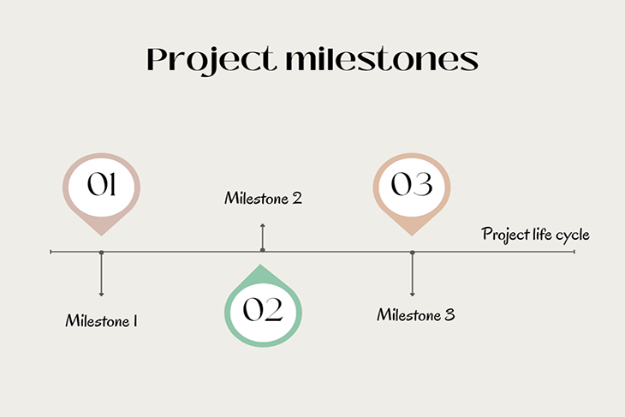
  Key Milestones:
Milestone 1: Finalize Requirements – Month 1
Milestone 2: Prototype Review – Month 2/3
Milestone 3: Testing & Training Completion – Month 4/5
Milestone 4: Full Implementation – Month 6

Slide 12
Risk Mitigation & Contingency Planning
Mitigation Actions:
Comprehensive training sessions to ease user transition.
Establish clear KPIs to validate system performance improvements.
Regular stakeholder meetings for updates and feedback.
Contingency Plans:
Backup systems and support protocols.
Predefined escalation procedures for vendor performance issues.
Continuous post-implementation monitoring and adjustments.

Slide 13
Next Steps & Conclusion
Immediate Action Items
Conclusion
Q&A
Thank You

