Slide 1
Student Management System (SMS)
Prepared By: Ch. Pavan Kumar
Date: 23-10-2025

Slide 2
Executive Summary
Overview: The Student Management System (SMS) aims to digitize and centralize student operations such as attendance, facilities, and communication through an Agile–Scrum framework.
Approach: The project is divided into 8 sprints, each lasting 2–3 weeks, ensuring iterative delivery and continuous feedback from administrators, teachers, and students.
Deliverables: Each sprint produces a working software increment, leading to a functional MVP by the end of Sprint 4.
Outcome: The system will automate manual workflows, improve transparency, and reduce administrative effort by up to 80% through real-time updates and analytics dashboards.

Slide 3
Situationship
Institutes face difficulty managing student records, attendance, and facility requests efficiently.
Multiple disconnected systems create confusion, errors, and delays.
Communication between departments and with students is slow.
Students struggle to access updates, approvals, and announcements quickly.
Real-time tracking and transparency are lacking.
Developing a Student Management System (SMS) using Agile methodology unifies processes, automates routine work, and improves efficiency.

Slide 4
Problem
Institutions encounter several operational challenges:
Decentralized data: Student information is scattered across multiple databases or maintained manually.
Facility management issues: Hostel and transport requests are handled via paperwork, leading to delays.
Inefficient attendance tracking: Manual registers cause inaccuracies.
Limited student transparency: Students cannot easily check pending requests or attendance status.
High admin workload: Staff must manage repetitive data entry and report generation tasks manually.
These problems collectively slow down institutional performance and affect the overall student experience.

Slide 5
Opportunity
Developing a centralized Student Management System (SMS) provides a strong opportunity to modernize academic and facility operations through automation and real-time data access.
Institutions can:
Save time and cost by automating repetitive administrative work.
Improve coordination between students, teachers, and administrative staff.
Provide transparency students can easily track attendance, requests, and approvals.
Ensure data accuracy through a single, unified platform.
Make faster decisions using real-time reports and analytics.
Enhance student satisfaction with quicker responses and updates.
Scale easily by adding new modules (like ID cards, library, or transport) in future sprints.

Slide 6
Purpose Statement (Goals)
The purpose of the Student Management System (SMS) project is to streamline academic and administrative operations by providing a centralized platform to manage student data, attendance, grades, fees, communication, and analytics — using the Agile methodology for flexible and continuous improvement.
It aims to reduce manual workload, improve accuracy, enhance student tracking, and promote better communication among all stakeholders.

Slide 7
Project Objectives
To develop a centralized database for storing and managing student profiles, attendance, and academic performance.
To automate fee management, examination, and timetable scheduling.
To create an integrated communication channel among students, parents, and teachers.
To implement AI-based performance prediction for identifying at-risk students.
To generate real-time analytics dashboards for administrators and faculty.
To ensure data security, scalability, and user-friendly access through role-based logins.

Slide 8
Success Criteria
Increase operational efficiency by 70% through automation of attendance, grading, and report generation — measured by time saved in manual processes compared to baseline data.
Reduce manual paperwork and data redundancy by 80% via centralized digital data entry and retrieval.
Improve transparency by 95% — enabling students and parents to access real-time academic and fee updates through the portal.
Enhance communication response rate by 70% — measured by message delivery and acknowledgment tracking between faculty, parents, and students.
Provide accurate analytics with 98% data reliability for decision-making and early identification of at-risk students using AI-based performance predictions.
Support scalability for up to 10,000 student profiles and multiple institutions without system lag or performance degradation.

Slide 9
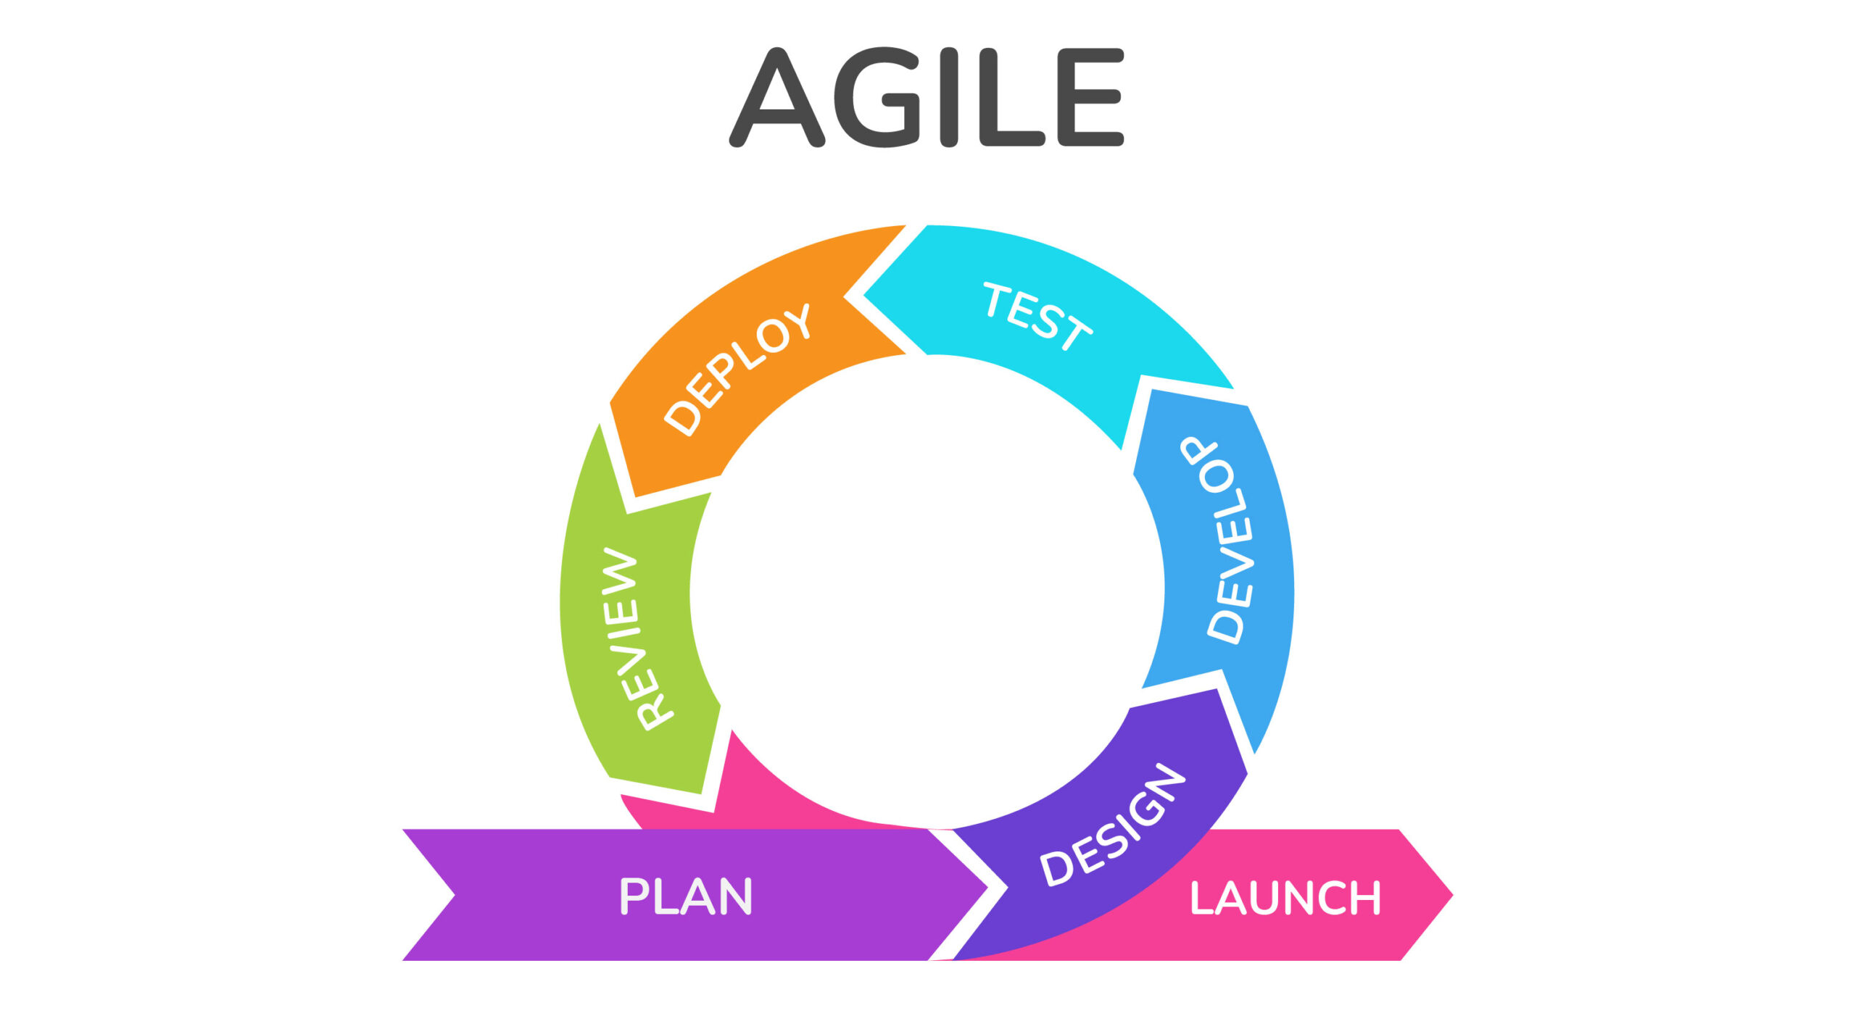
Definition of Agile Scrum
Agile is a software development approach that prioritizes flexibility, collaboration, and iterative delivery over rigid, linear processes.
Scrum is an iterative development methodology used to manage software projects.
For the Student Management System (SMS) project, we used the Agile approach to ensure flexibility and continuous improvement through iterative development.
The process was managed using the Scrum methodology, where work was divided into short sprints with planning, daily stand-ups, reviews, and retrospectives. This helped the team deliver updates regularly and adapt quickly to user feedback.
Agile Model Diagram

Slide 10
Methods / Approach
Requirement Gathering (Product Discovery)
  Conduct brainstorming sessions, interviews, and workshops with teachers, admin staff, and students.
  Capture both functional and non-functional requirements.
  Convert requirements into user stories with clear acceptance criteria.
Design (Planning & Backlog Preparation)
  Create the Product Backlog with prioritized user stories (e.g., registration, attendance, fees, communication, analytics).
  Define system architecture, data flow, and UI/UX wireframes.
  Use prioritization methods like MoSCoW and MVP.
Implementation (Development & Testing)
  Execute development in short iterations (2–3 week sprints).
  Conduct Daily Stand-up meetings to discuss progress and blockers.
  Perform Unit, Integration, and User Acceptance Testing (UAT) in each iteration.
Deployment (Integration & Delivery)
  Deploy tested builds to staging for stakeholder review, then to production.
  Use CI/CD pipelines for seamless updates and integration.
Maintenance (Continuous Improvement)
  Fix post-deployment issues and enhance system performance.
  Conduct regular feedback sessions for improvement.
  Ensure scalability, backups, and data security compliance.

Slide 11
Scrum Activities
Product Backlog Creation
  Product Owner lists all required features as user stories.
  Prioritize based on value to students, teachers, and admin.
Sprint Planning
  Team selects user stories for the sprint goal (2–3 weeks).
  Define tasks and assign responsibilities.
Sprint Execution (Development + Testing)
  Developers and testers work collaboratively to deliver features.
  Daily Scrum Meetings (15 mins) to discuss progress, blockers, and updates.
Sprint Review
  Demonstrate completed features (e.g., attendance tracking module) to stakeholders.
  Gather feedback for future improvements.
Sprint Retrospective
  Evaluate what went well, what didn’t, and how to improve in the next sprint.
  Update process and backlog accordingly.

Slide 12
User Story & Tools
User Story Workshop:
Each feature is documented as a User Story with:
Business Value (BV) – assessed by stakeholders.
Complexity Points (CP) – estimated using the Planning Poker technique.
Acceptance Criteria – defines when a story is considered “Done.”
Tools Used:
Jira – for sprint management, backlog tracking, and burndown charts.
Power BI / Tableau – for analytics dashboard visualization.
GitHub – for version control and code collaboration.

Slide 13
Required Resources
People:
1 Product Owner (Represents academic administration and defines priorities.)
1 Project Manager (Oversees overall project scope, schedule, and delivery timelines.)
1 Business Analyst (acting as Scrum Coordinator)
6 Developers (Frontend, Backend, Database, QA)
2 UI/UX Designers
Technologies:
Frontend: React.js / HTML / CSS
Backend: Node.js / Django
Database: MySQL / MongoDB
Cloud: AWS / Azure
Analytics: Power BI / Tableau

Slide 14
Budget Breakdown
Category | Details | Estimated Cost (₹)
Development Costs | Salaries for developers (frontend, backend, DB), BA, QA testers for 4–6 months | ₹43,00,000
Infrastructure | Cloud hosting, database, storage, backups for 1 year | ₹3,00,000
Licensing & Tools | SMS framework, project management & testing tools | ₹1,50,000
Training & Change Management | Trainer workshops, student orientation, training material creation | ₹1,50,000
Maintenance & Support (Year 1) | Bug fixes, server monitoring, updates, helpdesk support | ₹1,00,000
Contingency (10%) | Buffer for unexpected costs (scope change, infra upgrade) | ₹3,00,000
Total Estimated Cost: ₹53,00,000
Estimated project duration: 6 months (8 sprints × 3 weeks each).

Slide 15
Risks
Changing requirements from the academic department during sprint cycles.
Data privacy and security risks related to storing student records in the cloud.
Integration challenges with legacy databases or third-party applications (fees, attendance, library).
Delays in content or data inputs from stakeholders (exam schedules, fee structures, student lists).
Technical issues or bugs during AI and analytics module implementation.
Limited stakeholder participation during sprint reviews and feedback sessions.
Regulatory or compliance risks if data policies change during project execution.

Slide 16
Dependencies
Timely feedback from teachers, administrators, and students during sprint reviews.
Availability of cloud infrastructure, APIs, and server resources.
Integration with third-party tools (analytics, messaging, and payment gateways).
Access to existing student and academic data from legacy systems for import.
Continuous support from IT and security teams for deployment and maintenance.
Consistent internet connectivity and hardware for on-site users during implementation.
Compliance approvals for data privacy and institutional regulations.

Slide 17
Conclusion
The Student Management System (SMS) aims to digitize all aspects of student services from attendance to facilities through an Agile approach.
Using iterative sprints ensures faster feedback, quicker delivery, and adaptability to user needs.
This solution improves efficiency, reduces manual effort, and builds a modern digital experience for students and administrators alike.

Slide 18
Sign-off
To Be Completed by Appropriate Manager: Abhishek
Project Sponsor: Ravi Kiran
Project Manager: Atul Kumar
Approval Status: ☐ Approved ☐ Approved with Comments ☐ Not Approved
Planned Go-Live Date: 28/10/2025
Post-Implementation Review Date: 06/11/2025

Slide 19
Thank You

