Slide 1


Agile Healthcare Integration at Axia Women's Health
Unifying healthcare operations, IT, and HR on secure, compliant platforms.
by Saifullah Aamir

Slide 2
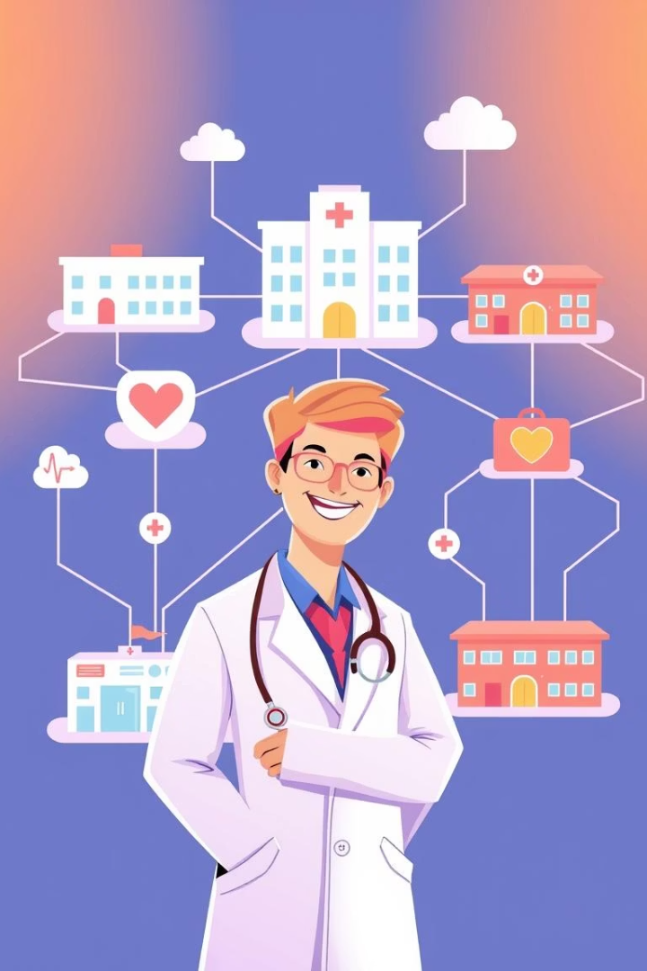
Executive Summary
Digital Transformation
Unify healthcare, IT, and HR services.
System Integration
EHR/EMR with HL7/FHIR, RCM with EDI.
ServiceNow Modules
ITSM, HRSD, ITOM for workflows.
Agile Scrum
Iterative value delivery, stakeholder alignment.

Slide 3
Current Challenges and Opportunities
Fragmented Environment
ServiceNow Opportunity
Legacy tools lack interoperability, compliance, scalability.
Automate and streamline operations.
Inefficient IT ticketing, HR case resolution.
ITSM: incident, request, change management.
No unified visibility.
HRSD: onboarding, benefits, personnel services.
Delayed clinician support.
ITOM: proactive infrastructure management.
Align IT/HR with clinical priorities.

Slide 4







Project Goals and Objectives
Unify Processes
Clinical, IT, HR on secure, scalable platforms.
Ensure Compliance
Regulatory standards, automation, user satisfaction.
Clinical
EMR/EHR, eRx, patient portals.
Revenue
Automate RCM via EDI standards.
IT Operations
Migrate BMC Remedy to ServiceNow.
Human Resources
ServiceNow HRSD for service delivery.
Security & Compliance
HIPAA, HITECH, SOC 2 controls.

Slide 5





Key Success Criteria
Full Compliance
HIPAA, HITECH, EDI standards.
Low Incident Backlog
<5% in ITSM post-implementation.
High Resolution Rate
90%+ first-contact resolution in HRSD.
High Uptime
99.9% via ITOM real-time monitoring.
Reduced Billing Errors
50% reduction via RCM, EDI.

Slide 6
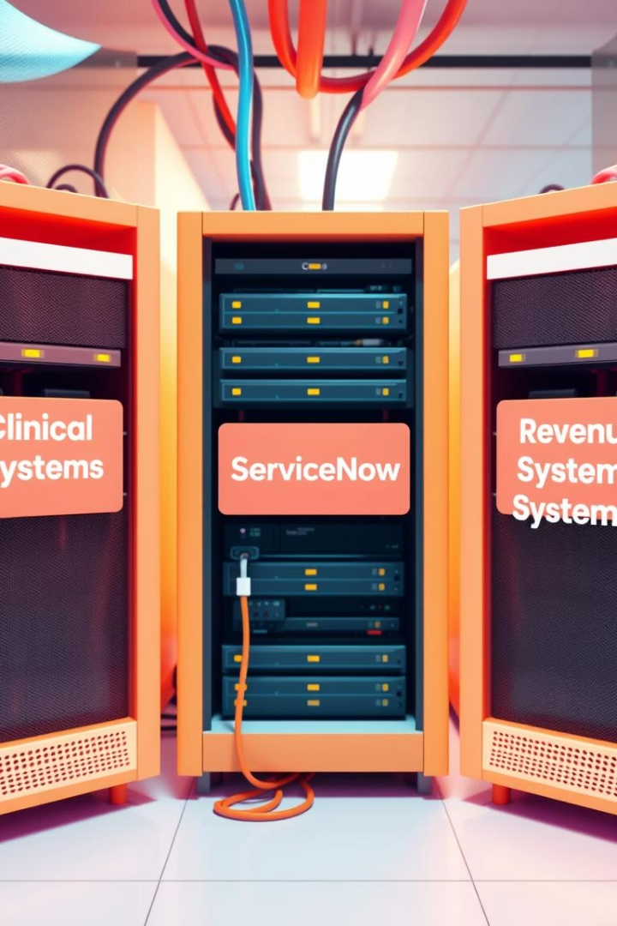
Proposed Solution Stacks
Clinical Stack
ServiceNow Stack
FHIR APIs for EMR/EHR, PACS/LIS.
ITSM: Incident, Change, Request, Knowledge.
Mirth Connect middleware.
HRSD: HR case, onboarding, benefits.
Tableau for population health.
CCD/CCR & eRx, patient portals.
ITOM: Discovery, CMDB, Health Monitoring.
Role-based access, service catalogs.
Revenue Systems
RCM automation for claims (837/835).
Real-time eligibility (270/271).
EOB parsing, reconciliation.
EDI engine for X12 formats.

Slide 7
Key Deliverables
Deliverables
FHIR-integrated EMR/EHR system with patient and physician dashboards
• Full deployment of ServiceNow ITSM, HRSD, ITOM modules
• Secure PHI/PII audit & access control systems with SOC2 reporting
• Real-time Tableau dashboards for clinical, HR, and IT operations
• Agile sprint artifacts: product backlog, burndown charts, sprint reviews, retrospectives
• HRSD knowledge base and self-service portal with SOPs
• RCM module with automated EDI transaction reporting and claim denial insights
• HL7 interface engine configurations and message routing documentation
• UAT test cases and validation reports for EHR, RCM, ServiceNow workflows
• Post-implementation support guide with escalation matrix and change request templates
• ServiceNow CMDB architecture with dependency mapping and uptime reports
• Comprehensive compliance checklist covering HIPAA, SOC2, HITECH, and PHI security controls
• Training manuals for clinicians, HR personnel, IT support, and billing staff

Slide 8
SMART Objectives
SMART Objectives
S: ServiceNow ITSM onboarding by Sprint 2.
M: 90% SLA compliance in HRSD by Sprint 5.
A: Full PACS/LIS integration by Sprint 4.
R: Migrate all IT assets to ServiceNow CMDB.
T: Go-live within 12 weeks + 2-week stabilization.

Slide 9
Resources and Risks
Resources Needed
Risks and Dependencies
People: Scrum Master, Product Owner, BA, Architect, QA, DevOps.
Data mapping inconsistencies.
EHR vendors’ FHIR/HL7 variance.
Tools: ServiceNow, Mirth, Tableau, HL7/FHIR libraries.
ServiceNow module delays.
Budget: ~$205,000.
Resistance to Agile ceremonies.

Slide 10
Agile Project Approach
Sprint 0
1
Agile setup, stakeholder alignment.
2
Sprint 1
HL7/FHIR framework, ServiceNow foundation.
Sprints 2-4
3
Build integrations, configure workflows, test handoffs.
4
Sprint 5
UAT, performance validation, go-live prep.
Post-Go-Live
5
Hypercare, retrospectives, backlog grooming.

