Slide 1
Project Title: Patient Appointment Tracking Application (PAT)
Prepared By: Yash Patil
Model Used :Waterfall Model
Date – 14/8/2025

Slide 2
Problem Statement: Why PAT Was Needed
Current Situation:
Manual appointment scheduling leads to errors and inefficiencies.
Patients face long wait times due to poor scheduling.
No centralized system for tracking appointments, leading to missed visits.
Staff spend excessive time managing appointments via phone/paper.
Problems:
Double bookings or missed appointments.
Lack of real-time updates for patients and doctors
Difficulty in tracking patient history and follow-ups.
Errors in scheduling and poor communication.

Slide 3
Opportunities:
Digital Appointment Tracking:
- Reduces manual errors and administrative burden.
- Improves patient satisfaction with automated reminders.
Centralized System:
- Doctors and staff can view schedules in real-time.
- Better resource allocation and reduced no-shows.
Data Analytics:
- Helps hospitals analyze appointment trends for better planning.
Automated reminders via SMS/Email

Slide 4
Purpose Statement
Purpose - Develop a Patient Appointment Tracking Application to streamline scheduling, aimed at hospital appointment scheduling, reducing errors, and improving patient experience, and enhance patient-doctor coordination.
Key Focus Areas:
- Automated appointment booking & reminders.
- Real-time schedule management for healthcare providers.
- Secure patient data handling.

Slide 5
Project Objective:
Solution Selection: Evaluate different scheduling models and choose the best fit.
Solution Prototyping & Testing: Develop a prototype and conduct user testing.
Streamline Event Documentation: Ensure seamless recording of appointments and patient history.
Integration with Existing Systems: Compatibility with hospital management software.
Enhance Stakeholder Participation: Encourage more doctors and hospital staff engagement via suggestion portals and instant notifications

Slide 6
Success Criteria:
Improve Records Availability & Accessibility (A&A)
Allow Doctors and staff members to access patient related files anytime from the portal.
Eliminate manual file handling and physical record archiving.
Reduce Downtime & Response Delays (RD&RD)
Faster scheduling, fewer missed appointments.
Ensure reliable uptime for appointments registration and scheduling modules.
Minimize system lags through optimized data flow and user interface.
Speed up appointment approval processes with automated workflows.

Slide 7
Feature of PAT Application:
Doctors Registration: Inputs – Doctors name, specialized department, Available dates.
Patient Registration: Inputs – Patient name, personal info, medical history, date.
Online Booking – Patient can schedule appointments digitally.
Automated reminders – SMS/Email notification
Doctor Availability Calendar – Avoid double bookings
Patients history and treatment tracking – maintain medical records
Admin dashboard – Manage appointments efficiently and staff dashboard
Prescription and billing Automation – In app digital billing and prescription printed version available.
Suggestion portal – Online feedback replaces physical suggestion box.

Slide 8
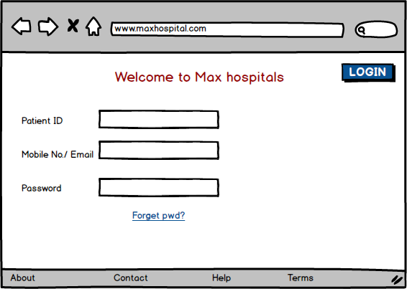
Wireframes for PAT:
Patient Homepage Wireframe

Slide 9
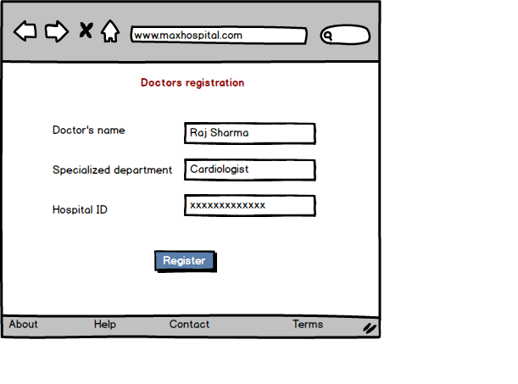
Doctor’s Registration Wireframe

Slide 10
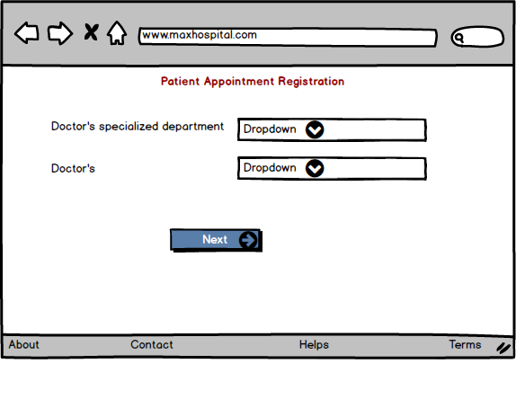
Patient Appointment Registration

Slide 11
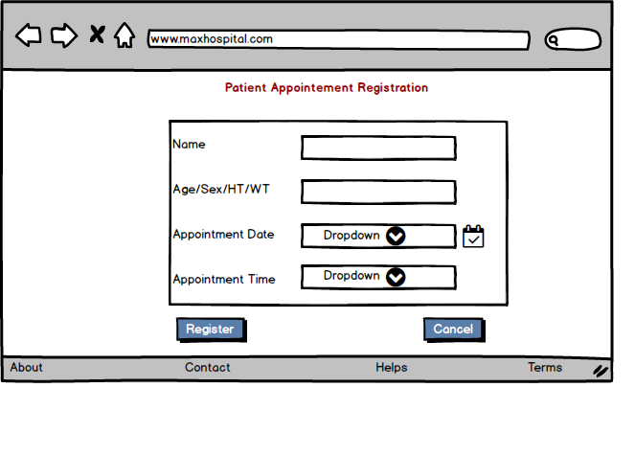
Patient Appointment Registration

Slide 12
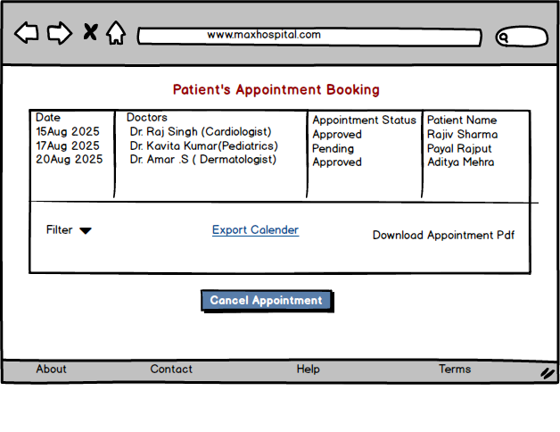
Patient’s Appointments Booking

Slide 13
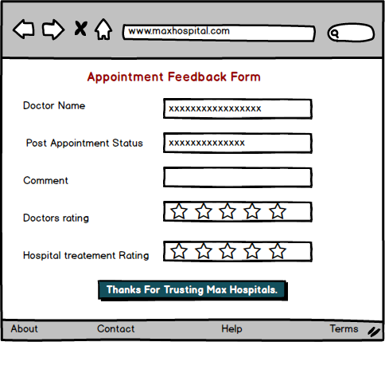
Appointment Feedback Form

Slide 14
Methods/Approach – Aligned with waterfall Phase:
Waterfall Phase | Method/Action Taken
Requirement Gathering | Establishing a selection committee with stakeholders and defined system requirements.
Design | Identified solutions options via RFPs (Request for Proposal),Conducted demonstrations and reviewed platform fit.
Development and Testing | Selected and implemented the chosen solution, trained users and tech staff, set up support.
Deployment and Implementation | Went live with the digital PAT system on hospital infrastructure with pilot events.

Slide 15
Sample Data Entry Table
Doctor’s Name | Patient’s Name | Specialized dept. | Date/Time
Raj Sharma | Anil Verma | Cardiologist | 22/7/25 (3pm-4pm)
Aman Singh | Madhavi Sinha | Dental | 13/8/25(4pm-5pm)
Rakesh Kumar | Arjun Patel | Dermatology | 15/8/25 (10am-11am)

Slide 16
Resources:
1. People
Project Team Members:
Doctors (Specialized Dept)
Hospital Staff Members
IT Support Team (Internal Tech Staff)
Roles Include:
Requirement Definition
Design Approval
Testing, Feedback & Deployment Assistance

Slide 17
2. Time
Estimated Implementation Duration: 3 Months (Includes planning, design, development, testing, training and deployment)
3. Budget
Category | Allocation
Hardware | ₹50,000.00
Software | ₹70,000.00
Training Materials | ₹5,000.00
Miscellaneous Services | ₹1000.00
Total Estimated Cost | ₹1,26,000

Slide 18
4. Other Resources
Third-party software evaluations
Site visits to peer institutions for process mapping
Dataquest reports or templates for best practices

Slide 19
Risks:
Technical Risks: - System downtime or Integration issues.
Operational Risks: - Resistance from staff to adopt new technology.
Financial Risks: - Budget overruns during development.
Mitigation Strategies: - Regular backups, staff training, and phased implementation.
Data Security: Unauthorized access.
User Adoption: Resistance to new tech.

Slide 20
Dependencies:
Stakeholder willingness to adopt new processes and tools
Active participation of IT support during deployment and training
Availability of Hospital infrastructure (Wi-Fi, systems, admin access)
Clear documentation for future maintenance and user self-support

Slide 21
Executive Summary:
A digital solution to manage patient appointments efficiently.
To reduce manual errors, improve efficiency, and enhance patient experience.
Using Waterfall methodology for structured development.
A reliable, user-friendly appointment tracking system.
Features include real-time booking, reminders, and integrated records.
Risk management and testing ensure smooth deployment.

Slide 22
To Be Completed by Appropriate Manager:
Project Sponsor
Name: Dr. R.G. Sharma
Designation: Founder(Max Hospital)
Role:
Approves overall project scope
Provides strategic guidance and stakeholder alignment
Endorses budget, resources and post-deployment reviews
Project Manager
Name: Yash Patil
Designation: Business Analyst/Project Lead
Role:
Oversees requirement gathering, design and documentation
Coordinates with technical team and stakeholders
Manages timeline, testing and delivery milestones

Slide 23
Conclusion:
The system will digitize and streamline appointment scheduling.
Expected improvements in both patient experience and hospital efficiency.
The Patient Appointment Tracking Application will modernize healthcare scheduling.
Benefits include reduced no-shows, better time management, and improved patient care.
Future enhancements may include AI-based scheduling and telemedicine integration.

