Slide 1

PredictRam CRM
(Customized Risk Management)
Prepared By: Avinab Ashish Das, Business Analyst
Date: 11/07/2025
Goal: To empower investment professionals with an AI-driven personalized portfolio risk analysis

Slide 2

Executive Summary
In today’s volatile financial markets, investors are struggling to manage portfolio risks effectively due to fragmented data sources and inadequate real-time risk insights.
PredictRam CRM is a cutting-edge, AI-powered web-based platform designed to provide investment advisors, risk analysts, and portfolio managers with advanced, real-time risk analysis.
The system leverages both market and macroeconomic factors alongside sophisticated VaR calculations (Monte Carlo Simulation) and stress testing to offer a comprehensive view of portfolio risk.
By integrating AI-driven analytics with human expertise, PredictRam CRM empowers users to protect investments, enhance diversification, and make informed decisions, strengthening their competitive edge in risk management.
This solution will help investment professionals identify, access, and mitigate risks proactively, protect valuable assets from uncertainty, and deliver superior risk-adjusted performance for their clients.

Slide 3
Situation
Investment professionals face challenges managing portfolio risks due to market volatility, interest rate changes, currency swings, inflation, and geopolitical issues.
Global markets are highly interconnected, driven by rapid interest rate changes, currency fluctuations, inflation, evolving policies, and unpredictable geopolitical events.
Regulatory pressure from SEBI and RBI under Basel III is increasing, demanding stricter compliance and risk transparency.
While the need for strong risk management is rising, many solutions are too basic, slow, or costly for smaller firms.
Problems
Current solutions lack integration of comprehensive market data, advanced simulation models, and sector-specific insights.
Advisors lose time on manual analysis and lack tools to measure stress scenario risks or adapt to regulatory/inflation shifts.
Sophisticated solutions are proprietary, costly, and require technical expertise, restricting use to large institutions while meeting SEBI/RBI norms.
Opportunity
Growing demand exists for AI-powered solutions offering fast, accurate predictive analytics for risk assessment using vast datasets.
PredictRam CRM offers an AI-based platform automating risk analysis with real-time macro data and inflation-linked strategies.
It empowers professionals to protect assets, optimize returns, comply with SEBI/RBI, and gain a competitive edge in risk management.
This innovation meets unmet needs in speed, accuracy, and affordability, helping gain market share in risk management.

Slide 4
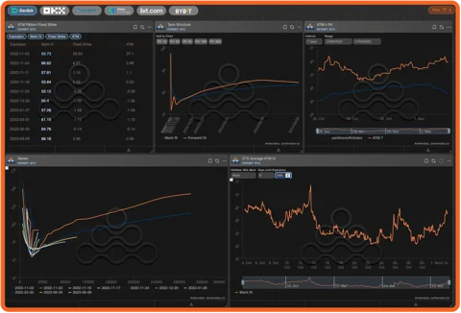
Purpose Statement
Solving issue
Automates risk calculations using advanced Monte Carlo VaR simulations, stress testing, and scenario analysis by integrates macroeconomic and market condition data daily into a centralized data warehouse and providing tailored risk strategies, including CPI-linked bonds and custom ETFs, to protect investor assets from inflation and uncertainty.
Effective
AI automates data standardization and analysis, ensuring rapid, precise insights and regulatory compliance with SEBI, RBI, and Basel III norms minimizing potential losses and maximizing growth opportunities.
Better than alternatives
Unlike fragmented tools, it consolidates diverse market, macroeconomic, and geopolitical data for a truly comprehensive risk view provides deeper, sector-specific, interactive dashboards, real-time market trend analysis and inflation-adjusted strategies not commonly offered by static or delayed reporting in competing systems.
Make it happened
Continuous collaboration between the finance research team and tech team of 6 developers, led by Mr. Arnab, and testers Ms. Anuja and Mr. Rohan to refine risk models, incorporate new market factors, and ensure regulatory alignment, build a data warehouse for daily truncation, loading, and secure storage of vast historical and real-time financial data and Launch MVP to gather user feedback, iterate, and scale to full rollout.

Slide 5

Project Objectives
The system must handle large datasets (e.g., historical market data, transactional data) and support a growing user base, ensuring performance under high demand.
Employ Monte Carlo simulations for VaR calculations, stress testing for extreme market scenarios, and covariance/correlation analysis for portfolio components.
Achieve VaR calculations at 95%, 99%, and 99.9% confidence levels within a 10-day horizon for trading portfolios, with accurate stress testing results.
Align with SEBI guidelines for mutual funds, brokers, and banks, and RBI Basel III norms for banks and NBFCs, ensuring regulatory adherence.
Support portfolio risk analysis based on market conditions (e.g., interest rates, CPI, currency volatility) and macroeconomic/geopolitical factors (e.g., policy changes, US Fed decisions).
Intuitive dashboard and downloadable PDF reports tailored for investment advisors, risk analysts, and portfolio managers, ensuring ease of use and accessibility.
Establish a roadmap for ongoing enhancements, including support for new asset types, evolving compliance norms, and improved AI models.
Assessing the system's speed and responsiveness under various loads, especially for real-time data processing and complex simulations.
The objectives to development and rigorously test, design and select a robust, AI-powered web-based platform that meets specific design criteria, technical specifications, and functional requirements to address the complexities of portfolio risk management.

Slide 6

Success Criteria
User Adaption:
Target ≥50 pilot client subscriptions of investment advisors, risk analysts, and portfolio managers onboarded within the first 3–6 months of launch and ≥500 active subscriptions within 12 months of full launch.
Engagement:
≥80% of users generate at least one key modules like VaR calculation, stress testing, PDF report generation, and dashboard analytics and ≥70% of users utilize the platform’s Demat account integration for portfolio management tasks.
Timely Updates:
Daily refresh of market, macroeconomic, and geopolitical data truncation and loading (e.g., interest rates, CPI, Brent Crude prices etc.) within 2 hours after market close, with ≥99% success rate.
System Uptime:
Maintain >99.5% uptime to ensure zero critical outages (i.e., downtime >5 minutes) during peak usage hours (9 AM–5 PM market hours) and response times of ≤2 seconds for portfolios with up to 1,000 assets.
Data Security:
Achieve zero data breaches or unauthorized access incidents, ensure all sensitive data (e.g., transactional data, user portfolios) is encrypted with industry-standard protocols (e.g., AES-256) and periodic internal and external security audits and penetration tests.

Slide 7
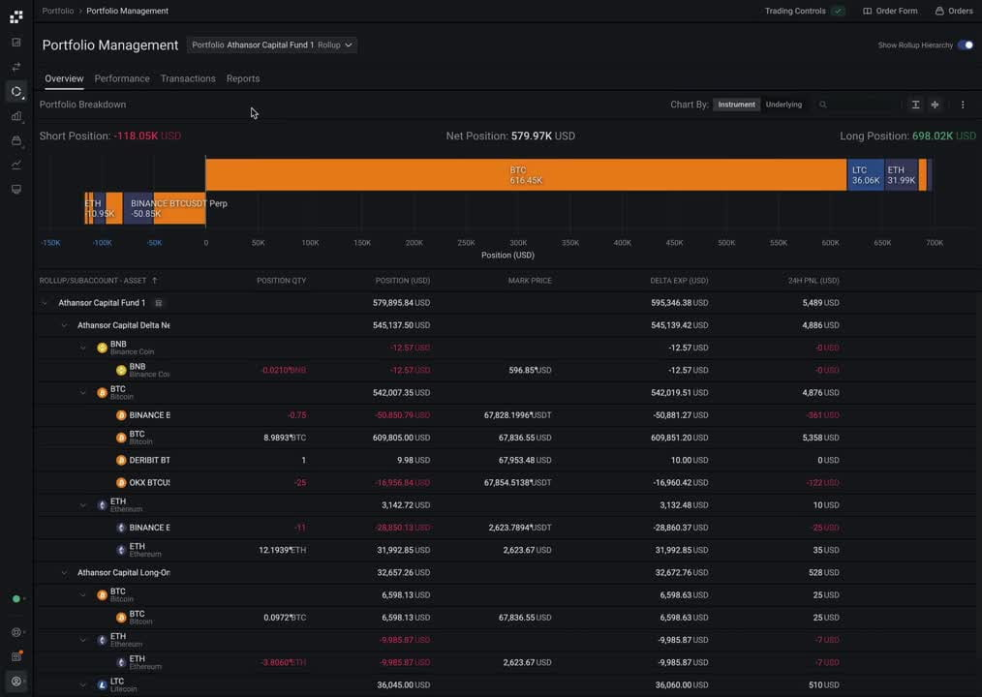
Methods/Approach
Project Initiation
Conduct kickoff meetings with the Board of Directors, founders (Mr. Subir and Ms. Sheetal), finance team, and tech team (led by Mr. Arnab) to define the vision for PredictRam CRM (e.g., "Revolutionizing portfolio risk management with AI").
Document high-level requirements for risk models, compliance needs, select technology stack (e.g., Python for AI, React for frontend, PostgreSQL for data warehouse, AWS for cloud hosting) and user roles.
The Finance team, with their deep domain knowledge, will work with Business Analysts to draft initial user stories and features and Tech Lead (Mr. Arnab), Developers, and Testers (Ms. Anuja, Mr. Rohan) established agile tools e.g., Jira for task management, Confluence for documentation.
Sprint Planning
Conduct 2-week sprint planning sessions with the tech team, finance team, and stakeholders to break down the product backlog into prioritized user stories e.g., daily data ingestion, VaR simulation engine, PDF reporting.
Estimate effort, collectively adapted 2 weeks sprint cycle (e.g., Develop Monte Carlo simulation for VaR at 95% confidence level and Implement core VaR calculation for equity portfolios)
Developers break down selected user stories into smaller, manageable tasks and set clear acceptance criteria for each story aligned with regulatory standards.

Slide 8
Methods/Approach
Development & Iteration
Develop in 2 week sprints delivering incremental, working features. Conduct short daily meetings for the development team to synchronize, discuss progress, impediments, and plans for the day.
Developers write code, perform unit tests, and integrate their work continuously. Regular demos of portfolio analysis modules, dashboards, stress testing tools, and reporting outputs.
Weekly check-ins with stakeholders involve founders and other stakeholders, providing direct feedback on completed increments for transparency and alignment.
Testing and Quality Assurance
Conduct unit testing for individual components (e.g., VaR algorithm, data pipeline) during development.
Ms. Anuja and Mr. Rohan, as testers, will be actively involved from the beginning of each sprint, writing test cases and executing tests as features are developed.
Involve key finance team and founders in end-users testing increments to ensure usability and functional fit.

Slide 9
Methods/Approach
Deployment and Release
Implement rolling releases, initiate MVP to a pilot group (≥50 clients) in production after passing QA checks.
Monitor system performance post-deployment (e.g., uptime, response time) Consider rolling out new features to a subset of users first to gather feedback before a full release, especially for major functionalities.
Plan incremental launch of new features, targeting ≥500 subscriptions within 8-12 months of launch. Announce new features and updates to users, providing release notes and training.
Retrospectives and Continuous Improvement
Conduct sprint retrospectives after each 2-week sprint to discuss what went well, what didn’t, and action items for improvement.
→What went well?
→What could be improved?
→ What will we commit to doing differently in the next sprint?
Incorporate ≥80% of actionable pilot client feedback within 2 months of collection based on retrospective outcomes implement changes to workflows, tools, or communication strategies
Document lessons learned and best practices to build collective knowledge to inform future development cycles.

Slide 10

Resources
Human Resources
Leadership:
      Mr. Subir (CEO & Founder): Provides strategic direction, ensures alignment with business goals, and oversees stakeholder engagement.
      Ms. Sheetal (Co-Founder & CFO): Guides financial modeling, compliance with SEBI/RBI regulations, and budget oversight.
      Board of Directors: Approves project milestones, provides domain expertise from experience in investment banking, and validates strategic decisions.
  Finance Research Analysts: 3-4 domain experts to define risk models, risk metrics, validate market data, regulatory requirements, and data analysis needs.
Tech Team:
1 Tech Lead (Mr. Arnab): Oversee system architecture, AI module development, and integration with trading/Demat accounts.
6 Developers (front-end, back-end, AI/ML): Skilled in Python (AI/ML) for AI-driven risk analysis, React for frontend dashboard, Django for backend, and PostgreSQL for data warehousing and build data pipeline, and PDF report generation.
2 Testers (Ms. Anuja & Mr. Rohan): Conduct unit, integration, performance, and security testing using tools like Selenium
Time
Phase 1: Discovery & Foundation (Months 1-3): Detailed requirements analysis, architecture design, initial data warehouse setup, core technology stack selection, and prototyping of key UI/UX elements.
Phase 2: Core Development (Months 7-11): Building the core risk calculation engine (Monte Carlo VaR), data ingestion pipelines, dashboard functionalities, initial reporting, and integrating essential market data feeds. Iterative development with continuous testing.
Phase 3: Advanced Features & Optimization (Months 12-16): Implementing AI-powered personalization, stress testing, dynamic asset onboarding, regulatory compliance logic refinement, and performance optimization.
Phase 4: Incremental Testing & adding new features (Month 17 month onwards): Comprehensive UAT, security audits, adding ne features as per market, and new market like US and Singapore market analysis.

Slide 11
Resources
Budget Breakdown:
  Hardware (Rs. 1.5 Crores):
    Cloud infrastructure (AWS): Rs. 1.2 crores for hosting, data storage and daily data ingestion and supporting ≥1,000 concurrent users.
    Development servers and testing environments: Rs. 30 lakhs for local and staging setups.
  Software (Rs. 60 Lakhs):
    AI/ML frameworks (e.g., TensorFlow, PyTorch): Rs. 50 lakhs for licenses and cloud-based processing.
    Database (PostgreSQL) and analytics tools: Rs. 5 lakhs for data warehouse setup and management.
    Development tools (e.g., Jira, Selenium): Rs. 1 lakhs for licenses per years.
    Security tools (e.g., third-party auditing software like OWASP Zed Attack Proxy): Rs. 0 for penetration testing and compliance.
    Frontend/backend frameworks (React, Django): Rs. 4 lakhs for licenses and integrations.
  Services (Rs. 6.5 Crores):
    Developer, tester salaries, Financial Analysts, and BA: Rs. 5.5 crores (avg. Rs. 50K to 1L/month per person).
    Security consultant and compliance audits: Rs. 30 lakhs for third-party audits (PCI DSS, ISO 27001).
    Data licenses (market data, e.g., Bloomberg): Rs. 70 lakhs per year for 4 financial analysts.
    Other Requirements:
  Contingency (Rs. 1.4 Crore):
    Buffer for unforeseen costs (e.g., additional cloud resources, extended testing).
    Visit 3-5 pilot client offices (investment firms, banks) to gather requirements, conduct UAT, and provide onsite training.
    Engagement of external legal or compliance experts for highly nuanced interpretations of SEBI guidelines and RBI norms, ensuring the system's outputs are fully compliant.

Slide 12

Risks & Dependencies
Scope Creep: Risk of uncontrolled changes in features (e.g., new asset types or analytics) risks delaying the timeline and exceeding the Rs. 10 crore budget.
Technical Challenges: Complex integration of AI-powered risk models Monte Carlo simulations and compliance logic may delay development or data pipeline integration may delay MVP delivery or compromise VaR accuracy (target: ≥98%).
Data Warehouse Readiness: Break down of Datawarehouse may cause gap in historical data that are crucial for the system's analytical capabilities.
User Adoption Resistance: Investment advisors or portfolio managers may resist adopting the platform or limited or unclear feedback from pilot clients , hindering the target of ≥500 subscriptions within 12 months.
Regulatory Changes: Evolving SEBI and RBI guidelines necessitate continuous monitoring and rapid adaptation of the system's compliance logic. Breaches or non-compliance with SEBI/GDPR standards could undermine user trust and lead to regulatory penalties.
Budget Overruns: Unexpected costs for market data licensing, compliance audits, or professional services may exceed estimates.
Inadequate Testing: Insufficient testing (e.g., missing edge cases in stress testing) risks system errors, impacting reliability and user satisfaction (target: ≥4.5/5).
Training and Support: Inadequate training or support may result in low user proficiency (target: ≥95% training completion), reducing adoption and engagement.

Slide 13

Thank you

