Slide 1
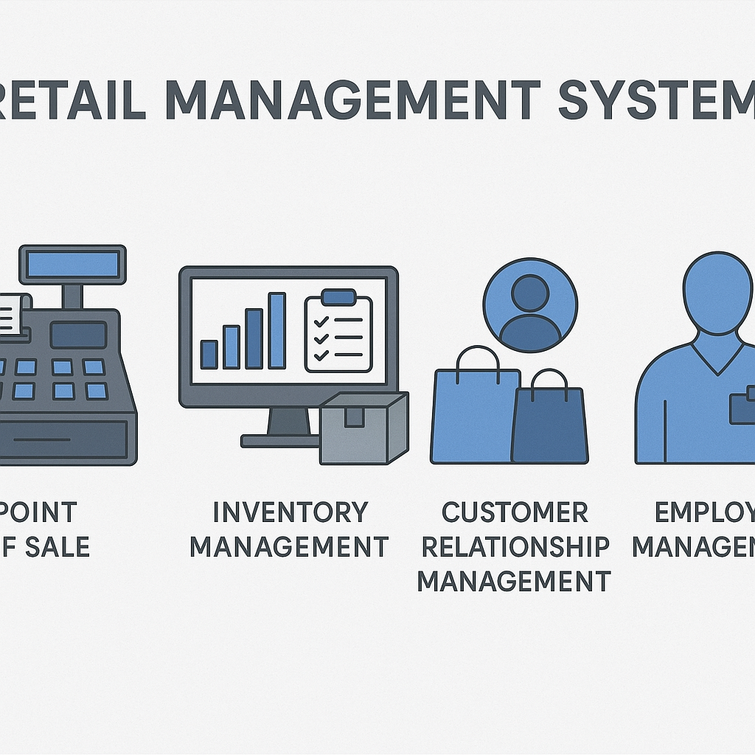
Retail management system
Presented by - Suthari Srikanth
Date - 21-07-2025

Slide 2
Introduction
A Retail Management System (RMS) is software used to run retail store operations efficiently.
Used in supermarkets, fashion outlets, online stores, etc.
Key Goal: Streamline POS, inventory, CRM, and sales.

Slide 3
Objectives of RMS
Automate sales and billing process
Track inventory in real-time
Manage suppliers and vendors
Handle customer data and loyalty programs
Improve store performance and profitability

Slide 4
Opportunities/ Benefits
RMS enables data-driven decision-making, opening opportunities for targeted marketing and personalized customer experiences.
It supports business scalability by efficiently managing multi-store operations from a centralized system.
Retailers can identify trends and optimize stock, increasing sales and reducing operational costs.

Slide 5
Situation of RMS
A busy supermarket chain was struggling with inventory mismatches, delayed billing, and manual sales tracking
They implemented an RMS to automate POS operations and real-time inventory updates across all branches.
Cashiers began processing checkouts faster with integrated barcode scanners and digital receipts. Managers accessed live sales reports and adjusted stock levels using centralized dashboards.
Customer satisfaction improved, and the business saw a 20% increase in operational efficiency.

Slide 6
Purpose statement
The purpose of a Retail Management System is to streamline and automate all retail operations,
from sales and inventory to customer management. It aims to improve efficiency, reduce human errors, and enhance the overall shopping experience. By centralizing retail processes, RMS supports better decision-making and business growth.

Slide 7
RMS RISKS
RMS may face data security risks, such as unauthorized access to sensitive customer and sales information.
System downtime can disrupt operations, leading to revenue loss during peak hours.
Integration issues with third-party tools (e.g., payment gateways, e-commerce platforms) can cause data inconsistencies.
Inadequate staff training may result in operational errors and underutilization of the system’s features.

Slide 8
Methods and Approaches’
Agile methodology can be very useful in developing and improving a Retail Management System (RMS) because retail is a dynamic industry where customer demands, technologies, and market conditions change rapidly. Here’s how Agile applies to RMS,
1. Incremental Development
Agile allows breaking the RMS into smaller modules (e.g., inventory, billing, customer loyalty, supplier management).
Each module is developed, tested, and deployed in short iterations (sprints), so value is delivered continuously instead of waiting for the entire system.
Flexibility & Adaptability
Retail trends change quickly (e.g., cashless payments, e-commerce integration, discounts, personalized offers).
Agile makes it easy to adapt to these changes by reprioritizing backlog items and delivering new features without disrupting the whole RMS.
Continuous Improvement
Agile promotes regular retrospectives.
RMS teams can analyze what worked well (e.g., faster billing) and what needs improvement (e.g., stock updates delay) and adjust in the next sprint.
Here we can also conduct the scrum meting with scrum masters and product owner developers and stakeholders and others team members to understand the requirements, we can see also run the daily standup meting g to discuss about daily activities to starting of the day
Inventory management automation – Online order & in-store pickup – Real-time sales analytics dashboard – Payment gateway integration during the sprint me and my team members focus this key points

Slide 9
Agile
Customer-Centric Approach
Agile emphasizes constant feedback from end-users (store managers, cashiers, customers).
Features like POS integration, online ordering, real-time stock tracking can be refined based on real store feedback.
Sprint meetings here I conducted sprint meetings with scrum master and product owner and other team to understand the clear requirements we have different sprint meetings like sprint planning meeting it showing like how to manage the sales and how build the relationship between customers and what kind of methods we can use like before sprint start we can plan this meeting the we have sprint review meeting, sprint retrospective meeting, then I create product burndown chart, sprint backlogs to understand requirements
here I am using different tools to run this RMS like JIRA to create user stories for scrum meetings and understanding the requirements, then using power BI and SQL to get more data from different sights to which are useful to the RMS, in the sprint meetings we have stages like we can see one example here to Suppose a store wants to add “online order + store pickup”.
Sprint 1 → Build online cattalo
Sprint 2 → Add order & payment module
Sprint 3 → Enable store pickup option
Sprint 4 → Integrate with inventory
It highlights the cyclical process: gathering retail needs → sprint planning → development → testing with real users → deployment of modules → review & improvements → back to next sprint.
Would you like me to also make a RMS-specific example flow (e.g., Inventory → Billing → Customer Loyalty → E-commerce) in Agile cycle format these all information about methods iam using

Slide 10
Resources Used for Retail Management System
Hardware Resources: POS terminals, barcode scanners, receipt printers, and servers for system operation
Software Resources: Retail management software, inventory systems, CRM tools, and analytics platforms.
Human Resources, Network Infrastructure: Reliable internet connection, routers

Slide 11
SUCCSESS CRETERIA
Improved Operational Efficiency: Streamlined processes with reduced manual errors and faster transactions
Accurate Inventory Management: Real-time tracking with minimal stockouts or overstock situations.
Enhanced Customer Experience, Data-Driven Decision Making, System Reliability & Scalability:

Slide 12
Conclusion
RMS is essential for modern retail success
Helps improve efficiency, customer satisfaction, and profits
A must-have for scalable and data-driven retail

