Slide 1
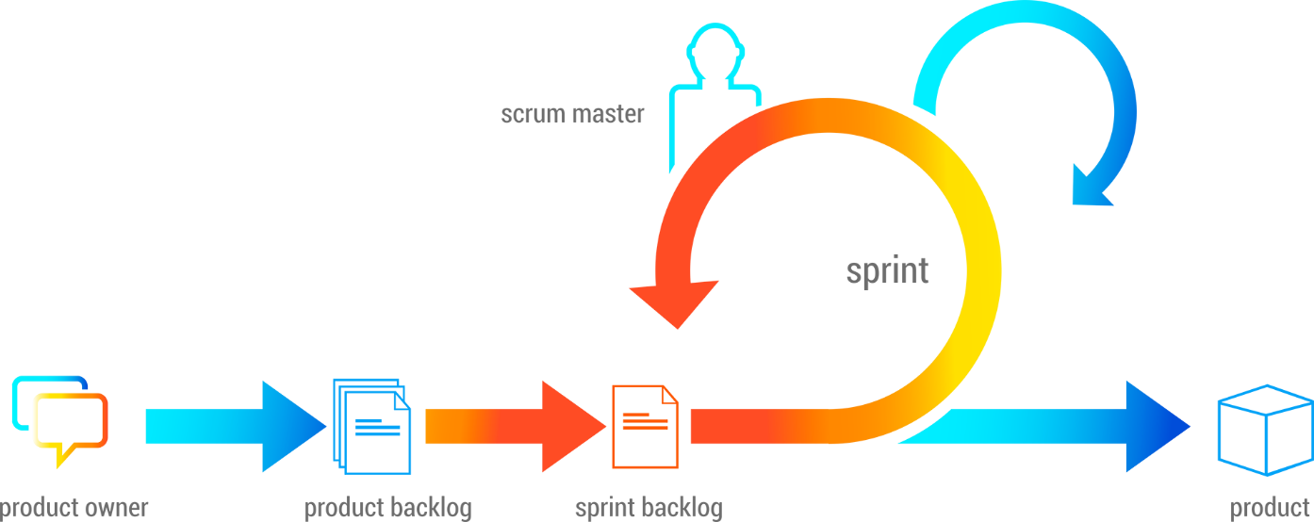
TATA AIA Agent Onboarding & Commission Automation using Agile
coepd pune dinesh kulkarni July, 07 2025 slide 1

Slide 2
Situation The current context
Background
TATA AIA Life Insurance Company Ltd. is a leading private life insurance provider in India.
It is a joint venture between Tata Sons Pvt. Ltd. – One of India's most respected business conglomerates. AIA Group Ltd. – The largest independent publicly listed pan-Asian life insurance group headquartered in Hong Kong.
The current TATA AIA CAMS process
TATA AIA Life Insurance uses a centralized system called CAMS (Channel Administration & Management System) to manage agent onboarding, commission calculation, agent movement, training status, and policy-level mapping.
While this system has been in use for over 8 plus years and serves critical business functions, much of its operation still depends on manual data entry, Excel uploads, and human approval workflows.
The system supports various channels such as: Agency LP (Life Planner), Banka HB (HDFC Bank), Corporate CC (Corporate Channels)
Each channel has its own rules for commissions, designation, onboarding, and performance metrics, making the system complex and highly dependent on operational accuracy.
coepd pune dinesh kulkarni July, 07 2025 slide 2

Slide 3
Problem What’s going wrong?
Despite CAMS being an established system, it suffers from these issues
Manual Processes:
  Agent onboarding, commission reversals, and training status updates are manually handled.
  Movement between designations or channels requires offline approvals.
Operational Inefficiencies:
  Errors in commission calculations due to outdated rate tables or misconfigured rules.
  Delayed reversal handling during freelook or policy cancellation.
Limited Automation & Real-time Capability:
  No real-time agent onboarding validation or commission preview.
  Agent ledger or commission history is not dynamically available.
Compliance Gaps:
  Delay in reflecting IRDAI training status.
  Static rule engine lacks agility for quick regulatory updates.
Poor Stakeholder Visibility:
  Branch managers, zonal heads, and sales leaders lack real-time dashboards.
  Agents are unaware of changes in their commission or designation unless manually communicated.
coepd pune dinesh kulkarni July, 07 2025 slide 3

Slide 4
Opportunity What can be improved?
The CAMS system has following opportunity for Agile-based enhancement:
Streamlining Agent Onboarding:
  Automate KYC validation, document checks, and real-time designation assignment.
Commission Engine Revamp:
  Build a flexible rule engine to handle FYC/RYC, reversals, and movement-based payouts.
Dashboard & Notification System:
  Introduce real-time dashboards for branch ops and commission tracking for agents.
Agile Workflow Automation:
  Implement JIRA-style ticketing for agent movement, approval flows, and training status updates.
Compliance Readiness:
  Enable integration with IRDA and internal audit modules to maintain regulatory hygiene.
Agent Empowerment:
  Allow self-service tracking of onboarding, status, earnings, and movement history via mobile or web portals.
coepd pune dinesh kulkarni July, 07 2025 slide 4

Slide 5
Purpose statement (Goal) High-level outcome you want to achieve
The purpose / Goal of this Agile project is to improve TATA AIA’s agent management efficiency and commission transparency by developing a flexible, sprint-based solution for:
Automated onboarding
FYC/RYC calculation
Commission rollback
Agent movement management (Promotion/Demotion/Termination/Transfer)
coepd pune dinesh kulkarni July, 07 2025 slide 5

Slide 6
Project Objectives SMART (Specific, Measurable, Achievable, Realistic, Time-bound)
Solution selection according to design criteria, specifications, and requirements
Select a flexible, scalable solution that meets regulatory (IRDAI) compliance, automation goals, and business requirements for agent onboarding, commission handling, and movement workflows.
Solution prototyping and testing
Develop and test solution prototypes in Agile sprints to validate AI onboarding, commission logic, and workflow approvals. Use stakeholder feedback during UAT to improve functionality and usability.
Automate agent lifecycle processes (onboarding to termination)
Design and implement a fully automated agent lifecycle workflow that includes onboarding validation, channel-specific designation mapping, and movement (promotion/demotion/termination).
Build a configurable commission engine (FYC/RYC & reversal)
Implement a rules-based engine to compute commissions and process reversals based on channel, designation, and policy events.
coepd pune dinesh kulkarni July, 07 2025 slide 6

Slide 7
Success Criteria Benchmarks for project success
80% reduction in onboarding cycle time across all channels.
95% accuracy in FYC/RYC calculations within 2 months of deployment.
Reduction in manual commission reversals by 70%.
Positive feedback from 90% of internal users (sales, ops, and HR).
Seamless integration with existing CAMS with zero business downtime during rollout.
Dashboards available to all stakeholders (HR, Ops, Sales, Agents) with <2s response time
<48-hour resolution time for any post-deployment issues during the first 30 days
coepd pune dinesh kulkarni July, 07 2025 slide 7

Slide 8
METHOD / APPROACH Structured plan to deliver a solution
Project execution through Agile Methodology:
To initiate the CAMS Enhancement Project at TATA AIA Life Insurance, a cross-functional selection committee will be formed.
Initial Stage– Requirement workshops, user story writing, and prioritization with stakeholders (sales, ops, IT, HR).
Documenting clear acceptance criteria for each major module and prioritizing features using the MoSCoW method (Must, Should, Could, Won’t).
Select vendors and finalists through RFP, demonstrations, and reviews.
Finalize the solution and initiate implementation through Agile sprints.
Sprints 1-5 – Develop modules (Onboarding, FYC/RYC engine, Freelook, Agent Movement, Dashboards).
Daily standups, sprint reviews, retrospectives, and continuous stakeholder feedback.
Create automated test cases and RTM for sprint validation.
Deploy in a phased manner using CI/CD pipelines.
Go Live with new system.
Monitor system performance, gather feedback in retrospectives, and make final tweaks.
Ensure production stability, agent access, and UAT sign-off before formally transitioning to full-scale operations.
coepd pune dinesh kulkarni July, 07 2025 slide 8

Slide 9
Resources
People – Project team members from client community and ITS
Business Stakeholders: Sales Leaders, Operations Heads, Risk & Compliance Officers
Technical Team (ITS): Scrum Master, Product Owner, Developers, QA Engineers, Data Analysts
Support Roles: IRDAI Compliance SME, CAMS System Administrator, Training Coordinator
Vendor Partner Team: Solution Architect, Implementation Consultant, Support Engineer
Time – Implementation within 3 months
Initial stage (2 weeks): Requirement finalization, stakeholder onboarding, backlog grooming
Sprints 1–5 (10 weeks): Modular implementation: onboarding automation, commission engine, agent movement workflows, dashboards, testing
UAT & Go Live (2 weeks): Pilot rollout, feedback, signoff, and production launch
coepd pune dinesh kulkarni July, 07 2025 slide 9

Slide 10
Resources continue…
Budget – Hardware, software, training, and services not to exceed ₹12,00,000
₹5,00,000 – Custom module development (AI onboarding, commission engine)
₹2,00,000 – System integration (CAMS, CBS, IRDA, notification APIs)
₹1,50,000 – Infrastructure provisioning, licensing, and hosting
₹2,00,000 – Training (users + technical staff), documentation
₹1,50,000 – Agile coaching, post-go-live support & issue triage
Other – Third-party software evaluation, site visits, Dataquest reports – not to exceed ₹1,00,000
Evaluation of AI fraud detection engine, compliance tracking tools
Site visits to pilot branches for feedback collection and UAT sessions
Dataquest/Market study reports to benchmark system performance, tech stack adoption, and compliance efficiency
coepd pune dinesh kulkarni July, 07 2025 slide 10

Slide 11
Risk and Dependencies
 | Type | Description | Impact | Strategy | Action
1 | Risk | Resistance from users due to change from legacy CAMS | Medium | Mitigate | Involve users in UAT, provide early training and demos
2 | Risk | IRDAI compliance rules may change during project | High | Accept | Monitor regulatory updates and adjust in later sprints if needed
3 | Dependency | Commission logic cannot be developed until slab rules are finalized | High | Avoid | Get early sign-off from business in initial stage
5 | Risk | Agent portal may expose sensitive data if not secured | High | Transfer | Assign to IT security team; conduct formal penetration testing
6 | Dependency | Go-live training completion required before system rollout | Medium | Avoid | Schedule training during UAT with tracking and follow-up
7 | Risk | Freelook reversal logic varies by channel, increasing complexity | Medium | Mitigate | Design modular rule engine with channel-wise handling
coepd pune dinesh kulkarni July, 07 2025 slide 11

Slide 12
Summary Report
The proposed project aims to modernize TATA AIA Life Insurance’s Channel Administration & Management System (CAMS) using an Agile methodology to address long-standing operational inefficiencies, manual processes, and compliance gaps that hinder agent servicing and commission accuracy.
Despite CAMS being the backbone of agent lifecycle management, it has become outdated due to its reliance on manual interventions for agent onboarding, commission calculations (FYC/RYC), reversals, and agent movement. These issues cause frequent delays, data inconsistencies, and low satisfaction among field agents and internal operations teams.
This Agile-driven CAMS enhancement project introduces sprint-based modules including AI-assisted onboarding, a rule-based FYC/RYC engine, real-time dashboards, and automated agent movement workflows.
Success will be defined by an 80% reduction in onboarding time, 95%+ commission accuracy, full paperless operations, real-time tracking, regulatory compliance, and significantly improved agent satisfaction through faster, transparent servicing.
Project Sponsor
Project Manager
coepd pune dinesh kulkarni July, 07 2025 slide 12

Slide 13

coepd pune dinesh kulkarni July, 07 2025 slide 13

