Slide 1
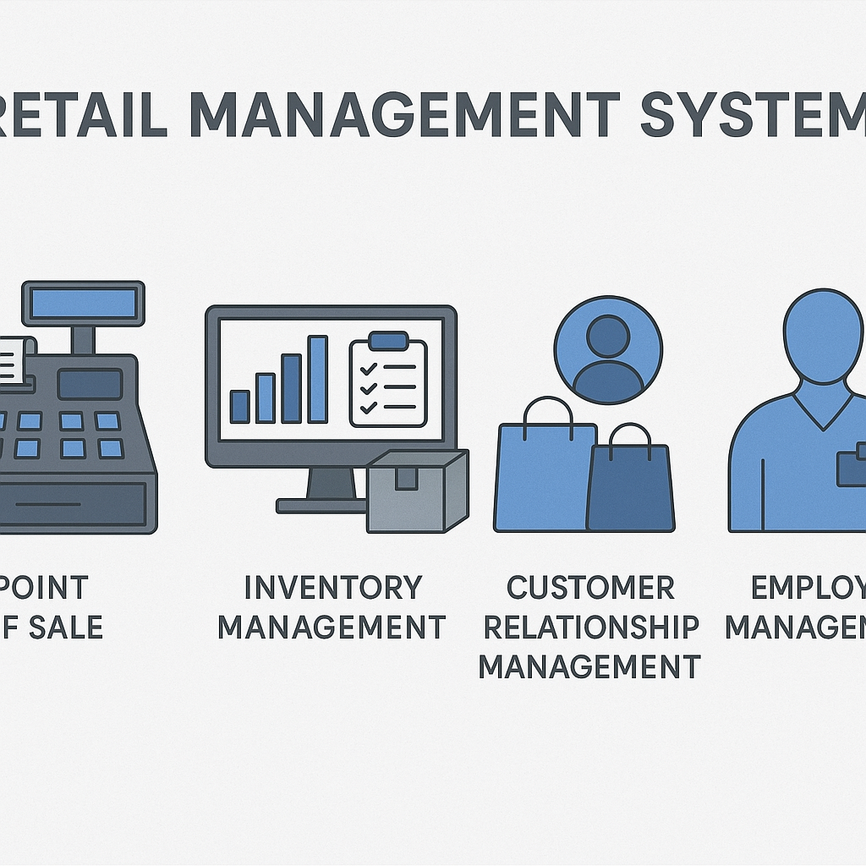
Retail management system
Presented by - Suthari Srikanth
Date - 21-07-2025

Slide 2
Introduction
A Retail Management System (RMS) is software used to run retail store operations efficiently.
Used in supermarkets, fashion outlets, online stores, etc.
Key Goal: Streamline POS, inventory, CRM, and sales.

Slide 3
Objectives of RMS
Automate sales and billing process
Track inventory in real-time
Manage suppliers and vendors
Handle customer data and loyalty programs
Improve store performance and profitability

Slide 4
Opportunities/ Benefits
RMS enables data-driven decision-making, opening opportunities for targeted marketing and personalized customer experiences.
It supports business scalability by efficiently managing multi-store operations from a centralized system.
Retailers can identify trends and optimize stock, increasing sales and reducing operational costs.

Slide 5
Situation of RMS
A busy supermarket chain was struggling with inventory mismatches, delayed billing, and manual sales tracking
They implemented an RMS to automate POS operations and real-time inventory updates across all branches.
Cashiers began processing checkouts faster with integrated barcode scanners and digital receipts.
Managers accessed live sales reports and adjusted stock levels using centralized dashboards.
Customer satisfaction improved, and the business saw a 20% increase in operational efficiency.

Slide 6
Purpose statement
The purpose of a Retail Management System is to streamline and automate all retail operations,
from sales and inventory to customer management.
It aims to improve efficiency, reduce human errors, and enhance the overall shopping experience.
By centralizing retail processes, RMS supports better decision-making and business growth.

Slide 7
RMS RISKS
RMS may face data security risks, such as unauthorized access to sensitive customer and sales information.
System downtime can disrupt operations, leading to revenue loss during peak hours.
Integration issues with third-party tools (e.g., payment gateways, e-commerce platforms) can cause data inconsistencies.
Inadequate staff training may result in operational errors and underutilization of the system’s features.

Slide 8
Methods and Approaches’
Agile methodology is used to develop this application, agile is iterative development which has the frequent collaboration with stakeholders and allowing for flexibility and responsiveness to changing requirements.
Scrum team has aligned work for this project which has 9 to 10 members which also includes scrum developers scrum master and product owner
Requirement gathering where the elicitation techniques have been applied like brainstorming, use case specifications JAD sessions and needed elicitation techniques to gather the requirements
- Product backlog has been created in the form of user story is nothing but the requirements which we have collected from the stakeholders. which has the old requirements of the stakeholders. This will be done through user story workshop which will be allocated in the product vision board.
- in the user story workshop the BV business value points CP capacity planning acceptance criteria will be created. BV will be valued by the development scrum currencies to them and rate them accordingly. CP will be given pokers card technique.
All the user stories are prioritized by the MOSCOW and MVP techniques to and also calculating the BV and CP points
-then sprints starts there will be delivery of software in two weeks
Sprint meetings- will be like daily scrum meeting, sprint planning meeting and sprint review meeting, sprint retrospective meeting conducted by BA to understand the requirements the any update during meeting they will update the requirement as per chang requirements,
Tools uses- TOOLS LIKE JIRA is mainly used to run the sprints and create the product burn down chart and generate the documents using power BI and Tableau
- Product burn down chart will be prepared by product owner in order to update on work done process this chart is very useful for requirements it showing like work done status. These are the methods and approaches am used for this project.

Slide 9
Resources Used for Retail Management System
Hardware Resources: POS terminals, barcode scanners, receipt printers, and servers for system operation
Software Resources: Retail management software, inventory systems, CRM tools, and analytics platforms.
Human Resources, Network Infrastructure: Reliable internet connection, routers

Slide 10
SUCCSESS CRETERIA
Improved Operational Efficiency: Streamlined processes with reduced manual errors and faster transactions
Accurate Inventory Management: Real-time tracking with minimal stockouts or overstock situations.
Enhanced Customer Experience, Data-Driven Decision Making, System Reliability & Scalability:

Slide 11
Conclusion
RMS is essential for modern retail success
Helps improve efficiency, customer satisfaction, and profits
A must-have for scalable and data-driven retail

Slide 12
Conclusion
RMS is essential for modern retail success
Helps improve efficiency, customer satisfaction, and profits
A must-have for scalable and data-driven retail

