Slide 1
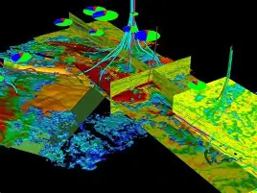
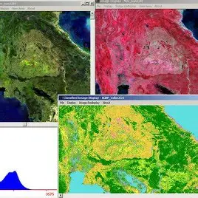
AI Seismic Data Analyzer
Prepared by: Nilansh Kohli

Slide 2
Project Overview
Objective: Automate seismic data analysis using AI/ML
Scope: Real-time analysis, pattern detection, anomaly alerts
Stakeholders: Geologists, Data Scientists, Operations, IT
Outcome: Reduce human intervention and improve data interpretation
Timeframe: 3-month agile release cycle

Slide 3
Problem Statement
Manual seismic data analysis is time-consuming
Difficulty in identifying subtle patterns and anomalies
Delays in decision-making and risk mitigation
Traditional methods are prone to human error
No real-time alert mechanism exists

Slide 4
Proposed Solution
AI-powered system to process and analyze seismic signals
Detect seismic patterns and flag anomalies in near real-time
Improve accuracy and response time
Provide intuitive UI for geologists
Enable integration with legacy systems

Slide 5
Goals and Objectives
Automate data preprocessing and filtering
Identify seismic events with high accuracy
Provide real-time dashboards and alerting system
Ensure scalability for large datasets
Improve stakeholder decision-making

Slide 6
Agile Methodology
Scrum framework
2-week sprints
Daily stand-ups, sprint reviews, retrospectives
Product backlog maintained in JIRA
Burndown charts used for progress tracking

Slide 7
Team Roles
Product Owner: [John Smith]
Scrum Master: [Bilklinton warne]
Development Team: AI Engineers, Geophysicists, Data Scientists, UI/UX Developers
QA Engineer: Responsible for validation and test automation
DevOps: Setup CI/CD pipeline and monitoring

Slide 8
Sprint Planning
Sprint 1: Data collection & preprocessing pipeline
Sprint 2: Model training (anomaly detection)
Sprint 3: Dashboard design & integration
Sprint 4: Alert system setup
Sprint 5: End-to-end testing and stakeholder demo

Slide 9
Architecture Diagram
Data Ingestion → Data Preprocessing → AI Models → Dashboard/Alerts
Tools: Python, TensorFlow, AWS, Apache Kafka, React
Real-time streaming with Kafka
Storage on S3, analysis on EC2

Slide 10
Technology Stack
Programming: Python, JavaScript
ML Framework: TensorFlow, Scikit-learn
Backend: Flask, FastAPI
Frontend: React.js
Cloud: AWS S3, Lambda, EC2
Data Stream: Apache Kafka
Visualization: Plotly, D3.js

Slide 11
Model Design
Input: Raw seismic signals
Preprocessing: Noise filtering, normalization
ML Model: CNN + LSTM for pattern recognition
Output: Event classification and risk score
Training data sourced from labeled seismic archives

Slide 12
Dashboard Overview
Real-time event map
Time-series plots
Risk scoring by location
Alert history and logs
Downloadable reports for audit

Slide 13
Risk & Mitigation Plan
Data quality issues → Implement rigorous validation
Model bias → Regular re-training with new data
Integration delays → Parallel testing of components
Team dependency risks → Regular sync-ups
Scalability risks → Use of microservices architecture

Slide 14
Key Achievements (To Date)
Seismic dataset collected and cleaned
Base ML model trained and evaluated
Initial version of dashboard deployed
Stakeholder feedback loop established
Achieved 92% accuracy in anomaly detection

Slide 15
Next Steps
Enhance model with more labeled data
Improve UI/UX of dashboard
Pilot deployment in real-world environment
Continuous monitoring and improvements
Expand integration with external APIs

Slide 16


