Slide 1

Alteryx
Alteryx is a data analytics and automation platform that helps users prepare, blend, and analyze data from various sources using a drag-and-drop interface. It enables users to build complex workflows for data manipulation, analysis, and automation without needing extensive coding knowledge.
Prepared by – SAURABH SONARE

Slide 2

Executive Summary
•Project Goal:
To develop a custom Alteryx solution to streamline data workflows and automate key analytical processes.
•Problem Solved:
Addresses inefficiencies, manual data handling, and delays in current data preparation and analysis.
•Importance:
Critical for enabling data-driven decision-making, improving operational efficiency, and gaining competitive advantage.
•How it Helps:
Empowers business users with self-service analytics, reduces reliance on IT for routine reports, and accelerates insights.
•Success Vision:
A fully integrated Alteryx platform enabling rapid data blending, advanced analytics, and automated reporting across departments, leading to faster, more accurate insights.

Slide 3
Introduction
What is Alteryx?
A leading data analytics and process automation platform.
Enables data preparation, blending, analysis, and deployment.
Visual, drag-and-drop interface, minimal coding required.
Project Context:
Our commitment to leveraging advanced analytics for business growth.
Developing Alteryx in-house to tailor solutions to specific organizational needs.
Agile Approach:
Adopting Agile methodology for flexible, iterative development.
Focus on continuous delivery, stakeholder collaboration, and rapid adaptation.

Slide 4
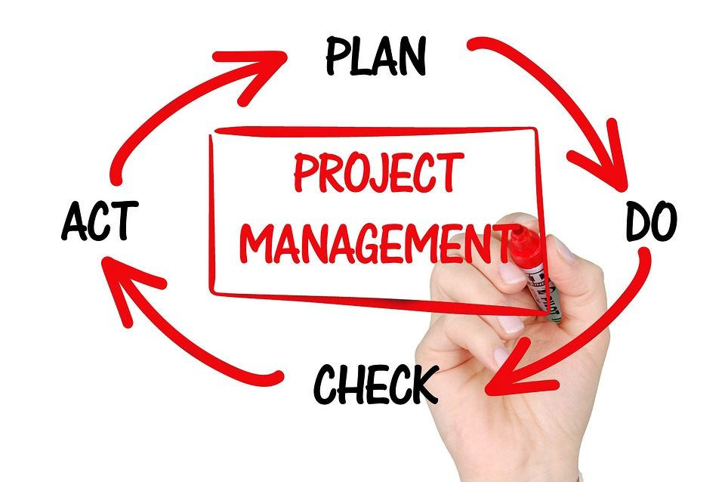
Project Background
History of the Problem:
  Growing data volumes and complexity over the past X years.
  Manual, spreadsheet-driven processes leading to errors and bottlenecks.
  Current tools lack integration and automation capabilities.
  Statistics: e.g. 50% of analyst time spent on data prep, reporting cycle takes 3 days.
Relation to Business Goals:
  Directly supports strategic objectives of operational efficiency and data democratization.
  Enables quicker market response and informed strategic planning.
  Aligns with our digital transformation roadmap and drive for innovation.

Slide 5

Current Situation
Situation:
Disparate data sources across departments, leading to fragmented views and inconsistent reporting.
Manual data collection and aggregation are common practices.

Slide 6

Problem
Time-consuming manual data cleaning and transformation processes result in significant delays and increased risk of errors.
Lack of scalable automation for repetitive analytical tasks hinders productivity and timely insights.
Dependency on specialized technical teams for routine data requests creates bottlenecks and limits business agility.
Inefficient data workflows lead to delayed insights, increased operational costs, and reduced analytical capacity.

Slide 7

Opportunity
Leverage Alteryx's capabilities to build a robust, user-friendly data analytics platform.
Empower business users with self-service analytics and process automation.
Unlock new analytical insights and drive data-driven innovation across the organization, transforming data into a strategic asset.

Slide 8
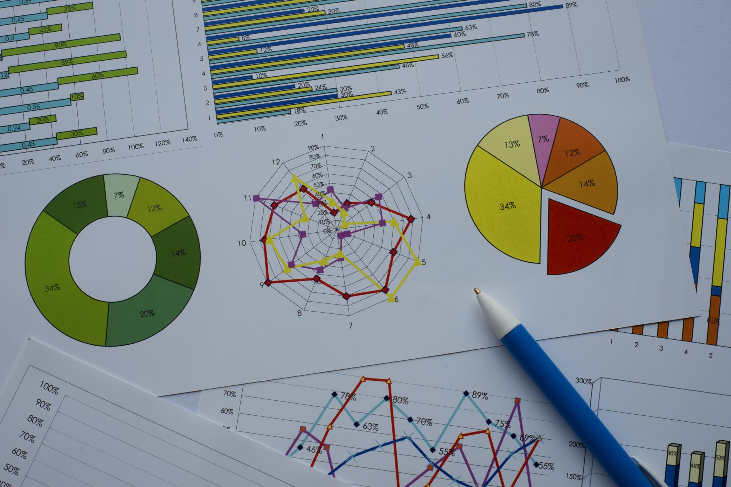
Purpose Statement
Overarching Goal:
To establish an agile, scalable, and intuitive Alteryx data analytics platform that empowers business users to independently prepare, analyze, and deploy data, thereby accelerating decision-making and optimizing operational efficiency.
Key Objectives:
Automate at least X critical data preparation workflows within the next 12 months.
Integrate Y key data sources (e.g., CRM, ERP, Web Analytics) into a unified analytical environment within 6 months.
Enable Z business functions (e.g., Marketing, Sales, Finance) to self-service their reporting needs, reducing reliance on IT by 40%.
Reduce manual data handling errors by 40% in target workflows, improving data accuracy.

Slide 9
Proposed Solution - Overview
How We Will Solve It:
Design and develop custom Alteryx workflows and applications tailored to specific business needs.
Establish robust data connectors to various source systems (databases, cloud platforms, APIs).
Implement user-friendly interfaces within Alteryx for data input, manipulation, and output.
Provide comprehensive training programs and ongoing support for business users to foster adoption.
Why It Will Be Effective:
Alteryx's visual interface significantly reduces learning curves and empowers business analysts directly.
Automation features eliminate manual errors, save significant time, and free up resources for higher-value activities.
Scalability ensures the solution can handle increasing data volumes and evolving business requirements.
The Agile approach ensures continuous alignment with evolving business requirements and rapid iteration based on feedback.
Why It's Better Than Alternatives:
Offers a unique balance of powerful data manipulation and user-friendliness compared to code-heavy ETL tools or basic spreadsheet-based solutions.
More flexible and integrated than siloed point solutions, providing an end-to-end analytics platform.
Lowers total cost of ownership by reducing reliance on external consultants or highly specialized IT resources for routine tasks.
What It Would Take:
Dedicated, cross-functional project team (Business Analyst, Alteryx Developer, Data Engineer).
Collaborative access to source data systems and active participation from relevant business stakeholders.
Support from IT for infrastructure provisioning, security configurations, and data access.

Slide 10
Project Objectives
Solution Selection Criteria:
Functionality: Meets specific data preparation, blending, advanced analytics, and reporting needs.
Scalability: Capable of handling increasing data volumes, complexity, and user concurrency efficiently.
Usability: Highly intuitive for business users with minimal specialized training, promoting self-service.
Security: Complies with all internal and external data governance, privacy, and security policies.
Integration: Seamlessly connects with existing enterprise systems (e.g., databases, CRM, ERP, cloud storage).
Specifications and Requirements:
Detailed user stories capturing explicit functional and non-functional requirements for each workflow/application.
Comprehensive data source mapping, data lineage, and transformation rules defined.
Performance benchmarks established for key workflows (e.g., processing time, data output accuracy).
Clear definitions of data quality standards and validation checks.
Solution Prototyping and Testing:
Iterative development of Minimum Viable Products (MVPs) and prototypes for early and frequent feedback.
User Acceptance Testing (UAT) conducted in short, focused cycles with end-users.
Continuous integration and regression testing embedded throughout sprints to ensure stability.
Performance testing to validate scalability and efficiency.

Slide 11
Methods / Approach
Agile Framework: Scrum
Team Structure:
Project Manager: Oversees the overall project, manages timelines, budget, resources, and stakeholder communication. Ensures project objectives are met and acts as a point of contact for high-level issues.
Product Owner: Defines and prioritizes the Product Backlog, represents stakeholder needs, and ensures the development efforts align with business value. They are the voice of the customer.
Scrum Master: Facilitates the Scrum process, helps the team adhere to Scrum principles, and removes any impediments that hinder the team's progress. They also coach the team in self-organization and cross-functionality.
Business Analyst: Bridges the gap between business needs and technical solutions. Gathers and documents requirements, creates user stories, and ensures the Alteryx solutions meet the defined business objectives.
Alteryx Developer(s): Design, build, test, and deploy Alteryx workflows, macros, and analytical applications. They are experts in Alteryx Designer and Server.
Data Engineer (or Data Architect): Responsible for establishing robust data connectors, ensuring data quality, optimizing data pipelines, and managing the overall data infrastructure that feeds into Alteryx.
Tester(s) / QA Analyst(s): Responsible for planning and executing various levels of testing (unit, integration, system, user acceptance) to ensure the quality, accuracy, and performance of the Alteryx solutions. They identify defects and ensure adherence to requirements.

Slide 12
Phases & Activities:
1. Inception/Discovery (Pre-Sprints):
High-level visioning workshop with key stakeholders.
Initial identification of high-value use cases for Alteryx.
Creation of an initial Product Backlog (Epics, Features).
Team formation and roles definition.
2. Sprint Planning (Start of each Sprint):
Sprint Length: 2-3 weeks (e.g., 2-week sprints).
Team selects items from the Product Backlog to create the Sprint Backlog.
Define the Sprint Goal: What will be delivered by the end of the sprint.
Break down selected items into smaller, actionable tasks.
3. Development Sprints (Ongoing):
Daily Scrums (15 min): Team synchronization ("What did I do yesterday?", "What will I do today?", "Any impediments?").
Alteryx Workflow Design & Development: Iterative building of Alteryx workflows, macros, and analytic apps.
Continuous Testing: Unit testing, integration testing, and peer reviews of workflows.
Stakeholder Collaboration: Regular informal check-ins and feedback loops.
4. Sprint Review (End of each Sprint):
Formal demonstration of the "Done" (shippable) increment to stakeholders.
Gather feedback on delivered functionality.
Collaboratively inspect the Product Backlog and adapt as needed.
5. Sprint Retrospective (End of each Sprint):
Team reflection on "What went well?", "What could be improved?", "What will we commit to changing?".
Process adjustments for the next sprint.
6. Release Planning (Periodically):
Regular releases of shippable increments to production or UAT environments.
May occur after several sprints, depending on business readiness.

Slide 13
Sprint Planning Structure
Sprint 0 — Project Kickoff & Setup (Week 1–2)
Define project vision and success criteria
Identify key data sources and business use cases
Set up Alteryx Designer, version control, and JIRA
Perform initial stakeholder interviews
Sprint 1 — Data Ingestion and Basic Workflow Design (Week 3–4)
Import sample datasets (CSV, SQL, APIs)
Create basic workflows to cleanse and join data
Demonstrate initial outputs to stakeholders
Collect feedback and backlog new tasks
Sprint 2 — Advanced Data Prep & Logic (Week 5–6)
Implement filters, formulas, and conditional logic
Design reusable macros
Introduce error handling and logging
QA and test performance
Sprint 3 — Reporting & Output Deployment (Week 7–8)
Generate reports using Alteryx Reporting tools
Export data to Tableau, Excel, or database
Begin setting up Alteryx Server (if used)
User feedback session
Sprint 4 — Automation and Scheduling (Week 9–10)
Set up scheduled jobs on Alteryx Server
Test and validate automation
Document the process and workflows
Train end-users or analysts
Sprint 5+ — Iteration, Optimization, & Enhancements
Optimize workflows for runtime and scalability
Incorporate user feedback
Add new data sources or outputs
Refine scheduling and monitoring strategies

Slide 14

Deliverables & Success Criteria
Key Project Deliverables:
Functional Alteryx workflows for specific processes, e.g., "Automated Sales Forecasting Model," "Marketing Campaign ROI Analysis Dashboard," "Supply Chain Inventory Optimization Report"].
Deployed Alteryx Server applications for collaborative access and scheduling.
Comprehensive user documentation, training modules, and FAQs.
Performance monitoring dashboards for Alteryx job execution and data refresh.
Post-implementation support framework.

Slide 15

SMART Objectives (Examples):
Specific: Automate the monthly sales report generation process from raw data to final dashboard using Alteryx.
Measurable: Reduce monthly sales report generation time from an average of 8 hours to 1 hour by Q4 2025; achieve 99% data accuracy in the generated reports.
Achievable: Leverage existing Alteryx licenses, dedicated development team, and proven Alteryx capabilities.
Realistic: Based on comparable Alteryx implementations in other departments/companies, with appropriate resource allocation.
Time-Bound: 27 Weeks
Measuring Success:
User adoption rates of new Alteryx applications (e.g., 75% active users within 3 months of launch).
Quantifiable time savings and efficiency gains across target departments.
Reduction in reported data errors and manual rework.
Results from stakeholder satisfaction surveys and feedback sessions.
Achievement of all defined SMART objectives.

Slide 16
Required Resources & Budget
Project Team (Salaries):
1 x Project Manager (Part-time, 25-50% allocation, depending on project complexity and PM's other responsibilities)
1 x Business Analyst (Full-time, 100% allocation or part-time, 50% allocation if shared across projects)
1-2 x Alteryx Developer(s) (Full-time, 100% allocation each)
1 x Data Engineer (Part-time, 25-50% allocation for data source integration, optimization, and governance)
1 x Tester / QA Analyst (Part-time, 50% allocation, focused on functional and data quality testing)
Scrum Master (Role may be combined with PM, BA, or a lead developer initially, or a dedicated role for larger projects)
Tools & Software:
Alteryx Designer & Server Licenses (if not already procured, specify number of seats/cores).
Version Control System (e.g., Git, integrated with development environment).
Agile Project Management Tool (e.g., Jira, Azure DevOps, Trello).
Communication & Collaboration Tools (e.g., Slack, Microsoft Teams).

Slide 17


Estimated Project Budget: Personnel Costs:40-60 Lakhs
  Software Licenses/Subscriptions: 8-16 Lakhs.
  Infrastructure/Cloud Costs:5-10 Lakhs.
  Project Management Tools:1-2 Lakhs.
  Training & Support Materials: 2-4 Lakhs
  Contingency Fund: 3-5 Lakhs.
  Total Estimated Budget:60-95 Lakhs
Infrastructure:
  Cloud resources (e.g., AWS, Azure, GCP instances) or on-premise servers for Alteryx Server deployment.
  Secure network access and bandwidth for data transfers.
  Database access and credentials for all required data sources.

Slide 18
Risks and Dependencies
Key Risks:
Data Quality Issues: Inaccurate, inconsistent, or incomplete source data significantly impacting Alteryx output and analytical results.
Mitigation: Implement robust data profiling, Alteryx-based data validation rules, establish clear data governance initiatives, and collaborate with data owners.
User Adoption Challenges: Resistance to new tools, lack of perceived value, or insufficient training leading to low utilization of the Alteryx platform.
Mitigation: Comprehensive and continuous training programs, establish an internal "Alteryx Champion" network, ongoing support and feedback channels, user-friendly design, and clear communication of benefits.
Scope Creep: Uncontrolled expansion of project requirements beyond initial definition, potentially delaying delivery and increasing costs.
Mitigation: Strict adherence to sprint goals, clearly defined user stories with acceptance criteria, strong Product Owner role for backlog management, and transparent change management process.
Technical Complexity: Unexpected challenges in integrating disparate data systems, API limitations, or performance bottlenecks with large datasets.
Mitigation: Conduct early proof-of-concept for complex integrations, involve experienced Data Engineers, maintain close collaboration with IT and source system owners.
Resource Availability: Key team members or stakeholders not being available as needed, impacting progress.
Mitigation: Secure dedicated resource allocation, proactive scheduling, and clear communication of commitment expectations.

Slide 19
Dependencies:
Availability of key business stakeholders for active participation in requirements gathering, feedback sessions, and User Acceptance Testing (UAT).
Timely access to required source data systems, APIs, and necessary credentials from IT/data owners.
Sufficient IT support for infrastructure setup, server maintenance, security configurations, and network access.
Readiness of existing Alteryx licensing and environment (if applicable) or timely procurement of new licenses.
Clear definition and agreement on data governance policies.

Slide 20
Conclusion / Call to Action
Recap: This Alteryx development project, strategically guided by Agile principles, offers a transformative opportunity to significantly enhance our data analytics capabilities.
Value Proposition: It will automate critical, time-consuming processes, empower our teams with self-service analytics, and facilitate faster, more informed, and agile business decisions.
Strategic Fit: Directly aligns with our strategic goals for operational efficiency, fostering innovation, and democratizing data access across the organization.
Request for Approval: We request your approval to proceed with the initiation of this project, enabling us to unlock the full potential of our data assets and drive significant business value.
Next Steps: [e.g., "Schedule Project Kick-off Meeting," "Finalize Resource Allocation and Budget Approval," "Begin detailed Product Backlog Refinement"].
Thank You

