Slide 1
Agile Project – Audit Data Request Automation (Transition)
Work Force Management
Suman Samaiya | Business Analyst
Date: 10/22/2025

Slide 2
SITUATION
The organization’s audit data request process is currently managed through emails, spreadsheets, and manual tracking.
Auditors send data requests to multiple departments via email, and business users respond with attachments or links.
Managers use Excel files to monitor request completion.
This decentralized approach results in limited visibility, inconsistent tracking, and delays in audit readiness.
Over time, as the audit volume increased, it became really difficult to manage — there was no single source of truth, no visibility on request status, and a lot of back-and-forth communication.”

Slide 3
PROBLEM
Since everything was manual, it led to a few major pain points:
Requests often got missed or delayed since there was no automated tracking.
Auditors and management couldn’t see pending or completed requests in real time.
There was no accountability — no proper audit trail of who responded and when.
And it consumed a lot of time in follow-ups instead of focusing on audit analysis itself.
So basically, inefficiency and lack of visibility were the biggest challenges.

Slide 4
Opportunity
By developing a centralized Audit Support Web Application, the organization can:
Streamline the end-to-end audit request lifecycle.
Improve visibility through real-time dashboards and automated notifications.
Reduce manual errors and follow-ups with structured workflows.
Enhance collaboration between auditors, departments, and managers.
Ensure audit compliance and readiness with better data governance and traceability.

Slide 5
Project Overview
Goal: Centralized platform to manage audit requests
Problem: Manual emails and Excel tracking, lack of visibility
Solution: Web app with request tracking, dashboards, notifications

Slide 6
Purpose Statement (Goals)
To create a centralized Audit Support Application that helps auditors and business teams manage,
track, and complete audit data requests efficiently — replacing the manual, email-based process.
Eliminate Email Chaos — Move from scattered email chains to a centralized request platform.
Improve Transparency — Track real-time progress of each audit request.
Enhance Accountability — Assign owners, set deadlines, and log audit evidence.
Enable Reporting — Provide dashboards on request status, turnaround time, and SLA breaches.
Ensure Compliance & Security — Control access and maintain data integrity.
The current process of handling audit data requests for 401k pension retirement plans is email-based,
causing inefficiencies, delays, and lack of transparency.
The project aims to automate and streamline the process using WFM as a centralized platform to track,
manage, and fulfill auditor data requests efficiently.

Slide 7
Success Criteria
Reduced audit request turnaround by 45%.
Improved tracking and accountability.
Enhanced transparency with live dashboards.
Ensured compliance documentation within SLAs.

Slide 8
Project Resources
People:
Project team members from both the client business community and IT Services (ITS) teams, including:
Product Owner
Business Analyst
Developers
QA Testers
Scrum Master
Stakeholder Representatives
Time:
The project is planned to be implemented within 6 months, following Agile delivery in multiple 2-week sprints (Sprint 0 to Sprint 4).

Slide 9
Budget:
Estimated budget covering hardware, software, training, and services — not to exceed ₹ 25 Lacs
Other Resources:
Third-party software evaluation for workflow and document management tools
Site visits and user interviews for process validation

Slide 10
Risks and Dependencies
Risks:
User Adoption Risk:
The current manual process has been in place for several years and is intuitive to existing users. Transitioning to a new digital platform may lead to resistance or slower adoption without proper training and change management.
Cost Justification Risk:
It may be challenging to quantify the business value of improvements such as ease of use, data quality, speed, and support efficiency in a way that clearly demonstrates ROI (Return on Investment) to senior management.
Technical Integration Risk:
Integration with existing systems (email, data repositories) may require additional configuration and could delay initial sprints.

Slide 11
Dependencies:
Stakeholder Availability: Timely input and feedback from auditors and business users are critical for refining backlog items and validating sprint outcomes.
Infrastructure Readiness: Availability of servers, access controls, and database setup before development starts.
Third-party Tools: Dependence on selected software or external data sources (e.g., reporting tools or audit document repositories).

Slide 12
Agile Team
Product Owner: Vision & backlog prioritization
Scrum Master: Facilitate Scrum ceremonies
Business Analyst: Suman – Requirements & user stories
Developers: – Build modules
QA: – Test & validate
UX/UI Designer: – UI & wireframes

Slide 13
BA Responsibilities During Sprint 0 (Initiation Phase)
“As part of Sprint 0, the Business Analyst focused on understanding existing processes, defining user needs, and preparing the initial product backlog.”
Day | Activity | Output
Day 1–2 | Stakeholder Interviews | Meeting notes & key requirements
Day 3 | Define “As-Is” & “To-Be” process | Workflow diagrams
Day 4 | Draft Epics and Backlog | Product backlog document
Day 5 | Backlog Refinement with Team | Refined user stories with points & acceptance criteria
Outcome: Clear epics and refined backlog ready for Sprint 1 planning.

Slide 14
Requirement Gathering – Approach and Techniques
As a Business Analyst, the requirements were gathered using multiple elicitation techniques:
1. Stakeholder Interviews: Conducted with auditors, audit support team, and compliance officers.
2. Workshops and JAD Sessions: Collaborated to understand workflow pain points and desired automation.
3. Observation: Monitored live audit request handling to capture bottlenecks.
4. Document Analysis: Reviewed email logs, historical data request forms, and SLA reports.
5. Prototyping: Used process flows to validate initial user stories.
6.Prioritization: Defined and refined epics for Sprint 1 readiness in alignment with business priorities.
Outcome:
Clear understanding of current and future processes.
Validated user requirements and pain points.
Initial Product Backlog and Epics prepared for Sprint 1 Planning.

Slide 15
Current (As-Is) Process
Auditor sends an email to request data from the business team.
Business users acknowledge (or sometimes miss) the request.
Data is collected manually and shared via attachments.
No centralized tracking, reminders, or dashboards.
Auditors often chase updates through multiple threads.
Pain Points:
Missing or delayed responses
No visibility on progress or deadlines
Duplication of requests
Manual tracking using Excel
Poor accountability

Slide 16
Proposed (To-Be) Process
Auditor logs into the Audit Support Application.
Creates a new data request with fields like: Request Type, Description, Due Date, Business Owner.
Business users receive a notification and upload the requested data.
The system tracks progress, deadlines, and completion status.
Managers view dashboards summarizing SLA performance and bottlenecks.

Slide 17
Product Backlog- Audit Support Web Application
Subtitle: Prioritized list of Epics and User Stories
 | Epic Name | Example User Stories | Priority | Story Points | Business Value
E1 | 📋 Request Management | US1 – Create Request US2 – View Requests US3 – Edit / Close Request | High | 11 | 10
E2 | 📂 Data Upload & Response | US4 – Upload Data US5 – View Uploaded Files | Medium | 8 | 9
E3 | 📊Dashboard & Reports | US6 – Dashboard Overview US7 – Generate Reports | Medium | 13 | 8
E4 | 🔔 Notifications & Alerts | US8 – Email Alerts US9 – Due Date Reminders | Medium | 5 | 7
E5 | 🔐 User Roles & Security | US10 – Role-based Access US11 – Reset Password | High | 11 | 9
Summary:
1. Total Estimated Story Points: 48
2. Planned Sprints: 5 (2 weeks each)
3. Sprint 1 Focus: Request Management (E1)

Slide 18
Sprint 1 Backlog
Request management
Epic | User Story | Priority | Story Points | Business Value | Acceptance Criteria (Summary)
E1 | As an auditor, I want to create a new audit data request, so I can request information from business users. | High | 5 | 10 | Form should capture request type, due date, and assign business owner.
E2 | As an auditor, I want to view all my requests so that I can monitor progress. | High | 8 | 9 | My Requests” page lists all open and completed requests.
E3 | As an auditor, I want to edit or close a request so that I can manage them easily. | High | 8 | 9 | Auditor can edit open requests or close completed ones, with changes saved, status updated, confirmation shown, and the request becoming read-only after closure.

Slide 19
Epics
Epic ID | Epic Name | Description
E1 | Create Request | Auditors can raise and submit new audit data requests.
E2 | View Request | As an auditor, I want to view all my requests so that I can monitor progress.
E3 | Edit / Close Request | As an auditor, I want to edit or close a request so that I can manage them easily.

Slide 20
User Story
US1: As an auditor, I want to create a new request
Acceptance Criteria:
1. Request form captures mandatory fields: Title, Department, Due Date
2. Unique Request ID auto-generated
3. Request gets assigned to correct support queue
4. Error messages for missing fields
5. Confirmation notification sent automatically

Slide 21
Sprint 1 Overview
Duration: 2 weeks
Goal: Enable auditors to create, view, and close requests
User Stories: US1 – Create Request, US2 – View Requests, US3 – Edit/Close Request
BA Contribution: Defined stories, clarified acceptance criteria, supported Dev & QA teams

Slide 22
Sprint 1 Burndown Chart
• User Story 1: Auditors can raise and submit new audit data requests..
• User Story 2: As an auditor, I want to view all my requests so that I can monitor progress.
• User Story 3: As an auditor, I want to edit or close requests so that I can manage them easily.
Sprint Duration: 2 Weeks
Deliverables: Enable auditors to create, view, and close requests.

Slide 23
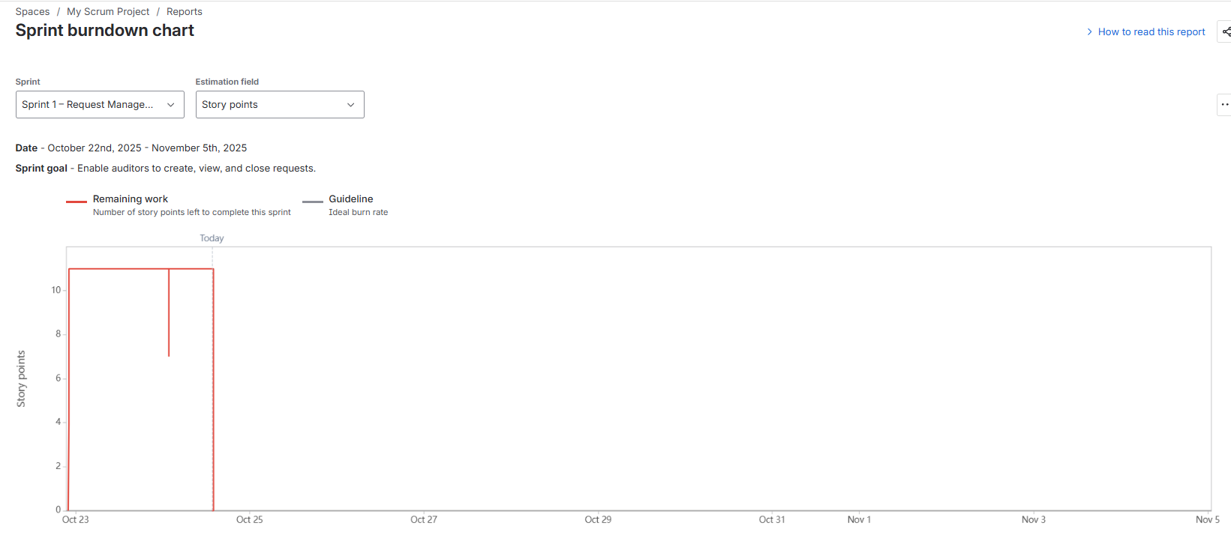
Total 11 story points completed.

Slide 24
Sprint Review & Retrospective
What Went Well: Clear user stories, smooth collaboration, timely delivery
What Can Improve: Deliver UI mockups earlier, start QA mid-sprint,
Action Items:
  BA to prepare ACs before sprint start
  UX to deliver designs before Day 1
  QA to start testing by Day 6

Slide 25
Key Outcomes & Benefits
After completing Sprint 1, the team successfully delivered core functionalities that
enhanced visibility, efficiency, and collaboration within the audit support process.
Reduced audit turnaround time by 45% through streamlined request tracking
Improved visibility and accountability via centralized dashboards
Enhanced cross-team collaboration with automated status updates
Eliminated email-based tracking using a unified portal for audit requests
Established a foundation for upcoming sprints (data upload, reporting, notifications)
Outcome: A more transparent, efficient, and auditable process ready for scale.

