Slide 1
Learning Management System (LMS)
Prepared By: Ch. Pavan Kumar
Date: 01-10-2025

Slide 2
Executive Summary
Problem: Current student learning is fragmented (courses, resources, evaluation booking).
Importance: Leads to inefficiency, poor progress tracking, and higher admin load.
Solution: A centralized LMS using the Waterfall model.
Success: 90% adoption in 3 months, automated booking, transparent dashboards, reduced manual work.

Slide 3
Situationship
Students currently use multiple platforms for courses, notes, and video learning.
Trainers manually coordinate project evaluation slots, leading to scheduling conflicts.
Course progress tracking is inconsistent and students cannot see pending/completed tasks clearly.
Institutions face difficulties in monitoring overall student engagement and learning outcomes.
Admin overhead is high due to lack of automation and centralized reporting

Slide 4
Problem
Fragmented Access: No single platform where students can access all resources.
Manual Evaluation Booking: Time-consuming for both students and trainers.
Lack of Progress Visibility: Students don’t know their exact learning stage, creating confusion.
Limited Engagement: No integrated video/YouTube resources, reducing interactive learning.
Institutional Challenges: Difficult for management to analyze student performance trends.

Slide 5
Opportunity
Centralized Learning Hub: All resources (courses, videos, downloads) in one system.
Automation: Streamline project evaluation booking and notifications.
Student Dashboard: Visual representation of completed and pending modules.
Digital Integration: Embed YouTube content for flexible and engaging learning.
Analytics & Reports: Provide institutions with insights into performance, usage, and student engagement.
Scalability: Expand LMS to handle large batches across multiple departments in future.

Slide 6
Purpose Statement (Goals)
Deliver a comprehensive Learning Management System that improves efficiency, accessibility, and engagement.
Provide students with 24/7 digital access to courses and resources.
Enable trainers to manage evaluations seamlessly.
Offer institutions a data-driven platform to measure progress and outcomes.
Ensure structured project delivery using the Waterfall approach for clarity and accountability.

Slide 7
Project Objectives
Requirement Gathering: Capture needs from students, trainers, and management.
System Design: Build user-friendly, mobile-friendly, and scalable design.
Course Module: Students can view course content, YouTube lectures, and materials.
Resource Downloads: Notes, PPTs, PDFs available for offline access.
Evaluation Booking System: Students schedule slots; trainers get automated notifications.
Progress Dashboard: Real-time tracking of course completion and pending tasks.
Admin Panel: For managing users, content, and reports.
Testing & Deployment: Deliver a reliable, error-free system.

Slide 8
Success Criteria
Student Adoption: 90%+ students actively use the LMS within first 3 months.
System Availability: 95%+ uptime with quick load times.
Automation Impact: 80% reduction in manual booking effort.
Improved Learning Outcomes: At least 20% improvement in assignment/project completion rates.
Trainer Satisfaction: 70%+ trainers report easier evaluation management.
Institutional Value: Improved data-driven reporting for decision making.

Slide 9
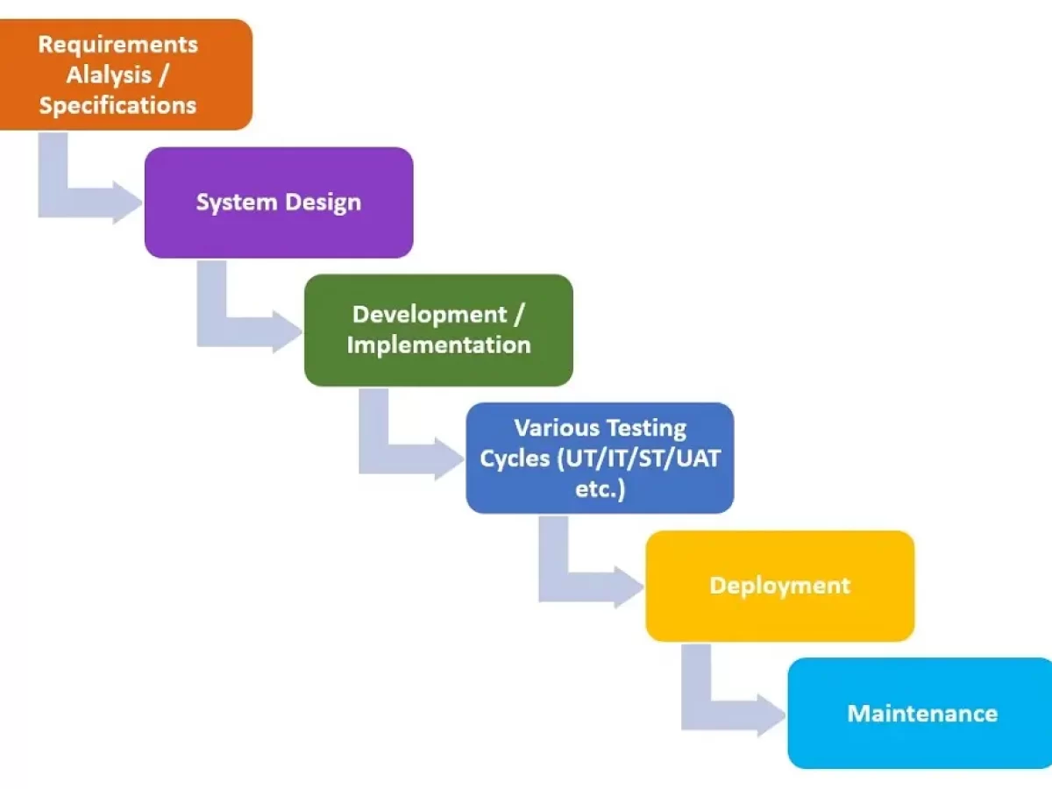
Methods / Approach (Waterfall Model)
Waterfall Model Diagram

Slide 10
Methods / Approach (Waterfall Model)
Requirements Gathering
  Conduct workshops with students, trainers, and admins.
  Document functional and non-functional requirements.
System Design
  UI/UX wireframes for student and trainer dashboards.
  Database design for courses, bookings, and reporting.
Implementation
  Develop in phases: Course module → Resource module → Evaluation booking → Dashboard → Admin.
Testing
  Unit testing, integration testing, UAT with pilot student group.
Deployment
  Launch LMS in a phased rollout.
  Provide initial training to students and trainers.
Maintenance
  Bug fixes, performance improvements, periodic feature updates.

Slide 11
Required Resources
People:
  Business Analyst (requirement gathering, documentation)
  Developers (frontend, backend, database)
  UI/UX Designers (interface design)
  Testers (quality assurance)
  Trainers & Students (pilot users, feedback)
Technology:
  Hosting server (cloud-based)
  Database system (SQL/NoSQL)
  APIs for YouTube integration
  Reporting/analytics tools
Time: 6–8 months structured delivery via Waterfall.
Budget: Development, hosting, testing, training, maintenance (detailed cost to be added).

Slide 12
Budget Breakdown
Category | Details | Estimated Cost (₹)
Development Costs | Salaries for developers (frontend, backend, DB), BA, QA testers for 6–8 months | ₹9,00,000
Infrastructure | Cloud hosting, database, storage, backups for 1 year | ₹2,50,000
Licensing & Tools | YouTube API (if paid), LMS framework, project management & testing tools | ₹1,50,000
Training & Change Management | Trainer workshops, student orientation, training material creation | ₹1,00,000
Maintenance & Support (Year 1) | Bug fixes, server monitoring, updates, helpdesk support | ₹2,00,000
Contingency (10%) | Buffer for unexpected costs (scope change, infra upgrade) | ₹2,00,000
Total Estimated Cost: ₹18,00,000

Slide 13
Risks
Adoption Risk: Students/trainers hesitant to shift to new system.
Technical Risk: YouTube API or server downtime may affect video content.
Time Overruns: Requirement changes in middle of Waterfall phases can delay project.
Cost Risk: Integration or infrastructure costs may exceed estimates.
User Training Risk: Lack of awareness could limit proper usage.

Slide 14
Dependencies
Infrastructure: Stable internet and server environment.
Stakeholder Commitment: Timely feedback from trainers and admins.
Content Availability: Courses, resources, and videos must be provided.
Approvals: Institutional/government approvals for LMS launch.
External Tools: Dependence on YouTube integration for video-based learning.

Slide 15
Conclusion
The LMS project directly addresses current challenges in student learning, trainer evaluations, and institutional reporting.
The Waterfall methodology ensures a structured, step-by-step approach with clear deliverables.
Benefits for stakeholders:
  Students: Easy access, progress tracking, flexible learning.
  Trainers: Automated evaluation management.
  Institutions: Better engagement analytics and reduced admin work.
This solution will transform the learning process, making it efficient, digital-first, and scalable.

Slide 16
Sign-off
To be completed by appropriate manager: Abhishek
Project Sponsor: Ravi Kiran
Project Manager: Atul Kumar
Approval Status: ☐ Approved ☐ Approved w/comments ☐ Not Approved
Planned Go-Live Date: 25/10/2025
Post-Implementation Review Date: 01/11/2025

