Slide 1
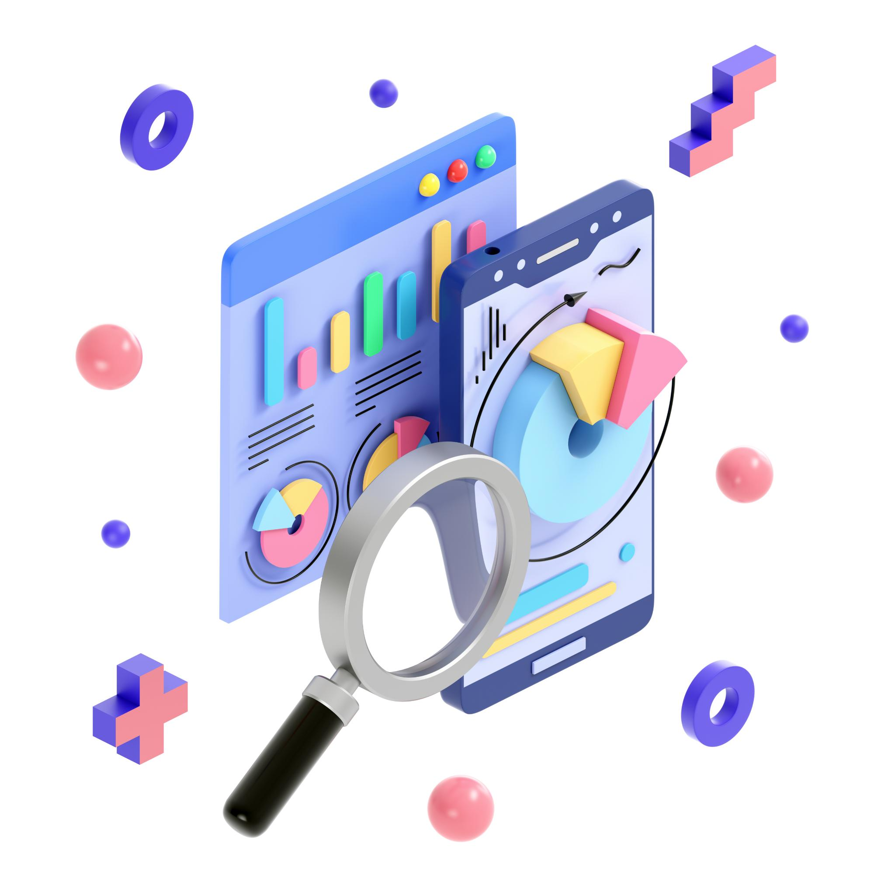
Alteryx Tool
Alteryx is a data analytics and automation platform that helps users prepare, blend, and analyze data from various sources using a drag-and-drop interface. It enables users to build complex workflows for data manipulation, analysis, and automation without needing extensive coding knowledge.

Slide 2

Identifying the Situation
Current State
Challenges
Opportunity

Slide 3
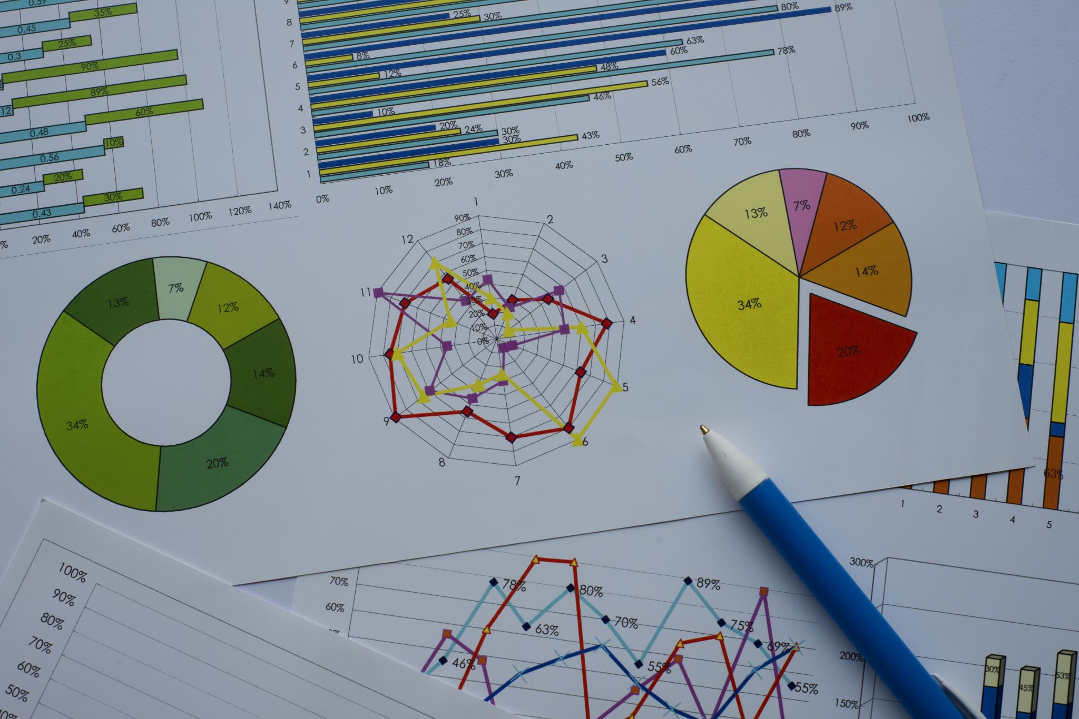
Purpose Statement
Primary Goal:
Implement a robust and intuitive data analytics solution using Alteryx.
Sub-goals:
Enhance ease of use and quality of information. Reduce system downtime and improve response times.
Enable a smooth transition from legacy systems to a modern, agile framework.

Slide 4
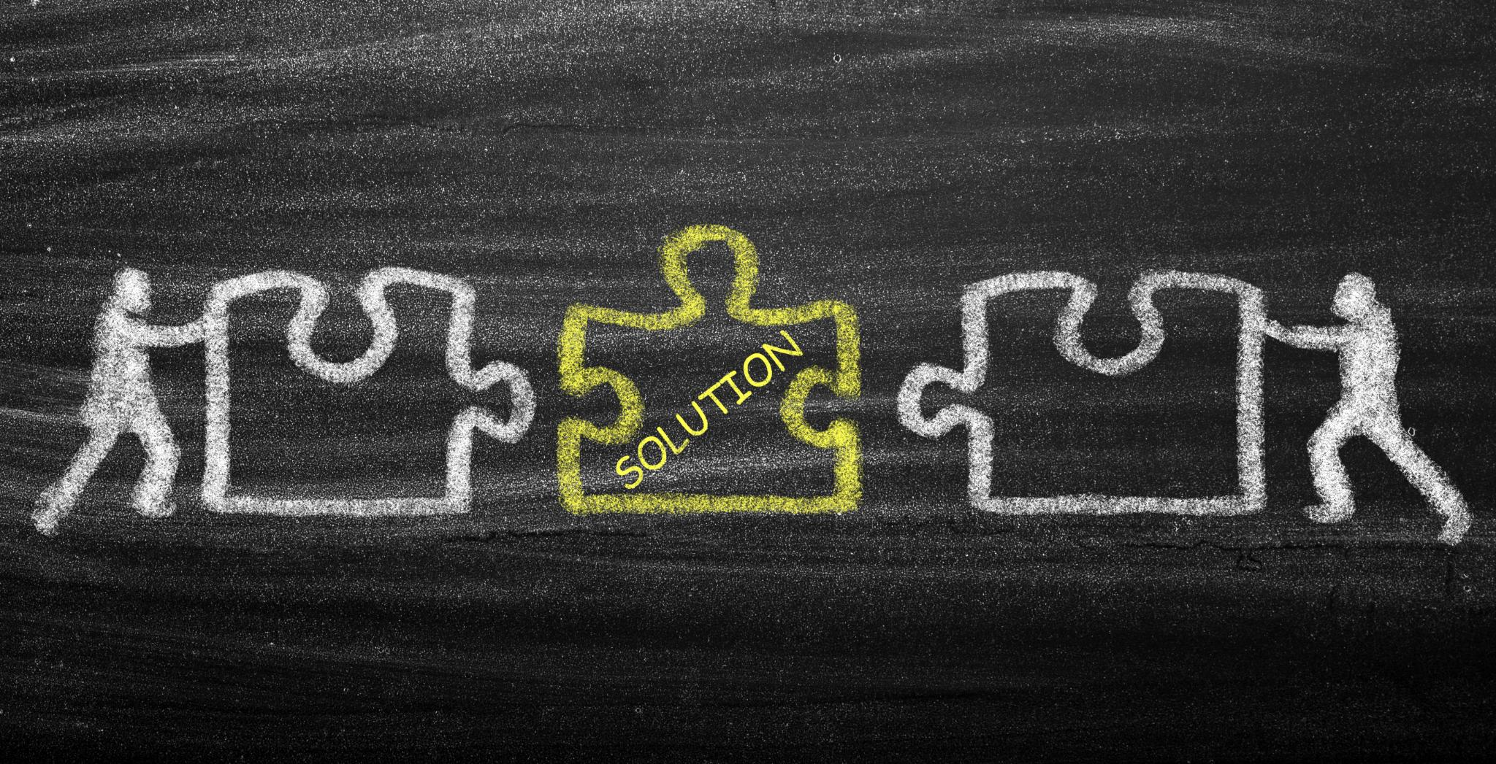
Project Objectives
Solution Selection:
Outline criteria and design specifications guiding vendor selection.
Ensure the chosen solution aligns with both technical requirements and business needs.
Prototyping & Testing:
Develop initial prototypes to validate design assumptions.
Conduct iterative testing to ensure the solution meets performance benchmarks and user expectations.

Slide 5

Success Criteria
Performance Metrics:
Increase records availability and seamless accessibility of information, collateral, forms, and documents.
Drastically reduce system downtime, wait times, and improve overall system response times.
User Experience:
Measurable improvements in user satisfaction.
Reduced learning curve and maintenance efforts.

Slide 6

Methods and Approach
Agile Methodology:
Adopt agile practices to drive iterative development and continuous feedback.
Step-by-Step Process:
Establish Selection Committee:
Define Requirements:
Vendor Selection:
Solution Implementation:
Go Live:
Transition to the new system with a focus on minimal disruption and continuous improvement.

Slide 7
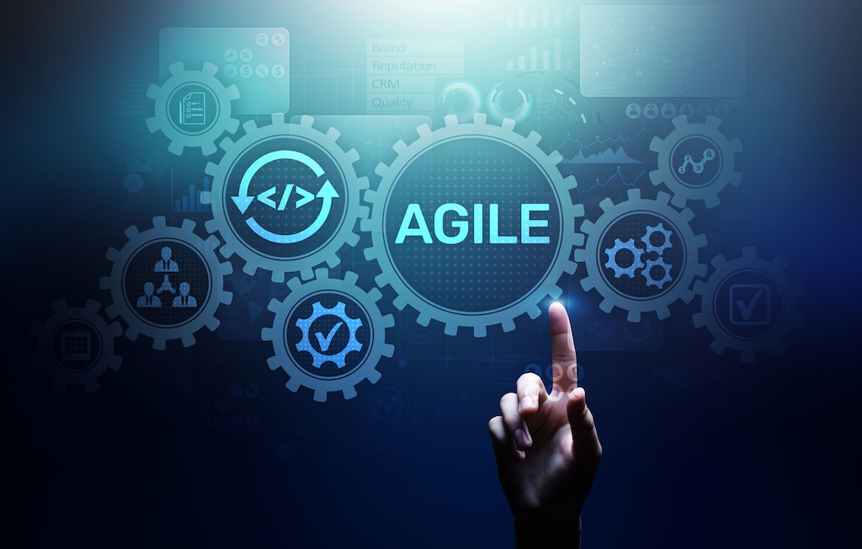
Agile Phases
Requirements Gathering
Design
Construction/Iteration
Testing
Deployment
Feedback/Continuous Improvement

Slide 8

Resource Allocation
Assemble a project team from client community.
Timeline for implementation.
Allocate budget for hardware and software.
Additional Resources

Slide 9
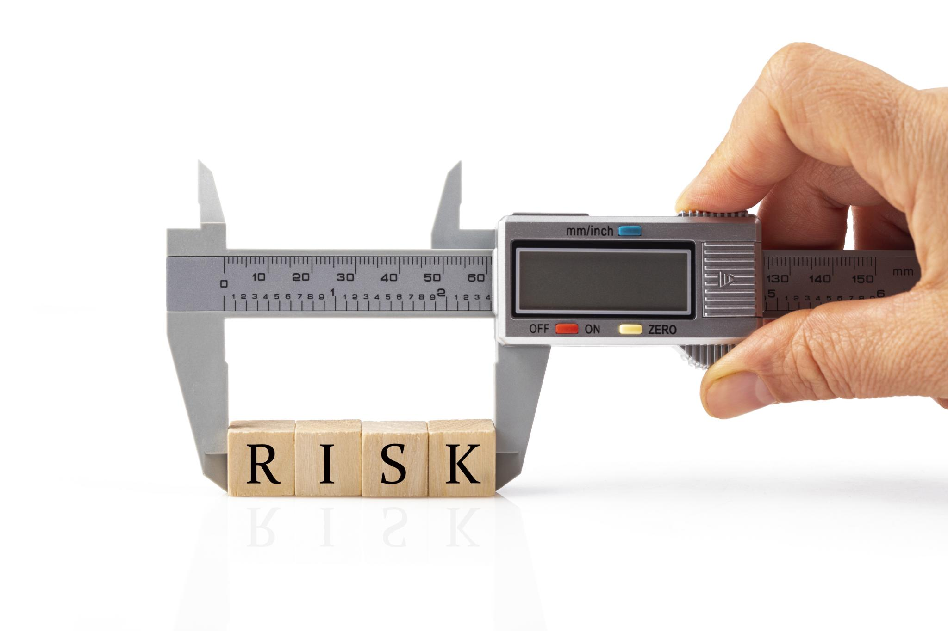
Risks and Dependencies
Existing Familiarity
Cost Justification Challenges
Mitigation Plans:

Slide 10
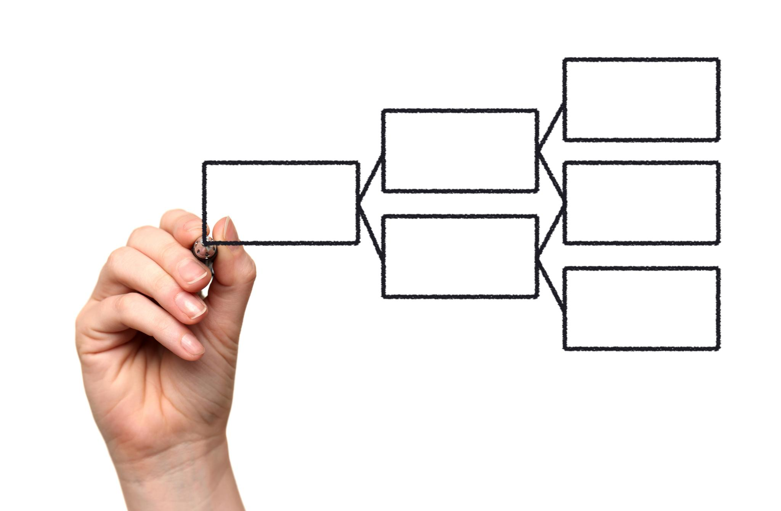
Conclusion
Alteryx can significantly improve data processes.
A well-defined project approach is essential.
Engagement from stakeholders is crucial for success.

Slide 11

Next Steps
Review and finalize project plan.
Begin vendor selection process.
Schedule training sessions for users.

