Slide 1

Minimizing Disruption, Maximizing Impact: Delivering Change & Release for Safe, Agile, and Reliable Digital Services
Presenter :- Sai Srinivas

Slide 2
Why This Matters
Digital transformation requires structured change and release management to avoid mere disruption, ensuring changes and releases are predictable, low-risk, and user-transparent.

Slide 3
My Role in Every Change
I have lead change and release management by acting as Architect, Operator, Advisor, and Collaborator to ensure smooth delivery.

Slide 4

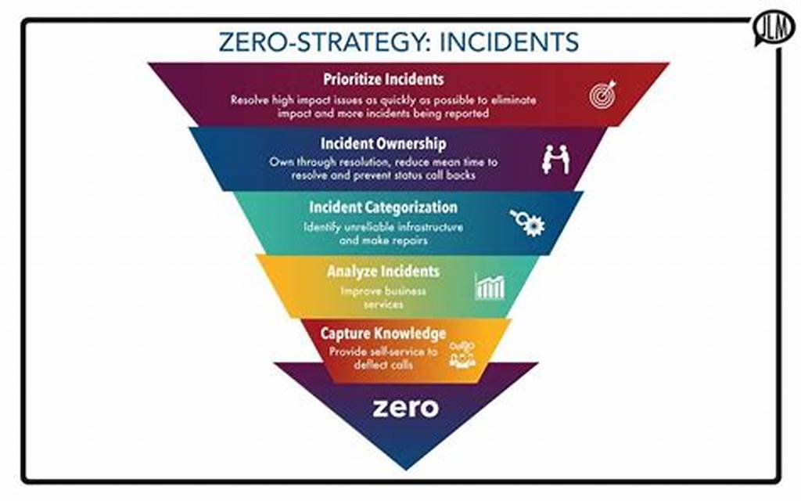
Building Governance – Post Office Modernisation
Project Overview
Key Achievement
The Strategic Platform Modernisation Programme covers over 11,500 branches and handles 7 million transactions daily.
Implemented new change policies and governance, resulting in zero critical incidents during the cutover phase.

Slide 5

Agile Release Excellence – Aviva & SQA
Aviva managed over 30,000 changes and release annually, implemented CI/CD, GDPR compliance, and platform upgrades, achieving a 99.8% change success rate.

Slide 6
Engineering Risk-Smart Change
Zero Downtime Achieved at TSB
TSB implemented runbooks, SOEs, and governance packs enabling weekend Dynamics 365 go-lives with zero downtime.
1
2
Comprehensive Change and release Management at NatWest
NatWest managed over 2500 changes during a global payments migration with full lifecycle oversight.

Slide 7
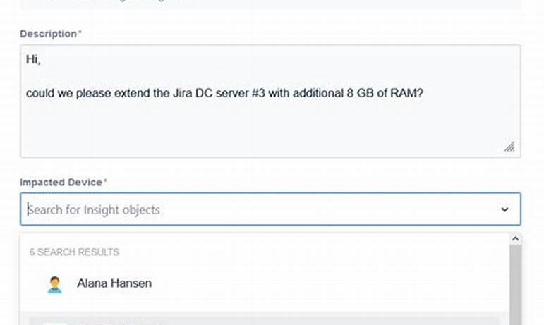
Change Management Framework
The framework utilizes ServiceNow, Jira, and Iceflo to manage change processes effectively.

Slide 8
Minimizing Disruption
1
Anticipating and Mitigating Risks
2
Ensuring Smooth Change Implementation
Pre-empting risk means identifying potential issues early and designing controls to mitigate them effectively.
Empowering teams with runbooks and governance, plus smart decisions and clear communication, ensures disruption-free changes.

Slide 9
Maximizing Impact
Repeatable, Scalable Release Process : Change acts as a value enabler by supporting stakeholder's trust and service reliability, ensuring agile and legacy systems coexist for sustainable, scalable release processes.

Slide 10
Thank You

