Slide 1
Agile Project – Audit Data Request Automation (Transition)
Work Force Management
Suman Samaiya | Business Analyst
Date: 10/22/2025

Slide 2
Project Overview
Goal: Centralized platform to manage audit requests
Problem: Manual emails and Excel tracking, lack of visibility
Solution: Web app with request tracking, dashboards, notifications

Slide 3
Purpose Statement (Goals)
To create a centralized Audit Support Application that helps auditors and business teams manage,
track, and complete audit data requests efficiently — replacing the manual, email-based process.
Eliminate Email Chaos — Move from scattered email chains to a centralized request platform.
Improve Transparency — Track real-time progress of each audit request.
Enhance Accountability — Assign owners, set deadlines, and log audit evidence.
Enable Reporting — Provide dashboards on request status, turnaround time, and SLA breaches.
Ensure Compliance & Security — Control access and maintain data integrity.
The current process of handling audit data requests for 401k pension retirement plans is email-based,
causing inefficiencies, delays, and lack of transparency.
The project aims to automate and streamline the process using WFM as a centralized platform to track,
manage, and fulfill auditor data requests efficiently.

Slide 4
Success Criteria
Reduced audit request turnaround by 45%.
Improved tracking and accountability.
Enhanced transparency with live dashboards.
Ensured compliance documentation within SLAs.

Slide 5
Agile Team
Product Owner: Vision & backlog prioritization
Scrum Master: Facilitate Scrum ceremonies
Business Analyst: Suman – Requirements & user stories
Developers: – Build modules
QA: – Test & validate
UX/UI Designer: – UI & wireframes

Slide 6
BA Responsibilities During Sprint 0 (Initiation Phase)
“As part of Sprint 0, the Business Analyst focused on understanding existing processes, defining user needs, and preparing the initial product backlog.”
Day | Activity | Output
Day 1–2 | Stakeholder Interviews | Meeting notes & key requirements
Day 3 | Define “As-Is” & “To-Be” process | Workflow diagrams
Day 4 | Draft Epics and Backlog | Product backlog document
Day 5 | Backlog Refinement with Team | Refined user stories with points & acceptance criteria
Outcome: Clear epics and refined backlog ready for Sprint 1 planning.

Slide 7
Requirement Gathering – Approach and Techniques
As a Business Analyst, the requirements were gathered using multiple elicitation techniques:
1. Stakeholder Interviews: Conducted with auditors, audit support team, and compliance officers.
2. Workshops and JAD Sessions: Collaborated to understand workflow pain points and desired automation.
3. Observation: Monitored live audit request handling to capture bottlenecks.
4. Document Analysis: Reviewed email logs, historical data request forms, and SLA reports.
5. Prototyping: Used process flows to validate initial user stories.
6.Prioritization: Defined and refined epics for Sprint 1 readiness in alignment with business priorities.
Outcome:
Clear understanding of current and future processes.
Validated user requirements and pain points.
Initial Product Backlog and Epics prepared for Sprint 1 Planning.

Slide 8
Current (As-Is) Process
Auditor sends an email to request data from the business team.
Business users acknowledge (or sometimes miss) the request.
Data is collected manually and shared via attachments.
No centralized tracking, reminders, or dashboards.
Auditors often chase updates through multiple threads.
Pain Points:
Missing or delayed responses
No visibility on progress or deadlines
Duplication of requests
Manual tracking using Excel
Poor accountability

Slide 9
Proposed (To-Be) Process
Auditor logs into the Audit Support Application.
Creates a new data request with fields like: Request Type, Description, Due Date, Business Owner.
Business users receive a notification and upload the requested data.
The system tracks progress, deadlines, and completion status.
Managers view dashboards summarizing SLA performance and bottlenecks.

Slide 10
Product Backlog- Audit Support Web Application
Subtitle: Prioritized list of Epics and User Stories
 | Epic Name | Example User Stories | Priority | Story Points | Business Value
E1 | 📋 Request Management | US1 – Create Request US2 – View Requests US3 – Edit / Close Request | High | 11 | 10
E2 | 📂 Data Upload & Response | US4 – Upload Data US5 – View Uploaded Files | Medium | 8 | 9
E3 | 📊Dashboard & Reports | US6 – Dashboard Overview US7 – Generate Reports | Medium | 13 | 8
E4 | 🔔 Notifications & Alerts | US8 – Email Alerts US9 – Due Date Reminders | Medium | 5 | 7
E5 | 🔐 User Roles & Security | US10 – Role-based Access US11 – Reset Password | High | 11 | 9
Summary:
1. Total Estimated Story Points: 48
2. Planned Sprints: 5 (2 weeks each)
3. Sprint 1 Focus: Request Management (E1)

Slide 11
Sprint 1 Backlog
Request management
Epic | User Story | Priority | Story Points | Business Value | Acceptance Criteria (Summary)
E1 | As an auditor, I want to create a new audit data request, so I can request information from business users. | High | 5 | 10 | Form should capture request type, due date, and assign business owner.
E2 | As an auditor, I want to view all my requests so that I can monitor progress. | High | 8 | 9 | My Requests” page lists all open and completed requests.
E3 | As an auditor, I want to edit or close a request so that I can manage them easily. | High | 8 | 9 | Auditor can edit open requests or close completed ones, with changes saved, status updated, confirmation shown, and the request becoming read-only after closure.

Slide 12
Epics
Epic ID | Epic Name | Description
E1 | Create Request | Auditors can raise and submit new audit data requests.
E2 | View Request | As an auditor, I want to view all my requests so that I can monitor progress.
E3 | Edit / Close Request | As an auditor, I want to edit or close a request so that I can manage them easily.

Slide 13
User Story
US1: As an auditor, I want to create a new request
Acceptance Criteria:
1. Request form captures mandatory fields: Title, Department, Due Date
2. Unique Request ID auto-generated
3. Request gets assigned to correct support queue
4. Error messages for missing fields
5. Confirmation notification sent automatically

Slide 14
Sprint 1 Overview
Duration: 2 weeks
Goal: Enable auditors to create, view, and close requests
User Stories: US1 – Create Request, US2 – View Requests, US3 – Edit/Close Request
BA Contribution: Defined stories, clarified acceptance criteria, supported Dev & QA teams

Slide 15
Sprint 1 Burndown Chart
• User Story 1: Auditors can raise and submit new audit data requests..
• User Story 2: As an auditor, I want to view all my requests so that I can monitor progress.
• User Story 3: As an auditor, I want to edit or close requests so that I can manage them easily.
Sprint Duration: 2 Weeks
Deliverables: Enable auditors to create, view, and close requests.

Slide 16
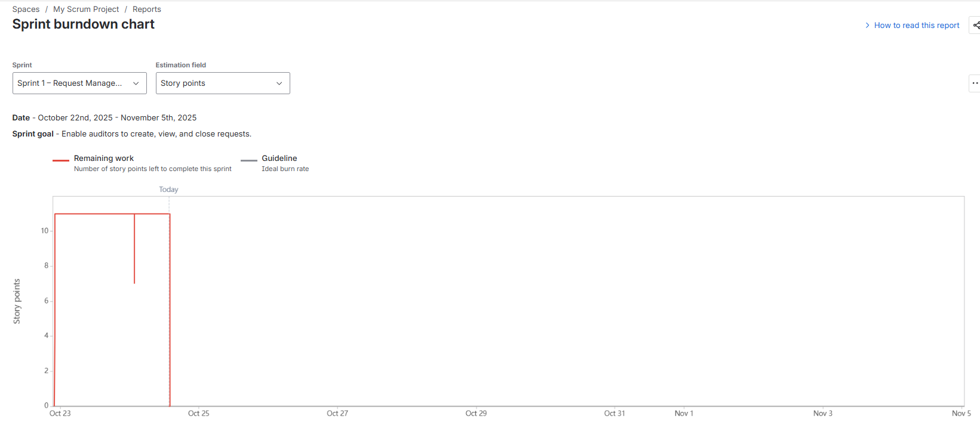
Total 11 story points completed.

Slide 17
Sprint Review & Retrospective
What Went Well: Clear user stories, smooth collaboration, timely delivery
What Can Improve: Deliver UI mockups earlier, start QA mid-sprint,
Action Items:
  BA to prepare ACs before sprint start
  UX to deliver designs before Day 1
  QA to start testing by Day 6

Slide 18
Key Outcomes & Benefits
After completing Sprint 1, the team successfully delivered core functionalities that
enhanced visibility, efficiency, and collaboration within the audit support process.
Reduced audit turnaround time by 45% through streamlined request tracking
Improved visibility and accountability via centralized dashboards
Enhanced cross-team collaboration with automated status updates
Eliminated email-based tracking using a unified portal for audit requests
Established a foundation for upcoming sprints (data upload, reporting, notifications)
Outcome: A more transparent, efficient, and auditable process ready for scale.

