Slide 1



Loan Management System (Enhancement)
Prepared By: [Apeksha Nilak]
Date: [14/08/2025]

Slide 2
Situation / Problem / Opportunity
Existing LMS has outdated KYC process with multiple manual steps leading to delays and errors
High TAT slows loan processing.
Inability to provide real-time loan processing status updates to customers
No integrations with latest RBI recommended credit reporting tools
Customer demand faster and mobile –friendly loan processing.

Slide 3
Project Background
Existing System Overview
LMS launched in 2018 to manage retail loan lifecycle—initiation, approval, disbursement.
Initially improved efficiency and accuracy through process automation.
Need for Enhancement
5+ years old – Limited adaptability to evolving RBI norms, competition, and customer demands.
Financial industry now faces demand for digital first services, rising competition for automation.
Misalignment with organizational goals of speed, compliance, and customer satisfaction.
Current system cannot scale to meet these demands

Slide 4
Purpose Statement (Goals)
Build an enhanced Loan Management System (LMS) that centralizes KYC with single data capture and reuse across products
Implement an integrated workflow & rules engine to enable straight-through loan processing and cut turnaround time.
Provide real-time, omnichannel customer updates & self-service tracking to improve transparency and reduce branch visits.
Embed automated RBI compliance with periodic credit data refresh and auditable trails for stronger governance.
Digitize disbursement end-to-end with e-sign/e-mandate to accelerate fund release and remove in-branch steps.

Slide 5
Project Objectives
Solution selection according to design criteria
Solution prototyping and testing
Automate loan workflow and reduce TAT by 40%
Enable online requests for part disbursement
Improve customer communication at all stages

Slide 6
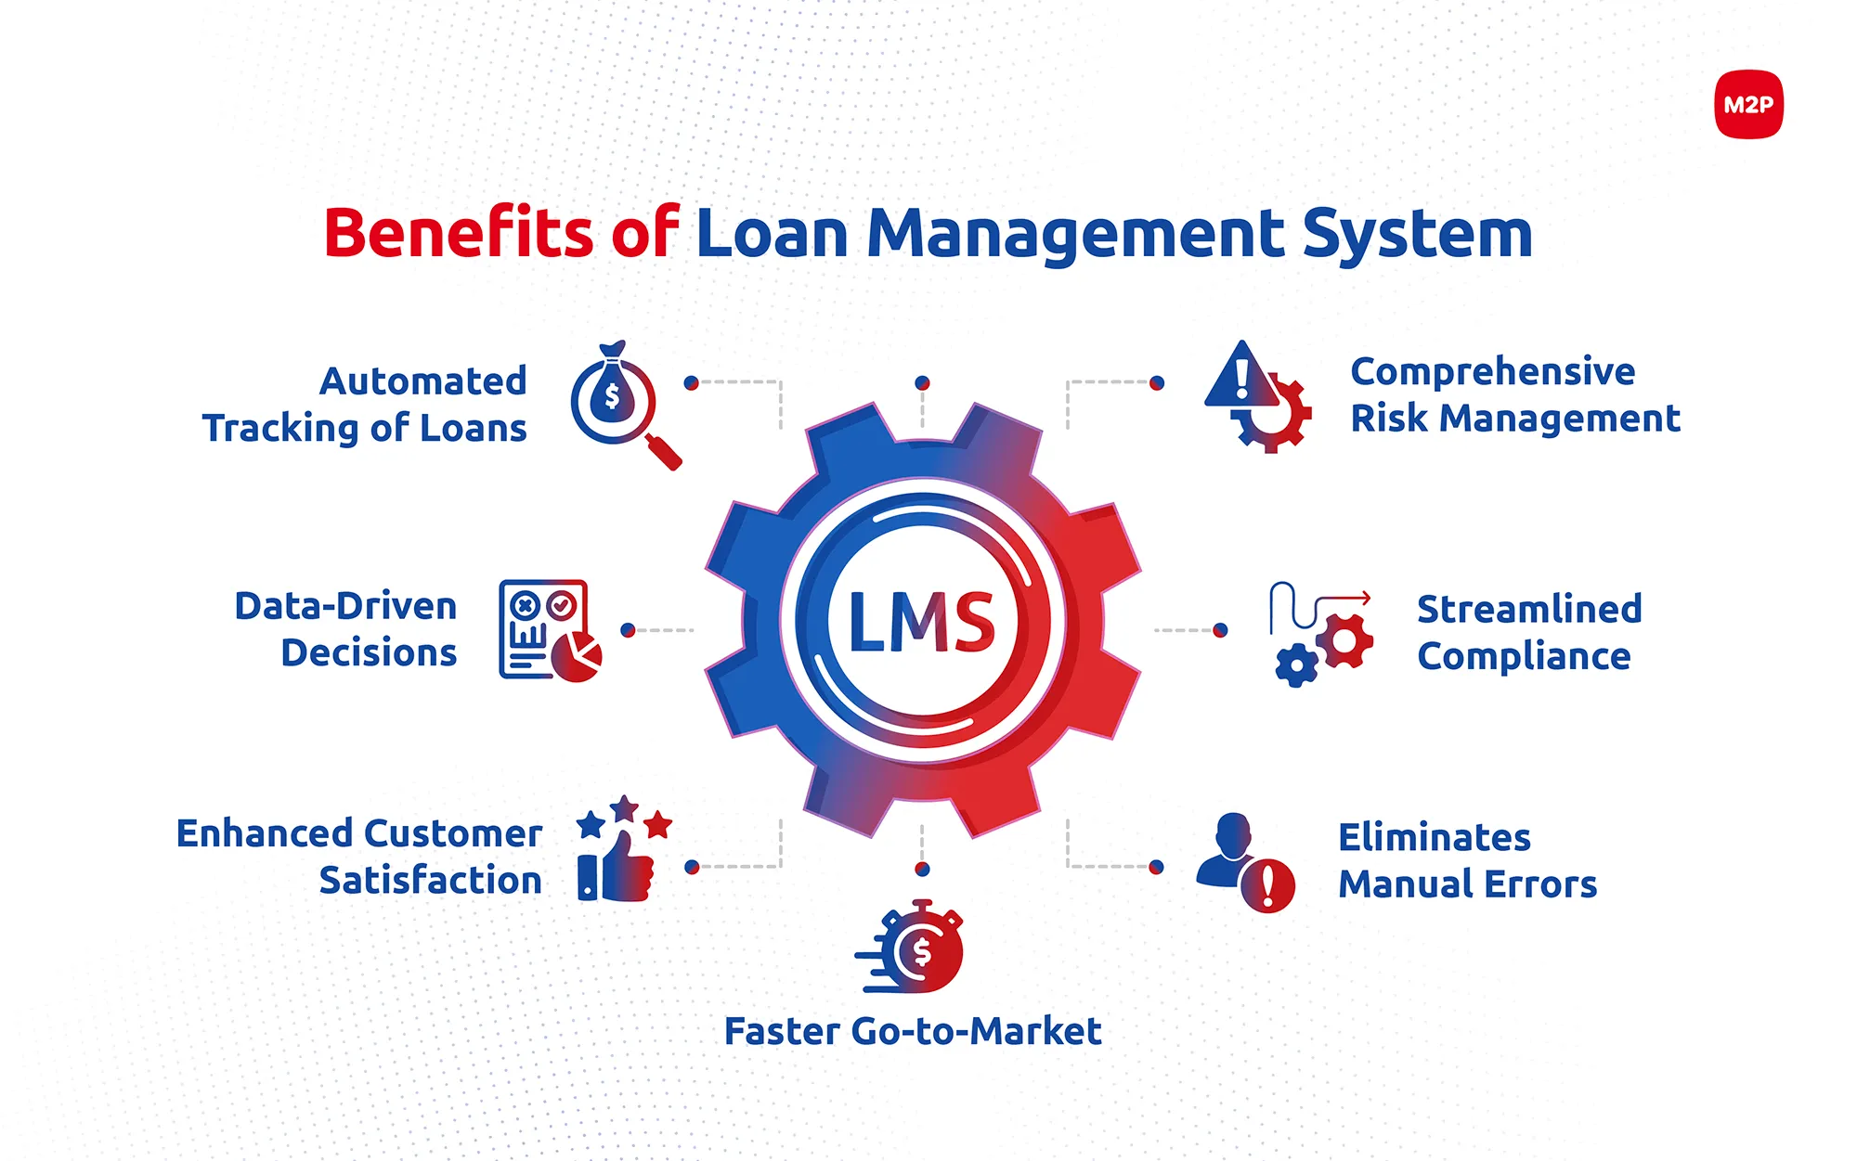
Benefits of LMS Enhancement
Scalable Business growth
LMS with speedy process automation.
Adherence to RBI compliances & regulations
Advanced risk reporting tools

Slide 7

Anticipated Results
Faster processing→ Reduced TAT, scalable for growth.
Compliance leadership→ 100% RBI adherence.
Better Customer Experience→ Transparent, seamless and branch-free servicing.

Slide 8
Methods / Approach SEQUENTIAL METHODOLOGY (WATERFALL MODEL)
Phase 1: Requirement Analysis
Committee formation(Business, Ops, IT, Compliance).
Identified gaps: manual KYC, high TAT, compliance.
Draft SRS for automation & reporting.
Phase 2: System Design
Redesigning loan workflows (initiation → disbursement).
Integrated KYC, bureau, payments.
Build MIS & audit trail framework.
Phase 3: Development & Integration
Develop & build portals for redesigned workflow
Integrate API for credit bureau, KYC and payments.
Configure reporting and analytics module

Slide 9
Contd…
Phase 4: Testing
UAT with users (loan ops).
Validating migration from old LMS.
Perform load & security checks.
Phase 5: Deployment
Final migration & setup.
User training (branches & credit team).
Go-live with reduced TAT.
Phase 6: Maintenance & Support
Support & helpdesk.
Regular RBI compliance updates.
Future upgrades

Slide 10
Resources
People – Project Sponsor, Project Manager, Architects, BA, Developers, Testers,, Network Admin, DB Admin ,IT Team, End users
Time – Implementation within 6 months
Budget – Costs for software, hardware, training cost around Rs. 65 lakhs
Other – Vendor demos, third-party software evaluations charges around Rs. 5 lakhs

Slide 11

Success Criteria
40% reduction in loan processing TAT
Full compliance with RBI guidelines.
95%+ customer satisfaction.
Reduced manual intervention by 80%.
99.9% system uptime after go-live.

Slide 12
Risks & Dependencies
Risks & Dependencies | Mitigations
Data migration errors | Backup data & test migration
Regulatory changes mid-project | Compliance team involvement
User resistance for new system | Training &change management
Vendor API delays | Parallel planning alternatives

Slide 13
Executive Summary
This project aims to upgrade the existing Home Loan Management System (LMS) to reduce turnaround time (TAT), improve transparency, and ensure compliance with evolving RBI guidelines.
Key enhancements include a unified KYC process, automated customer notifications(Email/SMS/WhatsApp), bimonthly credit report integration, and a self-service portal for part disbursements.
Success will be measured by a 40% reduction in TAT, 95% automated customer communication, and full regulatory compliance. The fully integrated LMS will improve operational efficiency, enhance customer satisfaction, and support the organization’s growth and market reputation, with implementation planned over 6–8 months

