Slide 1
Waterfall Deliverables - BA Perspective

Slide 2
Introduction
Overview of Waterfall Deliverables:
- Use Case documentation
- Screens and mockups
- Tools usage (Visio, Axure)
- BA Experience across phases

Slide 3
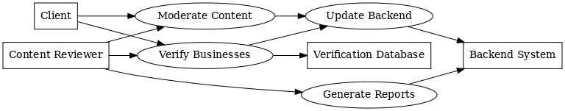
Document 6 – Use Case Deliverables
Use Case Diagram
*Actors:*
*Primary Actor:* Content Reviewer*
*Secondary Actors:* Client, Backend System, Verification Database
*Use Cases:*
* Moderate Content
* Verify Businesses
* Update Backend
* Generate Compliance Reports

Slide 4
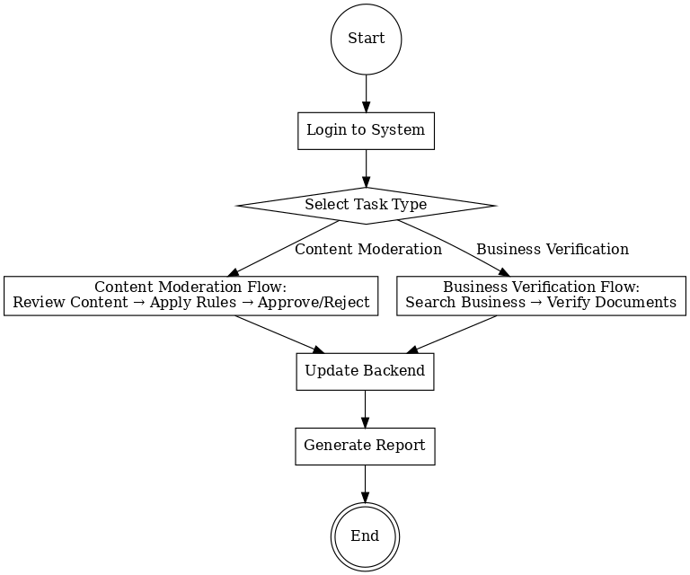
Activity Diagram

Slide 5
Use Case Specification:
1. Use Case Name
Moderate Content
2. Description
Review and remove harmful content before it reaches users, ensuring compliance with platform and legal standards.
3. Actors
Primary: Content Reviewer
Secondary: Backend System, Client

Slide 6
Use Case Specification:
4. Basic Flow
Reviewer logs into moderation tool.
Selects “Moderate Content” task.
Reviews flagged content.
Applies rules from SOP.
Approves or rejects content.
Updates backend with decision.
5. Alternate Flow
If content needs escalation, reviewer sends it to senior reviewer or client for decision.
If backend system is down, store decisions locally and update once system is restored.

Slide 7
Use Case Specification:
6. Exceptional Flows
If backend system is down, store decisions locally and update once system is restored.
7. Pre-Conditions
Reviewer has valid login credentials.
Updated rulebook/SOPs are available.
8. Post-Conditions
Backend updated.
Flagged content removed or approved.
Audit trail maintained.

Slide 8
Use Case Specification:
9. Assumptions
Reviewer is trained.
Internet connection stable.
Guidelines are up to date.
10. Constraints
Content must be reviewed within SLA (e.g., 2 hours from flagging).
11. Dependencies
Client-provided SOPs.
Working backend tools.
Access to moderation system.

Slide 9
Use Case Specification:
12. Inputs / Outputs
Input: User-generated content flagged for review.
Output: Approval/rejection decision in backend system.
13. Business Rules
Follow moderation guidelines.
Document every decision.
Maintain compliance logs.
14. Miscellaneous Information
Weekly moderation reports generated for client audits.

Slide 10
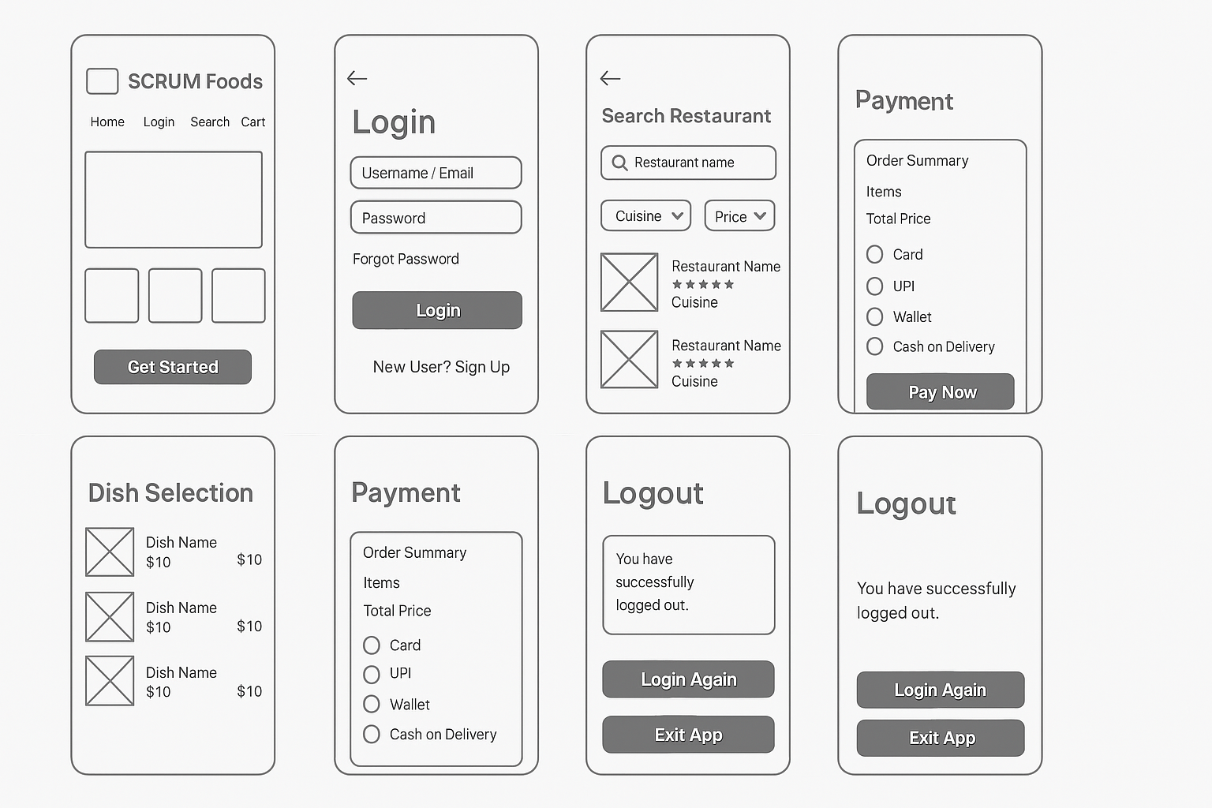
Document 7- Screens and pages

Slide 11
Document 8 – Tools Experience
Visio: For this project, *Microsoft Visio* was used extensively during the *Requirement Analysis* and *Design* phases:
* *Use Case Diagrams* – Created to show the relationship between actors (Content Reviewer, Client, Backend System) and system processes like moderation, verification, and reporting.
* *Activity Diagrams* – Designed to illustrate the sequential workflow for content moderation and business verification, ensuring clarity for both the technical and non-technical team members.
* *Flowcharts* – Used to represent decision-making points, alternate flows, and exception handling within the moderation process.
* *Advantages observed* – The drag-and-drop interface helped in quickly building diagrams, and export options allowed seamless sharing with the client for review.
* *Outcome* – Visio diagrams were instrumental in aligning the development team with the agreed requirements before coding began.

Slide 12
Document 8 – Tools Experience
Axure: Axure RP* was used for creating interactive, high-fidelity prototypes during the *Design* and *Requirement Gathering* phases:
* *Mock-up Creation* – Axure was used to design all key screens: Home Page, Login Page, Dashboard, Moderation Pages, Business Verification Pages, Reports, and Logout.
* *Interactive Flow* – Prototypes allowed clickable navigation, simulating the actual user journey from login to task completion.
* *Stakeholder Feedback* – The interactive nature helped clients visualize the system early, enabling faster feedback and reducing rework in later phases.
* *Advantages observed* – Axure’s widget library and conditional logic features allowed realistic workflows to be represented, making it easier for testers and developers to understand the expected behavior.
* *Outcome* – The Axure prototypes became the foundation for the UI design handoff to the development team.

Slide 13
Document 9- BA experience
1. Requirement Gathering
For the Secure Content Moderation and Business Verification project, I initiated requirement gathering by engaging with the client to understand their specific needs for real-time content moderation, harmful content removal, and business verification in compliance with regulatory standards.
Applied the MoSCoW technique to prioritize requirements, addressing “Must Have” needs first, such as timely backend updates and accurate verification.
Managed client unavailability by identifying alternate points of contact to obtain critical information proactively.
Validated requirements using the FURPS technique, eliminating duplicates and redundant items.
Created early-stage prototypes to provide stakeholders with a clear visualization of workflows for content review, verification, and backend updates.

Slide 14
Document 9 – BA Experience
2. Requirement Analysis
Prepared UML and activity diagrams to represent workflows, including step-by-step processes for moderating flagged content and verifying businesses.
Facilitated collaborative feedback from the technical and QA teams, integrating beneficial suggestions into requirements.
Delivered comprehensive Business Requirement Specification (BRS) and System Requirement Specification (SRS) documents to ensure the development team had a precise understanding of system functionality.

Slide 15
Document 9 – BA Experience
3. Design
Developed use case diagrams to support test planning and design.
Collaborated with QA to prepare positive and negative test cases for all functionalities.
Maintained communication with the client to finalize design and solution documents, ensuring alignment with platform compliance and moderation standards.
Prepared test data for functional areas and updated the Requirements Traceability Matrix (RTM) to ensure all requirements were mapped to design and testing activities.

Slide 16
Document 9 – BA Experience
4. Development
Facilitated Joint Application Development (JAD) sessions to clarify functional and compliance-related queries.
Conducted one-on-one discussions to resolve disagreements and encourage team cooperation.
Shared diagrams and process flows as reference materials during coding.
Organized regular review meetings with both the client and development team, recording sessions for absent members and conducting follow-ups to avoid missing critical details.

Slide 17
Document 9 – BA Experience
5. Testing
Derived test cases from use cases to ensure comprehensive coverage of system functionality.
Performed high-level workflow testing, including backend updates and compliance validation.
Requested additional test data from the client to verify edge cases where required.
Updated the RTM during testing to track requirement coverage.
Obtained client sign-off and prepared them for User Acceptance Testing (UAT) by sharing test scope and expected results.

Slide 18
Document 9 – BA Experience
6. Deployment
Shared the final RTM with the client for inclusion in the project closure document.
Coordinated with the client to create end-user manuals detailing moderation and verification procedures.
Organized and conducted training sessions for the client’s moderation team, ensuring complete understanding of operational procedures.
Supported a smooth transition from development to live operations, enabling the client to maintain safe and compliant platform practices.

