Slide 1
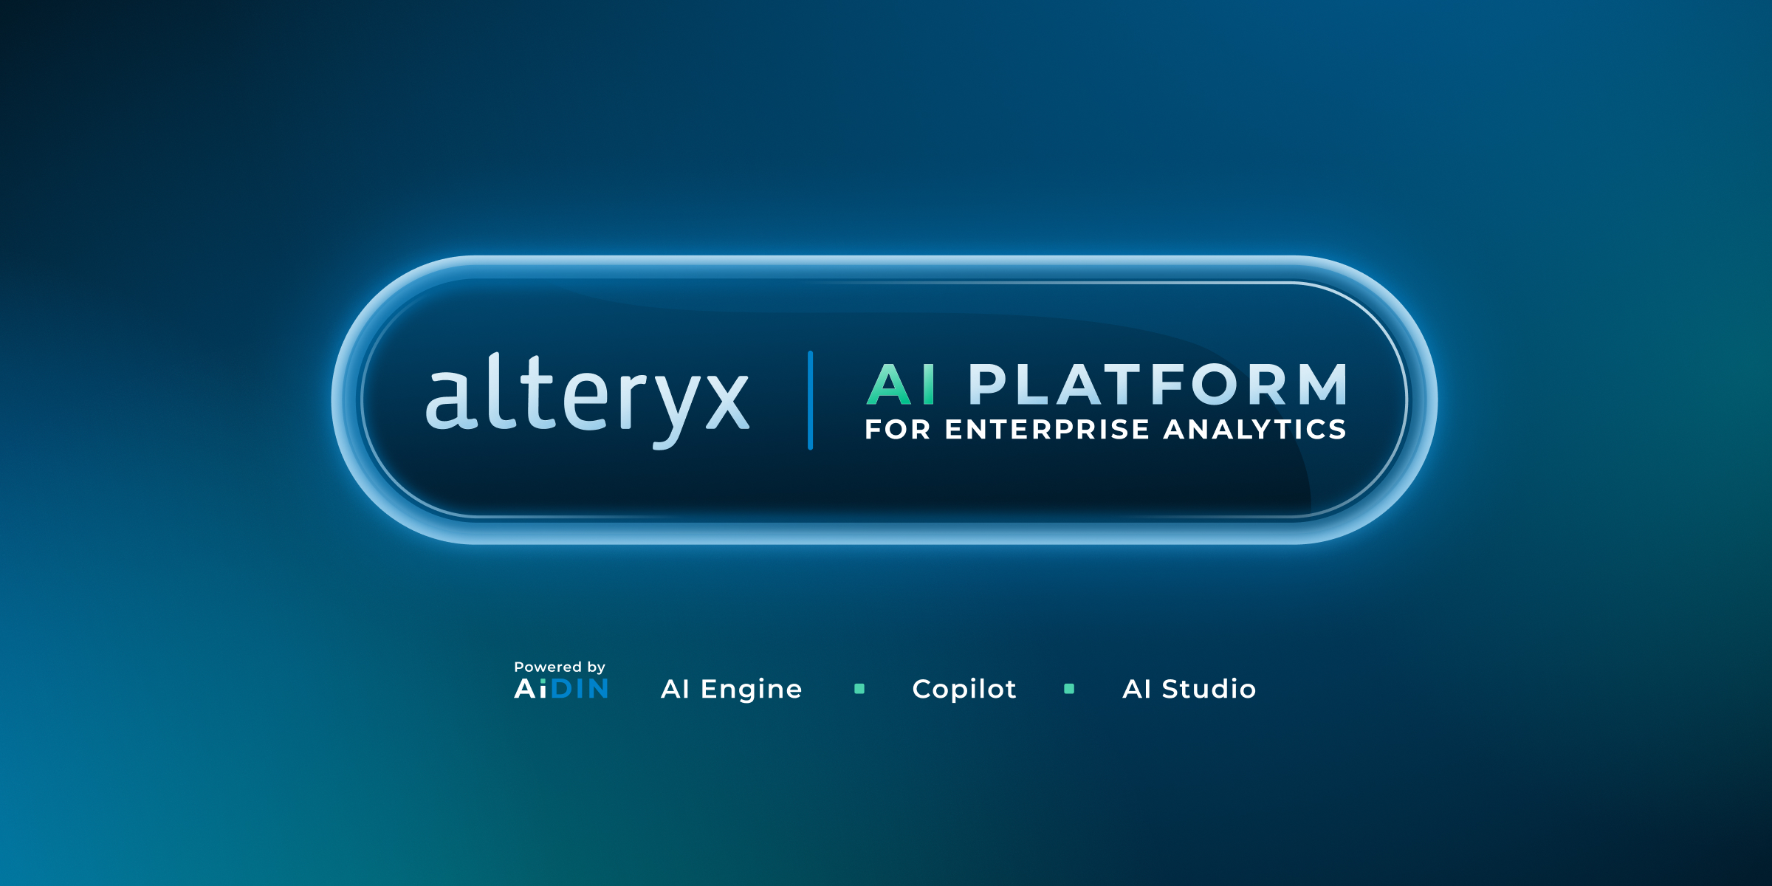

Alteryx
Alteryx is a data analytics and automation platform that helps users prepare, blend, and analyze data from various sources using a drag-and-drop interface. It enables users to build complex workflows for data manipulation, analysis, and automation without needing extensive coding knowledge.

Slide 2

Identifying the Situation
Current State
Challenges
Opportunity

Slide 3
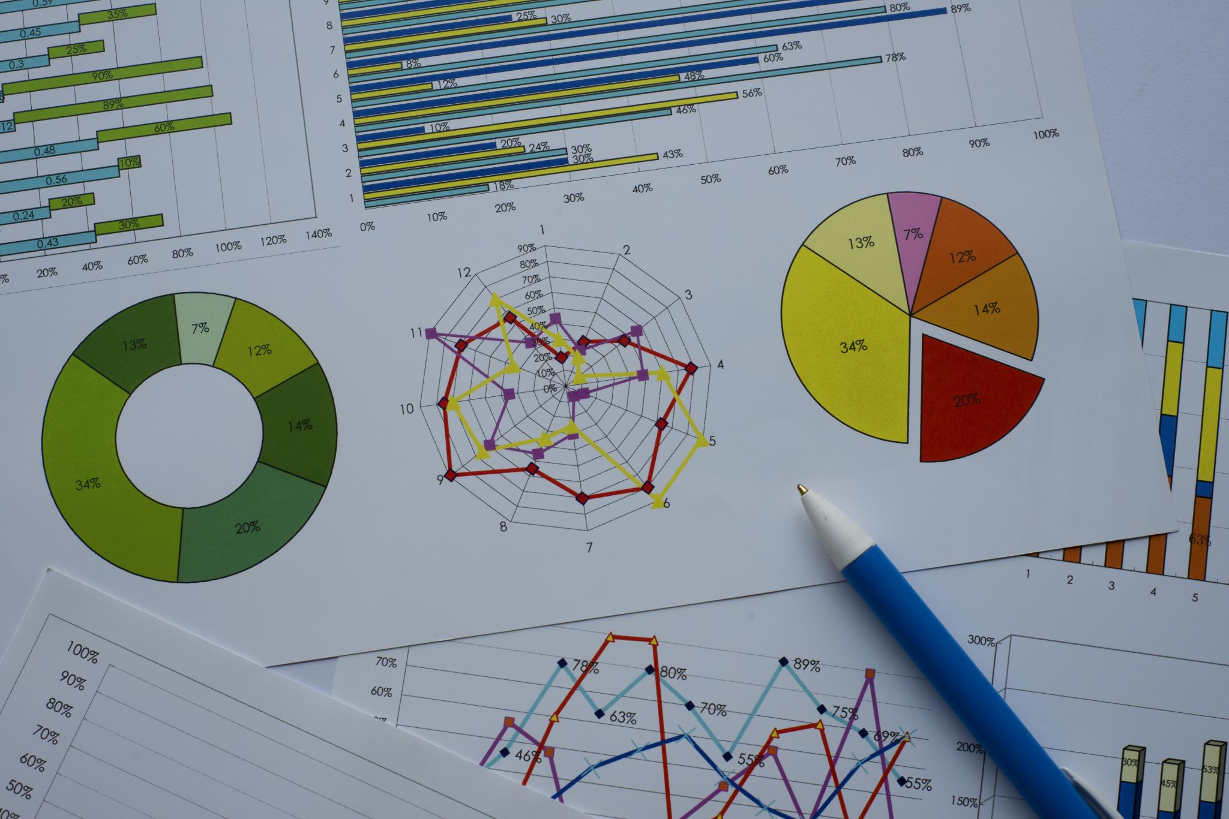
Purpose Statement
Primary Goal:
Implement a robust and intuitive data analytics solution using Alteryx.
Sub-goals:
Enhance ease of use and quality of information. Reduce system downtime and improve response times.
Enable a smooth transition from legacy systems to a modern, agile framework.

Slide 4
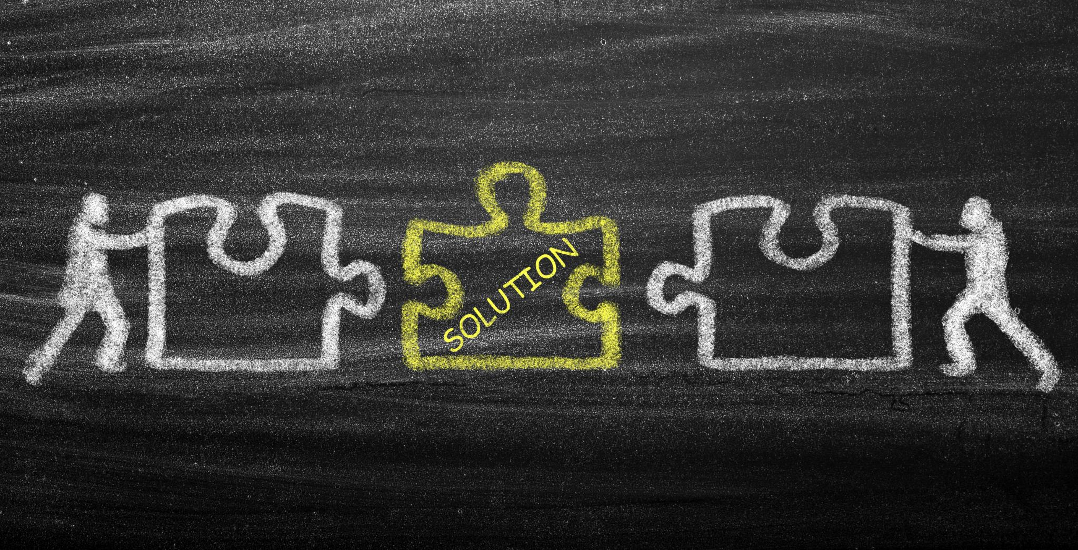
Project Objectives
Solution Selection:
Define requirements based on business needs and technical standards
Identify potential Alteryx solutions that meet agile requirements
Prototyping & Testing:
Develop initial prototypes to validate design assumptions.
Adjust requirements based on real-time performance data and stakeholder insights

Slide 5

Success Criteria
Performance Metrics:
Increase records availability and seamless accessibility of information, collateral, forms, and documents.
Drastically reduce system downtime, wait times, and improve overall system response times.
User Experience:
Measurable improvements in user satisfaction.
Reduced learning curve and maintenance efforts.

Slide 6

Methods and Approach
Agile Methodology:
Adopt agile practices to drive iterative development and continuous feedback.
Step-by-Step Process:
Establish Selection Committee:
Define Requirements:
Vendor Selection:
Solution Implementation:
Go Live:
Transition to the new system with a focus on minimal disruption and continuous improvement.

Slide 7
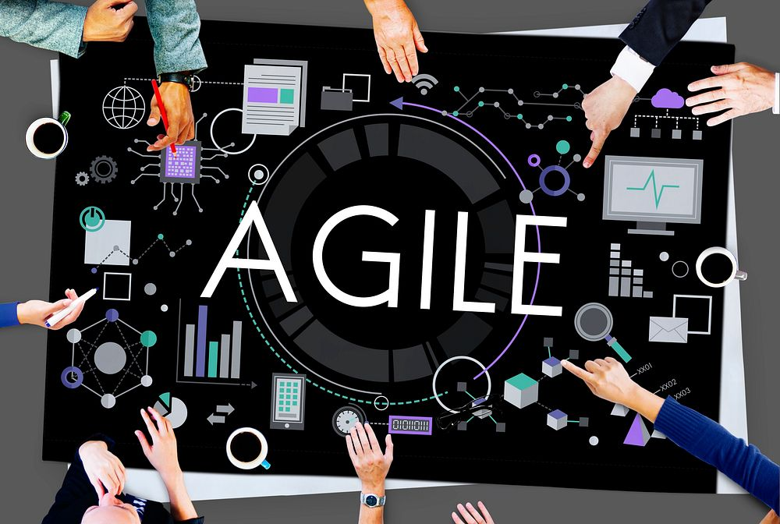
Agile Phases
Initiation
Planning
Development
Testing
Deployment
Maintenance/Retirement

Slide 8

Resource Allocation
Assemble a project team from client community.
Timeline for implementation.
Allocate budget for hardware and software.
Additional Resources

Slide 9
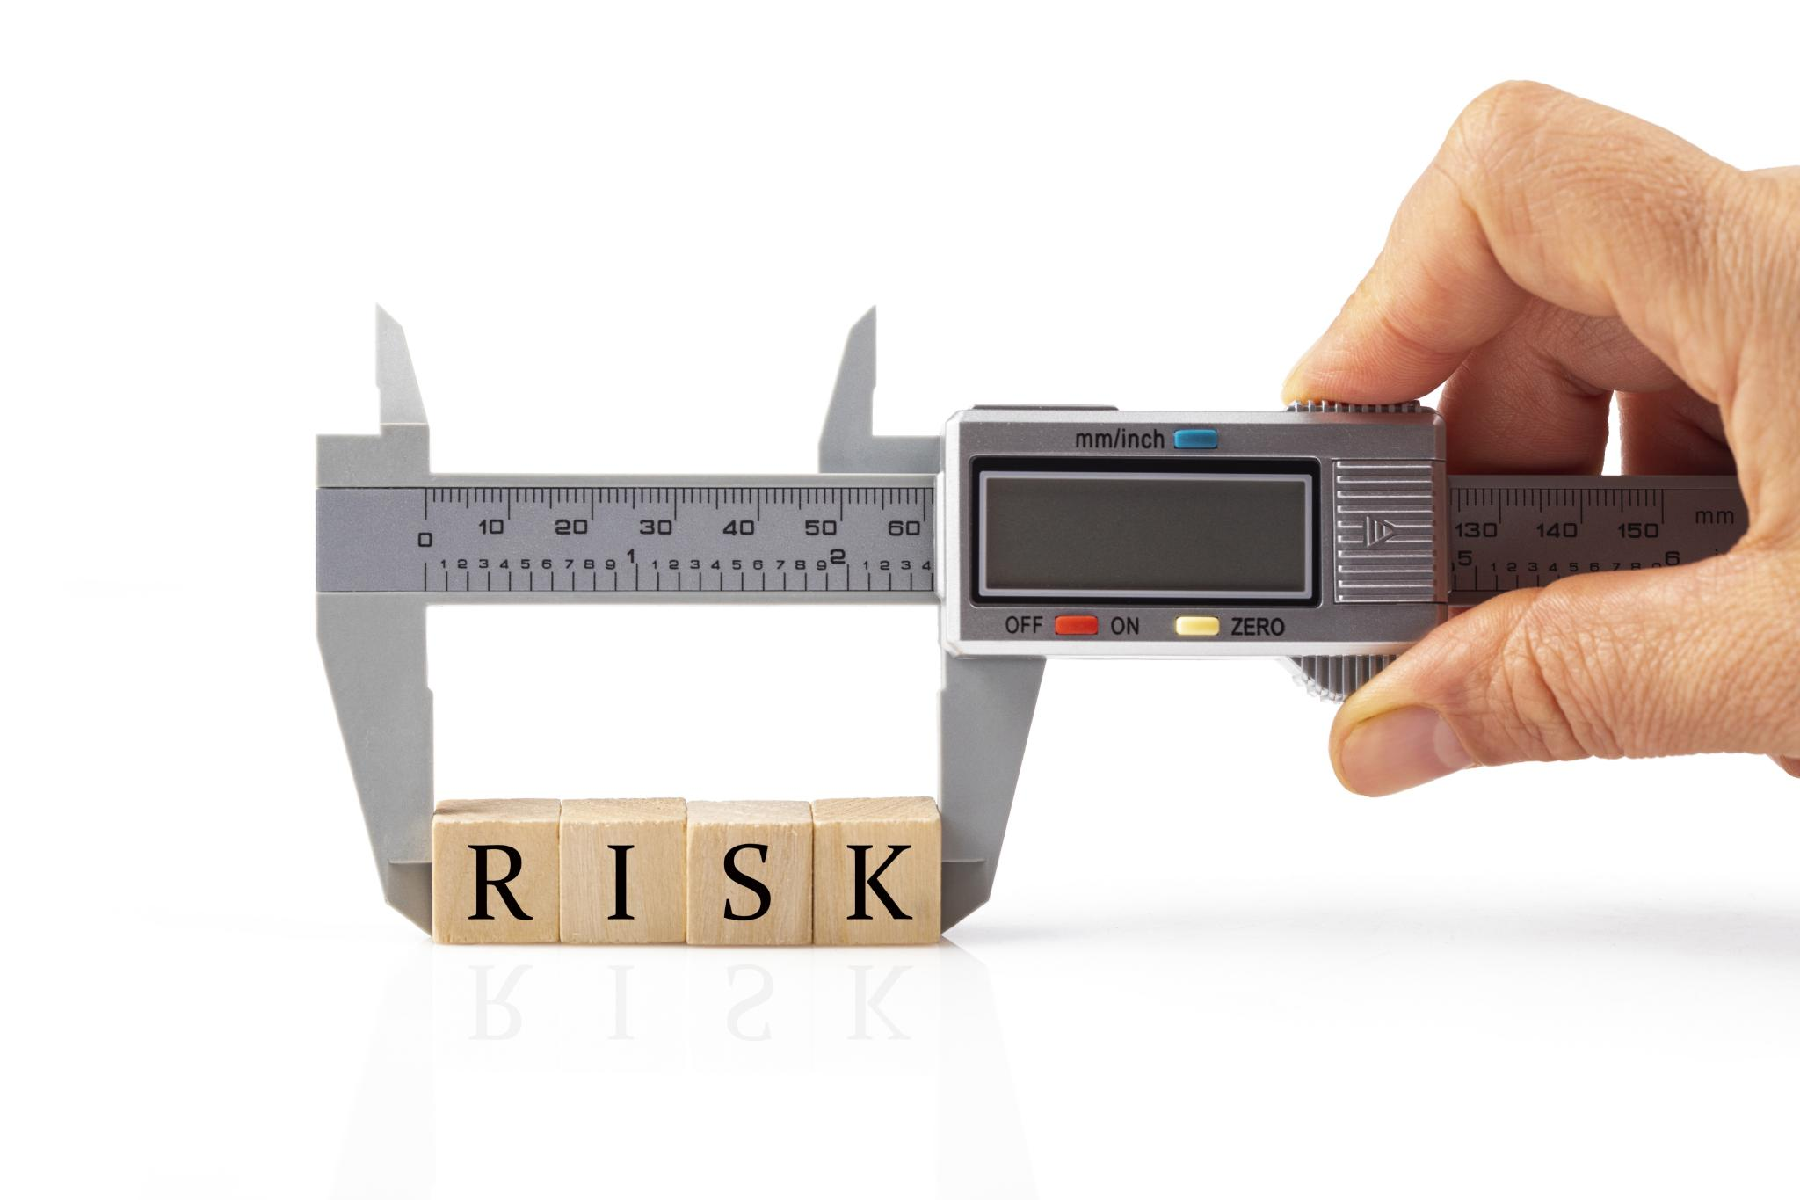
Risks and Dependencies
Existing Familiarity
Cost Justification Challenges
Mitigation Plans

Slide 10
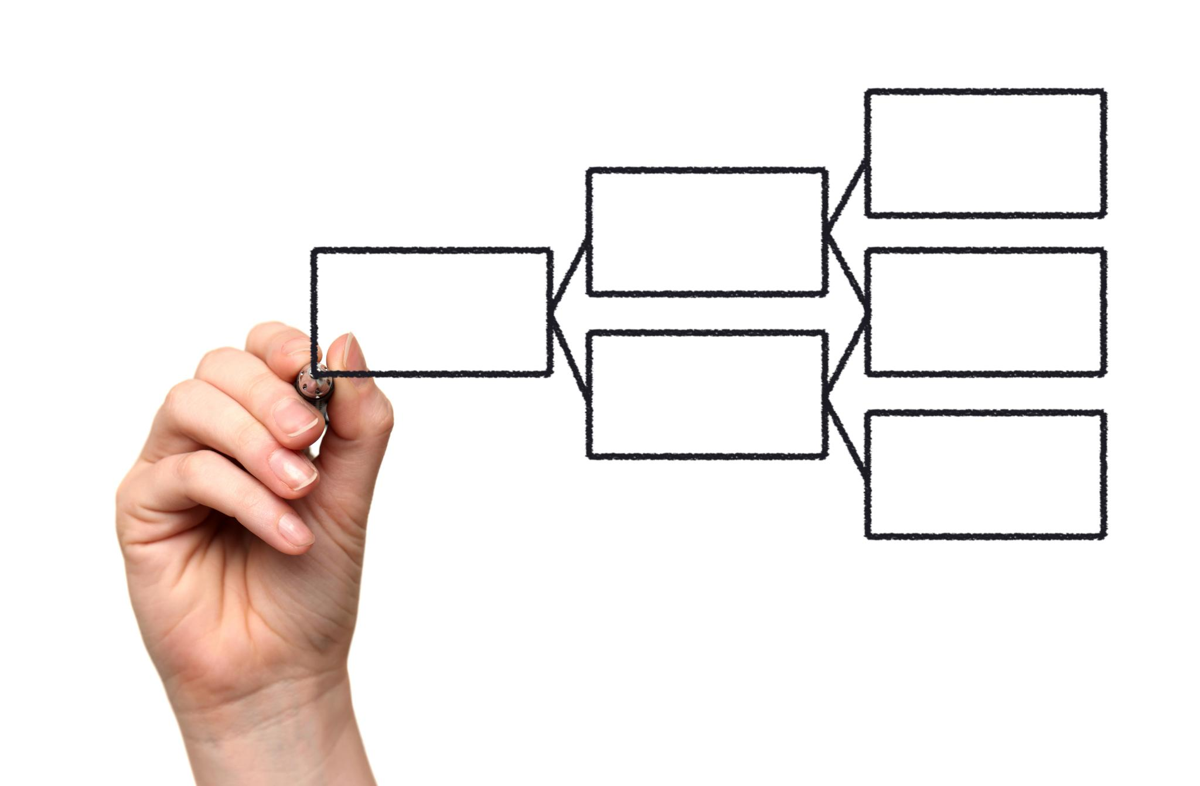
Conclusion
Alteryx can significantly improve data processes.
A well-defined project approach is essential.
Engagement from stakeholders is crucial for success.

Slide 11

Next Steps
Review and finalize project plan.
Begin vendor selection process.
Schedule training sessions for users.
Thank You

