Slide 1
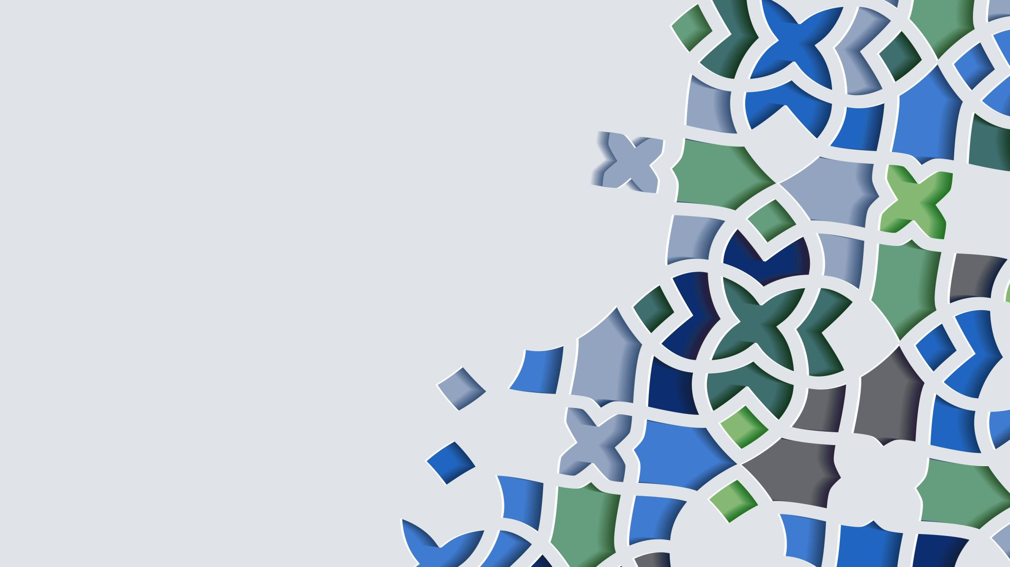
LIGHT AUTOMATION TOOL

Slide 2
Idea behind the project:
The motive behind this project was to understand the working of any payment engine and payment gateways. People have faith that their money is secured. This faith is turned into curiosity to know about the system behind it.
Business Goals:
To build An Automated Payment Release tool which is very user friendly and can release bulk payments with 100% accuracy without manual intervention.

Slide 3
PROJECT OBJECTIVES
Improve Accuracy and Consistency: Automating Tool ensures that processes are executed identically every time, eliminating human error and improving the reliability of results.
Increase Test Coverage: Tool Automation allows for the execution of more payments in less time.
Reduce Execution Time: Providing quicker feedback and enabling faster delivery of high-quality payments.
Detect Defects Early: By identifying bugs early in the development lifecycle helps prevent any operation loss.

Slide 4
SITUATION
In the current scenario the operator sorts the payment on the basis of payment category such as restricted fund, insufficient fund and based on that the operator Releases the payment, draft the mail to RM, send reminders and update status manually. This Involves more resources and consume more time. On a high-volume day in the month end or in the starting of the month when 400+ payments are received, the payment is not released on time, the day when there is a resource crisis the high priority payments are not filtered as sometimes operator is busy with checking responses of RM or drafting mails to RM (Relationship Manager)
Having Automation Tool implementation will streamline these activities, reduce manual effort, minimize human error, identify bottlenecks, and free up teams to focus on higher-value, complex work .

Slide 5
PROBLEM
Finishing the volume on time is a challenge on high volume day ,when the overall volume is more than 400+ for continuously ¾ working days. Each and every payment needs to check one by one by the operator, prioritize them as per their value takes more time. After releasing the payment the operator needs to send the mail manually becomes increasingly time-consuming and error-prone if the correct RM is not selected.
After the payment is released by maker or operator the checker is involved for quality checking (QC)and human error is still not avoided even after 4 eyes checking .
The SLA is missed very frequently, sometime team is overloaded with unfinished work which causing customer dissatisfaction and finally leads to operation loss.

Slide 6
OPPORTUNITY From the work summary the tool categorize the bulk payments as per unavailability of funds(INSUFFICIENT FUND) ,verify restriction on funds(RV) and then release the funds with 100% accuracy and thus reduce human effort. While tool implementation is required an initial investment, it significantly reduces long-term expenses because QC team’s involvement is not required and provide better Allocation of Resources. Faster and timely release of payment avoid workload on team members and reduce the chances of backlog. Automation speeds up payment execution, minimizes human errors, and scales efficiently, ultimately lowering the cost and delivering better ROI over time. Machines work faster, which is especially useful for repetitive task like checking customer’s fund and restriction on account if any. With faster tests and quicker results, teams can get feedback more frequently, which helps them detect issues and improve functionality. Seamless user experience, which increases customer satisfaction and overall success of the project.

Slide 7
PURPOSE STATEMENT
To Increase productivity of the team with less manual effort.
Prioritize the high value payment to release the payments on time.
Better quality assurance with Greater Speed.
Stronger competitive market position
Higher revenue generation.
Reduce cost

Slide 8
SUCCESS CRITERIA
Reductions in MANUAL CHECKING by100% , faster defect detection if any payment is not released by the tool and the appropriate action can be taken then and then and improvements in overall process turnaround.
Prioritize tasks that are repetitive.
The tool is intuitive interface for faster adoption and reduced training time.
Manpower is reduced by 6 % which quantify reduced operational costs, seamless integration with existing systems, security, and a positive return on investment (ROI) and improved overall customer satisfaction.

Slide 9
METHODS AND APPROCHES
The waterfall model's method is sequential, with distinct phases (such as Requirements Analysis, Design, Implementation, Testing, Deployment, and Maintenance) that must be completed one after another before the next can begin.
Requirements Gathering: This initial phase defines the overall scope of the automation tool, detailing what it should do, its features, and the needs of the users and stakeholders. I have interviewed the operators, supervisor and stakeholders. For better understanding I have gone through the existing document, have done the procedure review to get more information, have followed observation technique and have analysed them after observation
Design: Designers create the system architecture, user interfaces, and detailed technical plans for the automation tool based on the gathered requirements. A detailed blueprint for the project is created.

Slide 10
Implementation (or Development): In this phase, the actual code for the automation tool is written, transforming the design specifications into a functional program by the development team.
Testing (or Verification): After the software is coded, it is integrated and thoroughly tested to find and fix any bugs or issues, ensuring it meets the original requirements. After the tool is developed its tested in the working environment and a small set of payments are released ,after releasing the payment its crossed checked with the QA team to identify and fixing any bugs or errors.
Deployment: Once testing is complete and the tool is ready to operate, it is released to the end-users/Operator or deployed into a live environment.
Maintenance: his ongoing phase involves fixing bugs that may arise, making necessary updates, and adding new features or enhancements to the automation tool over time.

Slide 11
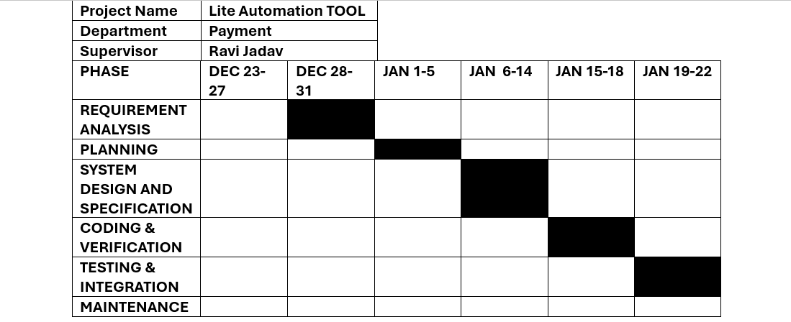
Project duration:

Slide 12
RESOURCES
Team Composition:
Frontend Developers
2 Backend Developers
1 UI/UX Designer
1 QA Analyst
1 DeVos Engineer
Tools & Technologies:
Frontend: HTML, CSS (Cascading Style Sheets), JavaScript
Backend: Node.js
Database: MySQL
Cloud: AWS
Tools: Git
Others: Postman, ELK Stack
Budget Breakdown
Development: $ 45
UI/UX+QA: $ 10
Training /Support: $7
Contingency: $ 5

Slide 13
RISK AND DEPENDEANCY
Risks:
Over-reliance: Becoming too dependent on the automation tool can lead to a decline in human skills and intuition for complex or unexpected scenarios.
Technical Issues: Tools are susceptible to software glitches, hardware failures, that can disrupt operations and cause downtime.
Maintaining Scripts and Data: The need for ongoing maintenance of tool is crucial but leads to system downtime.

Slide 14
Dependencies:
Underlying Systems: Automation tools often rely on specific operating systems, platforms, or network infrastructure to operate effectively.
Third-Party Components: Software, libraries, or other third-party dependencies are critical but can introduce vulnerabilities or licensing issues if not managed carefully.
Legacy Systems: Automation in older systems can be challenging due to their complexity and unique dependencies.
Access Denied: Tool access or using tool might be restricted for users ,in the same time multiple operators cant run the tool for releasing particular fund.

