Slide 1
Enhancement of DataKosh Solution – ITR & GST PDF Retrieval
Prepared By: Avinab Ashish Das, Business Analyst
Date: 09/06/2025
Goal: A Strategic Imperative for Small Banks and NBFCs to Inclusion of Original ITR and GST PDFs for Cross-Verification

Slide 2
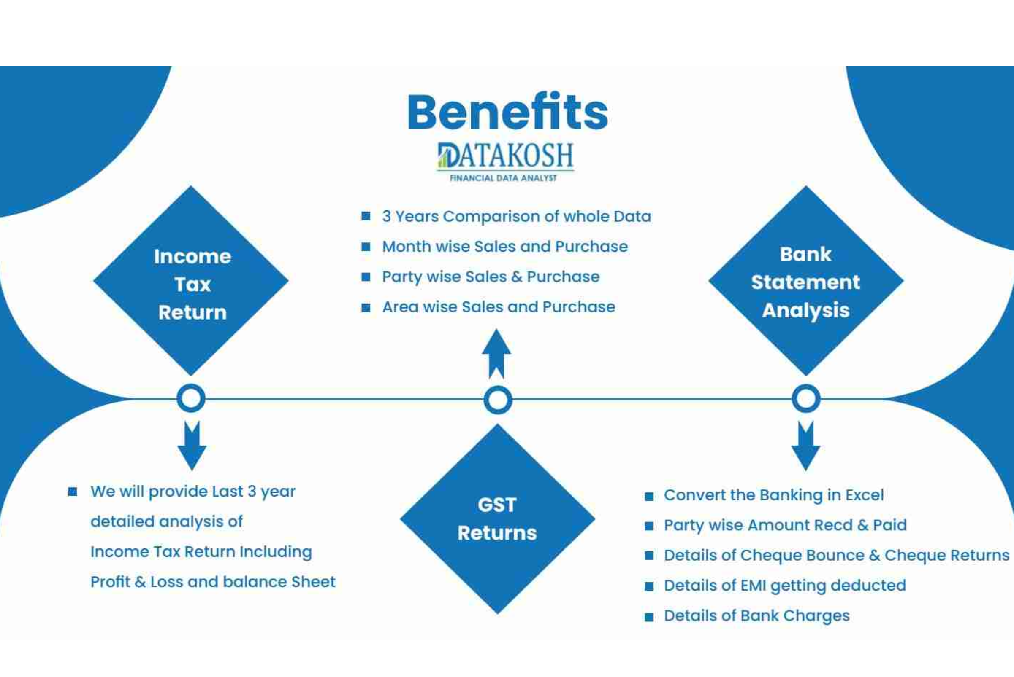
Executive Summary
Unsecured loan applications with fake documentation and poor financial analysis tools are among the primary factors of the rising non-performing asset (NPA) concerns in banks (specifically small banks) and NBFCs.
Datakosh is an AI-powered financial analysis tool that transforms raw financial data (GSTR, ITR, bank statements) into actionable insights.
Current model lacks retriving original ITR/GST PDFs, limiting client cross verification capabilities and confirmation of real income source.
The modification allows a possibility to automatically and securely retrieve ITR and GST PDFs from official websites without going into government websites and asking for private information.
This feature empowers clients with verified financial data, improving loan assessments, reducing defaults, and strengthening Datakosh’s market position.

Slide 3
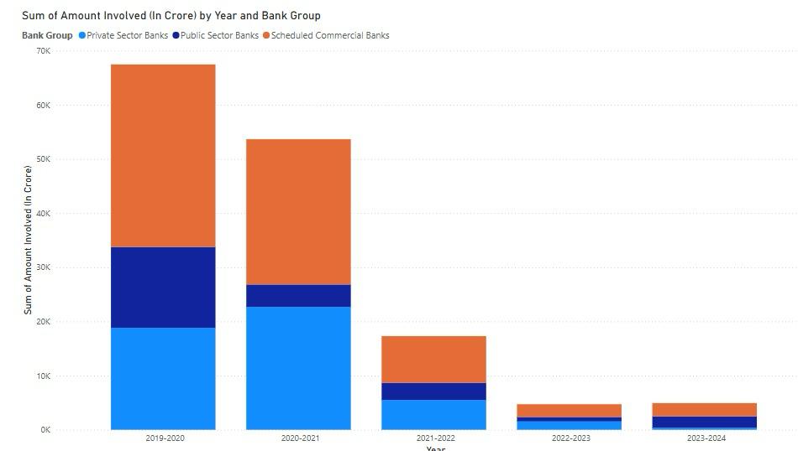
Situation, Problem, Opportunity
Datakosh’s AI-powered tools help small banks and NBFCs analyze financial documents to assess loan eligibility and reduce NPAs.
Its GSTR and ITR analysis offers a 360° view of borrowers' financial behavior, improving creditworthiness assessments.
The key clients now requires original ITR and GST PDFs to cross-verify data, critical to minimizing NPA risks.
Currently, Datakosh lacks original document access, forcing clients to go with manual checks for which credential of government portal needed to be share cause threatening data privacy.
The need to improve Datakosh, cut down on inefficiencies, and maintain trust is shown by a 25% increase in manual verifications reported by clients.

Slide 4
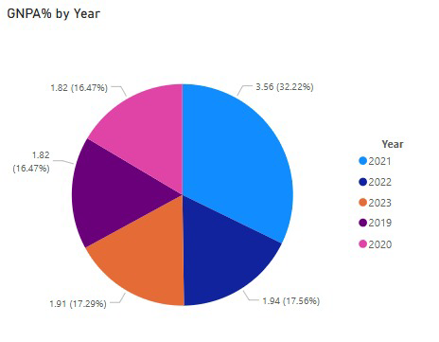
Purpose Statement
Enhance Datakosh Solution to securely fetch original ITR and GST PDFs along with analysed Excel/PDF reports for improved loan underwriting.
Enable accurate cross-verification via direct PDF access to reduce NPAs and improve loan assessment precision.
Boost client confidence by ensuring secure access of original PDF without compromising sensitive credentials
Eliminate data breach risks from manual logins and reduce loan errors from any friction in analysed data from Datakosh Solution.
Strengthen Datakosh’s competitive edge by solving the verification-security gap better than others in the market.
Reinforce Datakosh’s position as a trusted, secure analytics partner for banks and NBFCs.

Slide 5
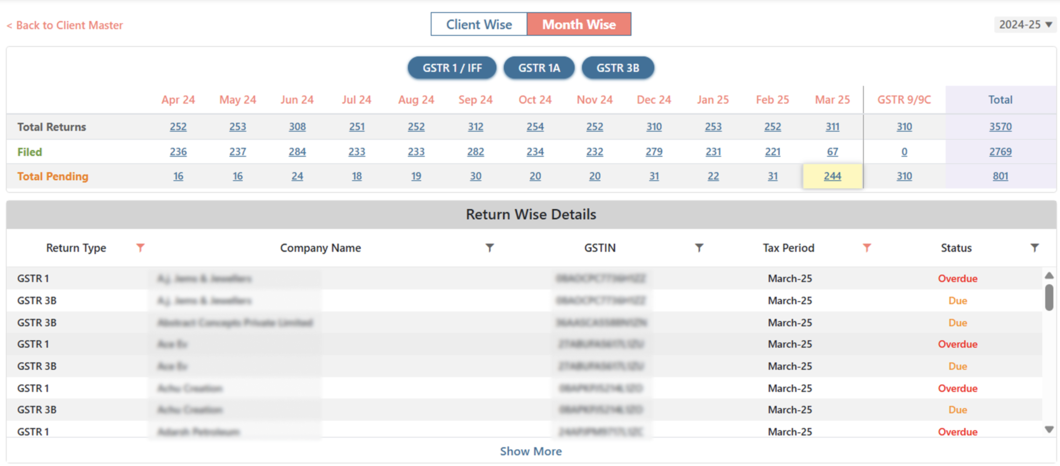
Project Objectives (SMART)
The Objectives are to take measurable steps that will lead to the successful completion of the project and the realization of its purpose. Our team is taking waterfall model approach, as it is typically align with distinct phases or significant milestones. We'll analyse and then formulate specific SMART objectives for this project:
Specific: Enable secure integration to fetch and display original ITR and GST PDFs within Datakosh as per client requirements.
Measurable: Achieve 100% PDF retrieval success, reduce financial data errors below 5%, and meet 95% test case pass rate.
Achievable: Execute the enhancement within 5.5 months using existing resources and proven API-based data retrieval methods.
Realistic: Ensuring the solution meets security standards without handling client credentials, following industry best practices.
Time-Bound: Complete the project by 31/12/2025, adhering to a six-month timeline from initiation.

Slide 6
Proposed Solution
A new, dedicated option on the dashboard will be developed and integrated into the existing Datakosh Solution platform.
The solution uses API integration to securely retrieve ITR/GST PDFs from government portals without login credentials.
After logging in Datakosh dashboard and providing GSTR number and ITR number in our secure desktop software or website or mobile app it will directly processing financial data.
On selecting the option for original PDF documents, the third party API-based will ensures access from government portal without triggering server alerts.
We are partnering with government-registered API providers to enable this functionality.
Government contracts are time-consuming; collaboration with registered providers avoids delays and compliance issues.
Direct server hits may raise alerts and penalties, making API partnerships a safer and faster alternative.
Our experienced team of developers and security experts will execute the project using the waterfall model.
Project completion is expected in six months and will lead to a revision in all subscription pricing models.

Slide 7
Success Criteria
The success of the Datakosh Solution Enhancement for ITR & GST PDF Integration will be measured across key dimensions: functionality, security, user adoption, and operational impact. Our criteria are designed to confirm that the new feature not only functions as intended but also delivers tangible value and addresses the core problem effectively.
Functionality
PDF integration feature fully operational and embedded in 100% of client reports by 31/03/2026
Functional Requirements Document (FRD) and UI mockups finalized and implemented
Technical Design Document (TDD) and secure API integration completed
New PDF feature available alongside existing Excel outputs
Security
Zero data breaches or security incidents reported within 6 months post-launch (by 30/06/2026)
Security protocols and audit mechanisms implemented and verified
API design includes secure, compliant methods for PDF retrieval
User Adoption
Minimum 90% client adoption rate measured via usage analytics and surveys by 30/04/2026
Client-facing manual, video tutorials, and FAQs provided for smooth onboarding
Positive user feedback on feature ease-of-use and reliability
Operational Impact
Full deployment of enhanced software completed on schedule by 31/12/2025
Streamlined workflow as PDFs are auto-integrated into reports
Reduced client dependency on manual document handling or third-party tools

Slide 8
Methods/Approach (Waterfall Model)
Requirements Gathering & Analysis
Conduct workshops/interviews with banking clients, product teams, and compliance experts.
Facilitate formal integration discussions between company leadership teams.
Prepare and validate the Business Requirements Document (BRD) with management sign-off.
System Design
Define secure mechanisms for PDF retrieval, storage, and display based on requirements.
Prepare documentation, system architecture, database schema, and security protocols along with development team.
Draft Statement of Work (SOW), Master document and user interface design for the new PDF module.
Implementation
Develop secure backend and frontend components per the Technical Design Document.
Integrate APIs, libraries, and secure storage within the existing Datakosh codebase.
Perform unit testing to ensure accuracy and functionality of each component.
Testing
Conduct integration testing to ensure seamless operation within Datakosh.
Execute full end-to-end testing of the enhanced solution.
Perform security audits, penetration testing, and vulnerability assessments.
Deployment & Maintenance
Roll out solution to production with minimal disruption to clients.
Deliver training sessions and updated documentation to banking clients.
Establish robust support protocols to manage client issues effectively.

Slide 9
Resources
Role | Responsibility | Phase Involved | Estimated Duration
Executive Management Team | Oversee and manage the entire project lifecycle, ensure adherence to plan and budget, manage risks, coordinate with partner company’s management. | Initiation to Closure, planning budget, analyse risks, attend third party meetings | 6 Weeks
Business Analyst | Gather requirements, create BRD/FRD, process mapping, communicate between business and technical teams, define detailed functional and non-functional requirements. | Requirement Gathering, Planning, documentation, process mapping, conduct meetings | 4 Weeks
Developers | Develop API integrations in Python, manage databases, ensure secure PDF data retrieval from partner portals. | Design, Development, Integration | 6 Weeks
Security Experts | Conduct vulnerability assessment, penetration testing, audit compliance, implement data encryption, ensure regulatory compliance. | Design, Testing, Deployment | 3 Weeks
Testers | Perform functional, security, and UAT, prepare test cases, conduct manual/automated testing, manage defects. | Testing, UAT | 5 Weeks

Slide 10
Budget
Cost Head | Details | Allocated Budget (INR)
API Subscription & Integration | Annual/project-specific third-party API subscription to securely retrieve PDFs and avoid direct government portal access risks. | ₹1,50,000
Training & User Support | Development of training materials (videos, FAQs) and conducting client training sessions. | ₹40,000
Deployment &Maintenance | Cost related to setting up and rolling out the solution at client site, including travel for training and setup, and ongoing support, system monitoring, bug fixes, and security patching | ₹80,000
Miscellaneous | Contingency funds for unforeseen expenses and minor ad-hoc requirements. | ₹30,000
Total |  | ₹3,00,000

Slide 11
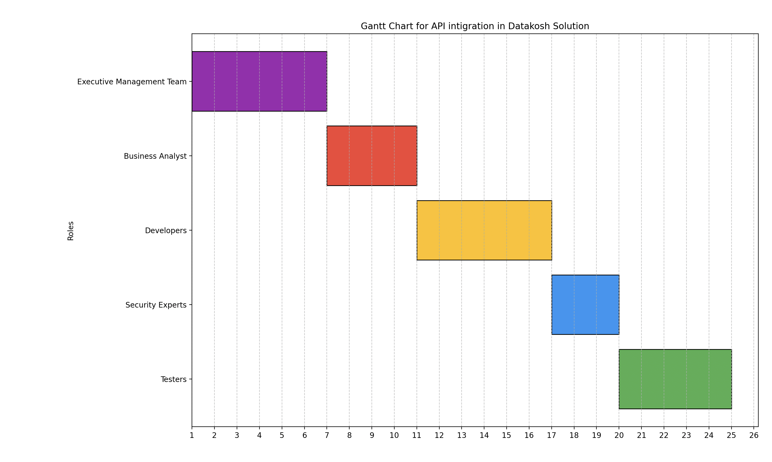
Risks & Dependencies
Risks:
Unexpected complexity or instability in third-party API integration could delay feature delivery.
Potential vulnerabilities in third-party APIs or data transfer may compromise sensitive financial documents.
Fixed budget limits may lead to cost overruns, affecting project continuity or scope.
Changes in banking or government standards could require rework to maintain regulatory alignment.
Dependencies:
Functionality relies heavily on the availability and stability of the external API.
Secure handling of data is dependent on the third-party provider’s infrastructure.
Budget Monitoring – Timely and accurate budget tracking is essential to prevent cost-related project risks.
Regulatory Updates – Continuous alignment with evolving RBI and government norms is needed to ensure compliance.

Slide 12
Conclusion
Many small banks and NBFCs still rely on manual processes for applicant document analysis.
While AI has eased tasks like market and risk analysis, loan fraud remains a major issue.
Datakosh aims to help reduce NPAs by analyzing ITR, GST, and bank statements with visual reports.
Clients need original ITR and GST PDFs for validation, and lack of access hinders product adoption.
This project strengthens our product, supports client success, and aligns with Datakosh’s mission to reduce NPAs.
The enhancement will boost client trust, reduce manual effort, and improve loan decision accuracy.
It positions Datakosh as a secure, all-in-one solution in the FinTech space.
This project is a crucial move to meet evolving client needs and maintain innovation and security standards.

Slide 13
Thank You

