Slide 1


Lead Management System
for
Prilube Industries
(Agile Methodology)

Slide 2

Current Problem: Inefficiency & Lost Revenue
Manual Tracking: Reliance on spreadsheets causes inconsistent follow-ups and data loss.
Zero Visibility: No clear view of the sales funnel, making prioritization difficult.
Missed Opportunity: Delayed responses and poor accountability lead to reduced conversion rates.

Slide 3

Solution: Implement a Centralized LMS
The Lead Management System will include the
following modules:
Lead Capture (from website, calls, and emails)
Lead Assignment and Follow up Management
Lead Scoring and Prioritization
Communication and Notes Tracking
Reports and Analytics Dashboard
The solution will enable automated tracking, timely follow ups, and improved collaboration between sales teams.

Slide 4

Opportunities: Unlocking Prilube's Growth
Boost Conversion: Ensure immediate, prioritized follow-up on high-value leads.
Digital Process: Transition to a data-driven, automated sales cycle from manual tracking.
Strategic Insight: Gain real-time sales funnel visibility for accurate forecasting and planning.
Optimize ROI: Accurately track which lead sources generate the most profitable business.
Stronger Engagement: Build a complete 360-degree view of the customer to enhance loyalty.
Operational Excellence: Standardize workflows for consistency and accountability across all regions.

Slide 5

Problem Statement
Prilube Industries currently manages leads through manual processes using spreadsheets and emails. This approach causes delays, data loss, and missed opportunities. The proposed LMS will digitize lead handling, provide better visibility, and align sales efforts with business objectives.

Slide 6
Project Objectives
Automate and streamline lead management workflow
Increase lead conversion rate by 25%
Improve team productivity and Accountability
Reduce manual reporting and data duplication
Success Criteria
System adoption by 100% of sales staff within 3 months
Reduction in lead response time by 40%
Accurate real time reports on lead status and performance

Slide 7

Project Phases
(Agile Methodology)
Requirement Gathering and Analysis
Testing
(Unit, Integration, UAT)
System Design (Wireframes, Prototype)
Deployment and
User Training
Development and Module Integration
Maintenance and Support

Slide 8

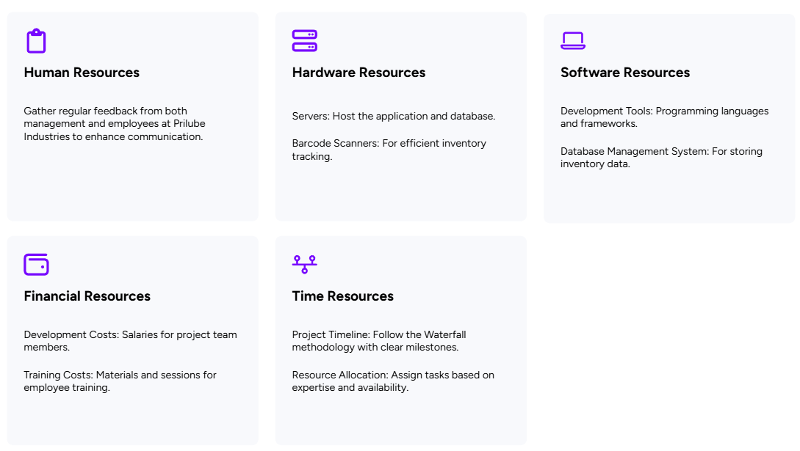
Resources

Slide 9

Risks & Mitigation Strategies
Resistance to adoption from sales staff used to manual processes
Data migration challenges from legacy systems
Dependency on third party CRM integrations
Risk mitigation through training and phased implementation

Slide 10

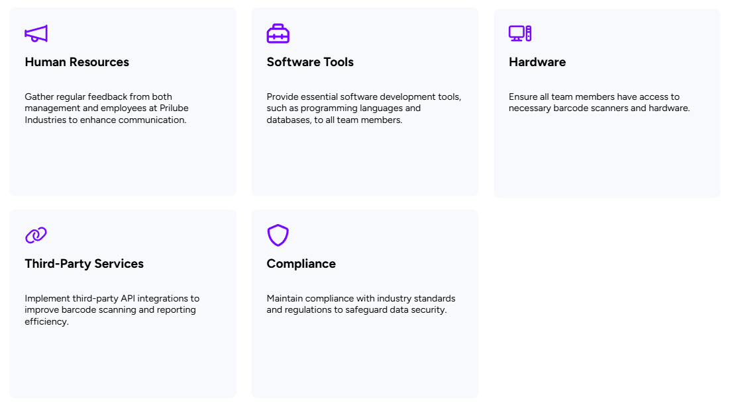
Dependencies

Slide 11

Budget Overview
Development Costs
Software development and project management costs total Rs. 200,000
Hardware Costs
Purchasing or leasing servers, barcode scanners, and other equipment costs Rs. 300,000
Maintenance Costs
Ongoing support and updates post-deployment will cost Rs. 100,000
Total Budget
The total budget amounts to Rs. 600,000 which is the sum of all individual costs.

